Slide 1



Community Bank Mergers and Acquisitions:
Market Update
June 2026
Presented by:
Brian Palmer
Co-Founder & President
bpalmer@olsenpalmer.com
720-797-9233
Washington, DC • Birmingham • Chicago • Dallas • Denver • Kansas City

Slide 2
Presentation Summary
1
Olsen Palmer - Firm Overview & Credentials
2
Current Montana and Wyoming Banking Landscapes
3
Current Bank Mergers and Acquisitions Landscape
4
Strategic Alternatives & Best Practices
Notes:
Prior tagline: Independent, client-centric approach to merger & acquisition advisory

Slide 3
I. Olsen Palmer - Firm Overview & Credentials

Slide 4

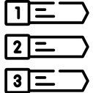

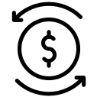

Olsen Palmer Overview
Industry-Leading Bank M&A Advisors
Industry-Leading Bank M&A Advisors
#1 Firm #1 sell-side bank M&A firm / Top 3 overall (sell-side + buy-side)¹ | Top Advisors 5 of top 10 individual advisors / #1 ranked advisor each of past 7 years² | 150+ Transactions Advised on over 150 completed bank M&A transactions | $4.0+ Billion Advised on more than $4 Billion in total M&A value
Services
Locations
Sell-Side Advisory | Proprietary ‘go to market’ approach
Buy-Side Advisory | Strategic, bespoke acquisition analyses
Branch Sale / Acquisitions | Financial modeling, market intelligence
Valuations / Analytics | Minority interest and transaction based
Fairness Opinions | Affirms fiduciary decision of the board
Strategic Planning | Long-term planning, strategic direction
Chicago
Denver
Kansas City
D.C.
Dallas
Birmingham
1 – Based on total no. of whole-bank M&A transactions since 2020. 2 – By whole-bank M&A transaction count, 2019 - 2025. Source: S&P Global.
Notes:
Prior tagline: Independent, client-centric approach to merger & acquisition advisory

Slide 5
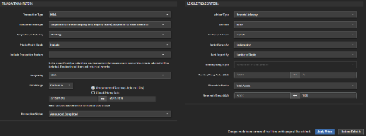
Bank M&A Advisor Rankings
Community Bank M&A Activity¹
Number of Whole-Bank Sell-Side Transactions Since January 1, 2020
Olsen Palmer is the #1 advisor to community banks nationwide based on the number of sell-side advisory engagements this decade
1 – Firm rankings reflect number of announced whole-bank sell-side transactions advised upon from January 1, 2020 to May 31, 2026 with seller total assets less than $1.0 billion. Source: S&P Global.

Slide 6










Montana and Wyoming Bank M&A Experience
Advised Seller
Advised Seller
Advised Seller
Has been acquired by
Has been acquired by
Has been acquired by
Integra
BG LLC
March 31, 2026
February 2, 2026
August 6, 2025
Advised Seller
Advised Seller
Has been acquired by
Has been acquired by
May 18, 2022
February 14, 2022

Slide 7
II. Current Montana and Wyoming Banking Landscapes

Slide 8
Banking Industry Consolidation
Industry Consolidation
Additions, Eliminations, and Institution Count
Note: Gray shading represents periods of economic recession in the United States as defined by the National Bureau of Economic Research.
De Novo data as of June 11, 2026, institution count as March 31, 2026. Source: S&P Global.

Slide 9
Number of Montana and Wyoming Banks
Number of Institutions
Montana – Commercial Banks and Thrifts
2026 Q1 vs. 2008
- 54.5%
Number of Institutions
Wyoming – Commercial Banks and Thrifts
2026 Q1 vs. 2008
- 38.5%
Note: Institution data as of March 31, 2026. Source: S&P Global.
Notes:
422 institutions in IL as of 9/19 → FDIC / 2019 number from SNL screener (425)
Number of institution
http://www2.fdic.gov/qbp/qbp_report.asp?menuItem=STBL&TBL1=INST_FINC_PROF_AGG&TBL2=INST_FINC_PROF_AGG&TBL3=INST_FINC_PROF_AGG&ST1=NT&ST2=NT&ST3=NT&CALLYM1=201309&CALLYM2=201209&CALLYM3=201109
SNL → Industries → Deposit Market Share → Mississippi → Banks and thrifts

Slide 10
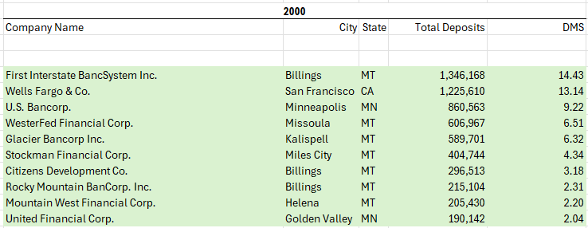



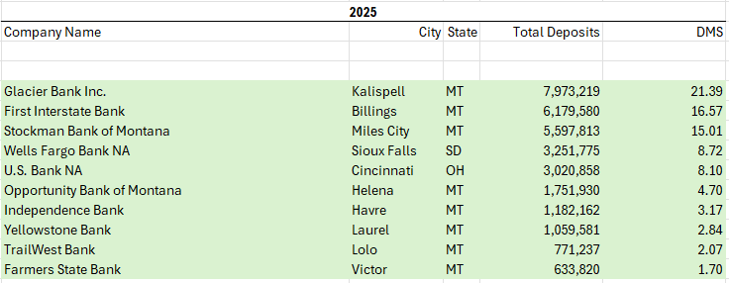









Montana Market Share and M&A Landscape
Top 10 Banks in Montana: 2000 vs. 2025
Ranked by Statewide Deposit Market Share
Most Active Acquirers of Montana Banks¹
By Number of Montana Banks Acquired Since 1990
2000
2025
1.
2.
3.
4.
5.
6.
Acquired
Going Concern
7.
Citizens Development Co.
8.
9.
Mountain West Financial Corp.
10.
United Financial Corp.
Indicates new entrant into the top 10
1 – Excludes FDIC-assisted transactions and branch acquisitions.
Note: Deposit market share as of June 30, 2025. Most active acquirer data as of June 10, 2026. Source: S&P Global.
Acquired/Liquidated
Notes:
https://www.capitaliq.spglobal.com/web/client?auth=inherit#branch/marketshare
Detailed report -> ownership mode 200 & 2022 (HOLDING COMPANY LEVEL)

Slide 11
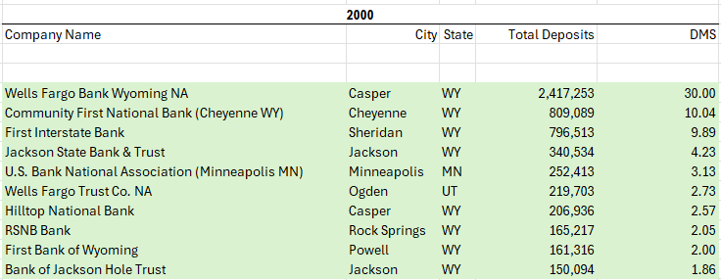

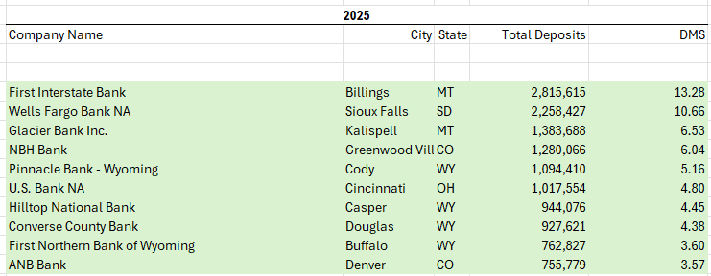









Wyoming Market Share and M&A Landscape
Top 10 Banks in Wyoming: 2000 vs. 2025
Ranked by Statewide Deposit Market Share
Most Active Acquirers of Wyoming Banks¹
By Number of Wyoming Banks Acquired Since 1990
2000
2025
1.
2.
3.
4.
Jackson State Bank & Trust
5.
6.
Acquired
Going Concern
7.
8.
9.
10.
Indicates new entrant into the top 10
1 – Excludes FDIC-assisted transactions and branch acquisitions.
Note: Deposit market share as of June 30, 2025. Most active acquirer data as of June 10, 2026. Source: S&P Global.
Acquired/Liquidated
Notes:
https://www.capitaliq.spglobal.com/web/client?auth=inherit#branch/marketshare
Detailed report -> ownership mode 200 & 2022 (HOLDING COMPANY LEVEL)

Slide 12
Market Share Leaders
Montana Deposit Market Share
By Percentage (%)
Wyoming Deposit Market Share
By Percentage (%)
Note: Deposit data as of June 30, 2025. Deposit market share includes pending acquisitions. Source: S&P Global.
Notes:
SNL → Deposit Market Share → click on Georgia

Slide 13
III. Current Bank M&A Landscape

Slide 14
M&A Activity Over Time
Bank M&A Volume
No. of Announced Transactions & Consolidation Rate
Note: Transaction figures exclude franchise deals. Data as of May 31, 2026. Source: S&P Global.
Notes:
Slide: Sale Options

Slide 15
Aggregate Transaction Value
Bank M&A Total Deal Value
Aggregate transaction value by year, in $B
Note: Transaction figures exclude franchise deals. Data as of May 31, 2026. Source: S&P Global.

Slide 16
Bank Valuations
Bank Stock Performance
Price Change of Select Bank Indices – Election Day 2024
2024
2025
2026
Note: Market data as of June 10, 2026. Source: S&P Global.
Notes:
Source:
https://www.macrotrends.net/2015/fed-funds-rate-historical-chart

Slide 17






























Return of Large Transactions
Noteworthy Transactions – Deal Value > $250MM
Sorted by Announcement Date
Ann. Date | Acquirer | Acquirer (Assets $B) | State | Target | Target (Assets $B) | State | Deal Value ($MM)
5/15 |  | $35.6 | MS |  | $2.1 | FL | $378
3/12 |  | $2.4 | NY |  | $2.0 | IL | $348
2/3 |  | $243.0 | DE¹ |  | $84.1 | CT | $12,300
2/2 |  | $11.0 | NJ |  | $5.8 | NJ | $597
1/28 |  | $38.5 | TX |  | $10.8 | TX | $2,000
12/29 |  | $14.3 | NJ |  | $8.9 | NY | $567
12/18 |  | $7.9 | VA |  | $3.1 | PA | $356
12/17 |  | $15.7 | CA |  | $5.6 | CA | $811
12/11 |  | $6.0 | IL |  | $1.4 | NY | $388
12/1 |  | $44.5 | WI |  | $5.3 | NE | $604
10/27 |  | $210.2 | OH |  | $53.3 | MS | $7,594
10/27 |  | $8.5 | CO |  | $11.6 | TX | $747
10/27 |  | $9.9 | OH |  | $2.5 | TN | $317
10/23 |  | $9.0 | WI |  | $6.3 | IA | $866
10/22 |  | $5.2 | OH |  | $2.0 | OH | $292
1 – Reflects US bank headquarters, ultimate parent headquarters is Madrid, Spain. Note: Buyer and seller assets are based on financials as of the transaction announcement date. Reflects 15 most recent transactions with deal value over $250 million. Deal metrics as of announcement date. Source: S&P Global.
Notes:
Source:
https://www.macrotrends.net/2015/fed-funds-rate-historical-chart

Slide 18

































Return of Serial Acquirers
Regional & Community Banks
Institutions with Multiple Recent Transactions
Acquirer (Assets $B) | Targets (Assets $B)
$210.3
$53.3
$12.5
+
$53.3
$4.4
$0.6
Went from Serial acquirer
to seller within months
+
$38.5
$2.6
$2.4
$10.8
+
+
$29.0
$1.3
$3.2
+
$18.6
$2.1
$1.4
+
$19.7
$0.7
$1.5
$2.4
+
+
$16.7
$0.7
$4.1
+
$6.4
$0.1
$0.9
$1.4
+
+
$6.3
$0.8
$0.9
+
$2.1
$0.2
$0.1
$0.1
+
+
$1.1
$0.1
$0.1
$0.1
+
+
Note: Serial acquirers defined as parties that announce a transaction having announced a previous transaction in the last 12 months. Financial data as of the transaction announcement date. Transaction data as of announcement date. Source: S&P Global.
Notes:
Source:
https://www.macrotrends.net/2015/fed-funds-rate-historical-chart

Slide 19
Credit Unions as Acquirers
Number of Banks Acquired by Credit Unions
Number of Whole-Bank Acquisitions By Year
Number of Transactions
% of Whole-Bank Transactions
Number of Transactions
% of Whole-Bank Transactions
Note: Data as of May 31, 2026. Source: S&P Global.
Notes:
Source:
https://www.macrotrends.net/2015/fed-funds-rate-historical-chart

Slide 20
M&A Pricing
Bank M&A Valuation Multiples
Median M&A Transaction Valuation Multiples By Year Since 2000
Note: ‘LTM’ refers to ‘last twelve months.’ Data as of May 31, 2026. Source: MacroTrends, S&P Global.
Notes:
Slide: Sale Options

Slide 21
Transaction Pricing Distribution
Pricing Distribution
% of Deals - by Price/Tangible Book Value Range
Last 12 Month Median:
1.42x
Note: Data reflects last 12 months through May 31, 2026. Source: S&P Global.

Slide 22
Deal Drivers

Slide 23
Economies of Scale
Efficiency Ratio
Median of All U.S. Institutions by Asset Size
Note: Data reflects last twelve months as of March 31, 2026. Source: S&P Global.

Slide 24
Liquidity + Cost of Funds
Loan-to-Deposit Ratio
All U.S. Institutions with Assets < $10Bn
Cost of Funds
All U.S. Institutions with Assets < $10Bn
Note: Data as of March 31, 2026. Source: S&P Global.

Slide 25
Credit Quality
NPAs / Assets
Median of All U.S. Institutions with Assets < $10Bn
Note: Data as of March 31, 2026. Source: S&P Global.

Slide 26










Competition
Deposit Market Share of The Top-50 Banks
Since 1990
Share of New Deposit Accounts
DDAs by Institution Type
2020
2025
A market share increase from 29% in 1990 to 74% in 2025
Note: Deposit market share data as of June 30, 2025. New deposit account distribution as of December 31, 2025. Source: Cornerstone Advisors, S&P Global.

Slide 27









Regulatory Developments
Regulatory M&A Commentary
Legislative Developments
“
Travis Hill
Acting FDIC Chairman
“Improve the bank merger approval process to ensure mergers that satisfy the Bank Merger Act are approved in a timely way”
Statement - January 1, 2025
 | Genius Act Establishes framework for widespread adoption of stablecoin
 | Clarity Act Defines digital-asset oversight
 | Project Crypto SEC Initiative to update securities laws to enable tokenized markets
Michelle Bowman
Fed. Reserve Vice Chair for Supervision
“Improve the speed and timeliness of regulatory decision making, applying review standards that are reasonable and consistent”
Workshop on the Future of Banking - April 2, 2024
”
Transaction Timeline
Months from Announcement to Closing
Non-Bank Charter Applications
Select Noteworthy Examples
 | Approved: February 27, 2026 Wealth management & financial planning
 | Applied: December 15, 2025 Digital payments and money transfers
 | Pending: October 15, 2025 Online payments infrastructure
 | Approved: July 2, 2025 Global blockchain payments network
 | Approved: June 30, 2025 Infrastructure for $75B in Stablecoin
Note: Reflects average of all transactions closed within that period. Source: S&P Global, U.S. Census Bureau, The New York Times.
Notes:
Slide: Sale Options

Slide 28




U.S. Elections
Federal Elections
Bodies Impacted by the Elections
Obama
Trump
Biden
Trump
Yr.
2012
2014
2016
2018
2020
2022
2024
2026
Type
Presidential
Midterm
Presidential
Midterm
Presidential
Midterm
Presidential
Midterm
President
Senate
House

Slide 29
IV. Strategic Alternatives & Best Practices

Slide 30
Strategic Options for Creating Value
Strategic Options Blueprint
Organic and M&A-Related Strategic Options
I. Status Quo
Continuation of existing strategy
  “Business as usual”
II. Organic Initiatives
Expense Reduction
Targeted reduction in non-interest expenses
  Head count reduction, branch closures, etc.
NIM Expansion
Targeted focus on NIM maintenance/expansion
  Yield maintenance and/or borrowing cost optimization
Fee Income Enhancement
Spurring non-interest income revenue
  Launch or expansion of fee income products/business lines
Earning Asset Growth
Growth in earning asset base
  Lender lift-outs, LPO launch, product line expansion, etc.
III. Acquisitions
Whole Bank
Whole-bank acquisition
  In-market or enter new market
Branch(es)
Branch acquisition(s)
  Acquire only select assets, locations, and deposits
Non-Bank
Non-bank acquisition(s)
  Fee income businesses or specialty finance companies
IV. Merger-of-Equals
Merge with similarly-sized institution
  Added scale drives value but addressing social issues is difficult
V. Strategic Merger
Strategic Merger
  Less than 50% ownership but potential for key executives to remain
VI. Sale
Whole Bank
Sale of institution
  Maximize near-term shareholder value but cede control
Branch(es)
Sale of branch(es)
  Reduce operating expenses and improve loan/deposit ratio
Notes:
Slide: Strategic Alternatives

Slide 31
For Prospective Buyers

Slide 32

Transaction Deal Team
Board of Directors
Outside Advisors
Transaction
Investment Banker
Legal Counsel
Accountants
Credit Review
Consultants
Other
Management

Slide 33
M&A Rationale and Financial Criteria
Strategic Considerations
Strategic Rationale for an Acquisition
Financial Considerations
Financial Rationale for an Acquisition
1
Operating Scale
Earnings per Share (“EPS”) Accretion | EPS increase (or decrease) following a transaction
Internal Rate of Return (“IRR”) | Return rate where the PV of future cash flows equals zero
Tangible Book Value Dilution & Earnback (in Years) | Initial dilution to an acquirer’s TBVPS & break-even analysis
Regulatory Capital (Leverage Ratio) | Measure of acquirer’s pro forma regulatory capital ratios
Deposit Funding and/or Loan Growth
Market Share
2
Diversification
Enhanced Fee Income
Cultural Compatibility
3
Maintain Brand / Identity
Minimize Ownership Dilution
4
Human Capital
Enhance Overall Franchise Value
Notes:
Slide: Acquisition Rationale

Slide 34
Acquisition Capacity Analysis
Acquisition Target Size ($MM)
Based on Various Amounts of Financing
3
2
1
Target Asset Size ($ Millions)
Scenario Summary
1 – Regulatory guidelines set the maximum borrowing for bank acquisitions at 75.0% of the purchase price.
Note: Analysis based on maintaining 9.0% pro forma bank-level leverage ratio, 1.50x TBV multiple paid, and standard purchase accounting adjustments. Source: S&P Global.

Slide 35


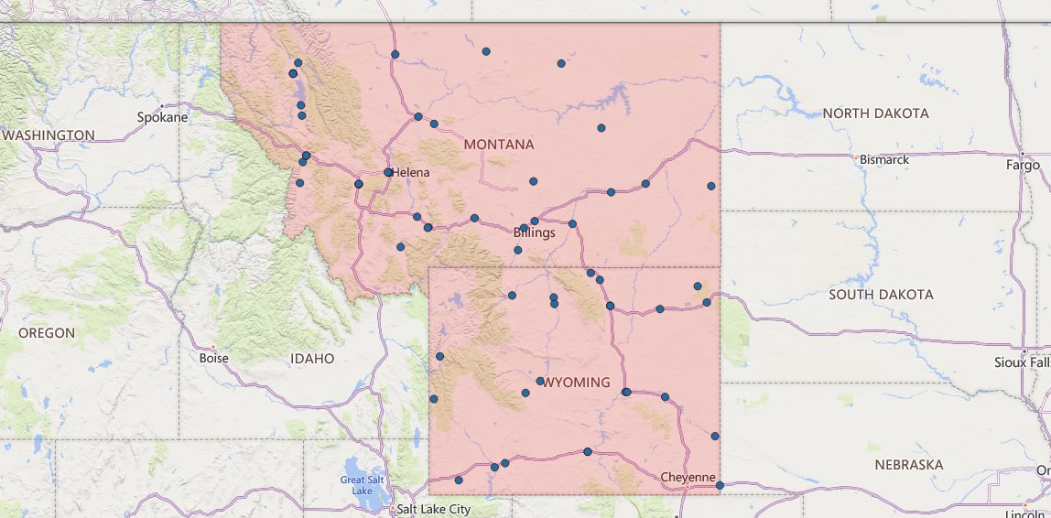
Acquisition Candidate Screening
Candidate Identification
Filtered by Geography and Financial Criteria
5
Asset Filter:
35 banks removed
due to asset size
Financial Filter:
19 banks removed by
financial filter
Results:
5 banks meet both
size and financial filters
MT (3)
WY (2)
Geographic Designation
Geographic Filter Based on the Highlighted Area
Legend
Headquarter locations of filtered banks
Area within geographic filter
Note: Analysis excludes credit unions and domestic subsidiaries of foreign banks. Source: S&P Global.

Slide 36
Target Bank Valuation
Illustrative Value Range
Illustrative Value Range ($ Millions)
Reference Value ($000)
Valuation Metric
1
2
3
Analysis at Various Prices
Note: For illustrative purposes only. Net income reflects last 12 months. Cost savings represent 30% of last 12 months noninterest expense. Range for discounted cash flow based on terminal multiples of 9.9x to 11.9x and discount rate of 14.9% to 16.9%. Ranges for selected transactions reflect 40th to 60th percentile values.

Slide 37
Acquisition Financial Impact
1
Refresh Needed
Glossary of Bank M&A Inputs and Outputs
1
Proportion of cash and stock used to pay the Purchase Price to target shareholders
1
2
Annual amount of earnings generated by removing duplicative expenses at target
2
3
Debt required to finance the transaction and supplement pro forma capital ratios (if any)
1
4
Costs incurred to effect the transaction (i.e., contract terminations, advisor fees, etc.)
3
5
#1 driver of bank valuation – percent increase in EPS as a result of the transaction
4
6
Measure of return on the investment made in the transaction
7
Break-even analysis between acquirer’s TBV before and after the transaction
8
Pro forma capital ratios must meet or exceed regulatory requirements
Accretion / (Dilution) of Earnings per Fully Diluted Share²
5
6
7
8
Accretion / (Dilution) of Tangible Book Value per Share²
1 – Debt issued to maintain a pro forma bank leverage ratio of at least 9.0%.
2 – 100% of transaction expenses reflected in closing tangible book value and are excluded from earnings.

Slide 38
Summary Acquisition Process
Blueprint of Process
Process and Timeline
Phase | I. | II. | III. |  |  | IV. |  |  |  |  | I.
Focus | Pre- Process | Initial Offer | Diligence & Negotiation |  |  | Transaction |  |  |  |  | Preview Discussions
Month | 0 – 24+ | 1 | 2 | 3 | 4 | 5 | 6 | 7 | 8 | 9 | 10 | 11 | 12 | 13 | 14 | 15 | 16+
Preparation / Informal Discussions
Initial Diligence
Initial Indication of Interest
Due Diligence
Post-Diligence Offer
Negotiation, Execution of Definitive Merger Agreement
Post-Signing Approvals
Closing
Conversion / Post-Closing Commitments
1
2
3
4
5
May be concurrent dependent on if process has 1 or multi-party due diligence
6
7
8
9
~ 6 - 12 months post-closing
Deal Milestone
Notes:
Slide: Sale Timeline

Slide 39










Acquisition Best Practices
Action | Description
Define | Strategy and rationale for acquisitions
Establish | Clear strategic and financial criteria
Analyze | Financial implications of any potential transaction
Assess | Capital capacity to consummate an acquisition: cash, common stock, preferred stock, debt, etc.
Apprise | Regulators of potential M&A plans
Understand | Legal and fiduciary implications of M&A
Educate | Board and key constituents on M&A landscape, valuation, deal process, and fiduciary duties,
Identify | Broad list of potential targets
Initiate | Relationships with potential targets
Engage | Expert advisors –investment banking, legal, accounting – well before any potential deal
Notes:
Slide: Acquisition Best Practices

Slide 40
For Potential Sellers

Slide 41
Options for Exploring a Sale
Take an Olsen Palmer ‘Private Client’ approach
Shape the narrative of the process rather
than ‘putting a book out’
Prescreen parties to be ‘invited’ into
the process
Recommendations
Relevance
Impact
There are different options for exploring
a sale transaction
There are points throughout a process where it is possible to adjust or tailor the selection
Processes can be unilateral discussions or
a broad auction
The more parties involved, the more leverage a seller will have in negotiations
Limited parties increases the volatility of the speed to close as there can be more extended negotiations since other parties can not be leveraged to anchor decision dates
Including a broader set of parties increases discretionary concerns
Sale Process Options
 | Unilateral Discussions | 2. Discreet Marketing Process | 3. Broad Auction | 4. Private Client
Description | Discreet negotiations w / only one party | Simultaneous discussions w/ several parties | Formal auction among multiple parties | Customized 2-stage effort: 1) Organized but informal introductory phase then 2) formal offer solicitation from subset of selectees
No. of Parties Involved | One | Some | Many | Select
Benefits | Maximizes discretion Enhanced relationship with acquirer may increase value | Avoids “all eggs in one basket” Leverage multiple parties | Typically maximizes value Maximizes negotiating leverage | Balance of leverage and discretion ‘Flips the tables’ such that buyers are competing for the right to bid
Limitations | Value may be lower than auction Time lost if talks are unsuccessful | Less discreet than unilateral Value may be lower than auction | Least discreet Arms-length may dissuade buyers | Entails relationship building Longer, more-involved process
Discretion Value Maximization Speed to Closing
Low
High
Low
High
Low
High
Low
High
Common Approaches
Olsen Palmer
Proprietary Process
Notes:
Slide: Sale Options

Slide 42

Elements of Best-In-Class Execution
Focused Preparation
1
2
3
OPERATIONS
Vendor Management
Credit Administration
Policies & Procedures
Human Resources
STRATEGY
Board Education
Define Priorities
Value Drivers
Know Your Buyers
EXECUTION
Timeline Development
Define Deal Team
Select Process Structure
Projections & Cost Saves
Transaction Diagnostic
Similar to getting your car checked, the diagnostic ensures readiness.
The process uncovers items that impact a transaction and suggests ways to remedy/mitigate, or highlight/feature points identified.
Months or years in advance, the review ensures a smooth process; maximizing value and minimizing risk.

Slide 43
Remaining Independent

Slide 44
Remaining Independent
Key Areas + Potential Initiatives
Key Topic | Potential Initiative
Shareholder Returns | Balance shareholder dividends with capital retention for growth Realize return on equity that surpasses cost of capital
Shareholder Liquidity | Increase daily trading volume Prepare for succession planning of large holders
Management Succession | Ensure plan for long-term succession for both management and Board Identify and proactively address other human capital needs
Remain Relevant | Invest in technology Remain competitive with increasingly deep pool of non-banks & fintechs
1
2
3
4

Slide 45
Community Bank M&A:
Market Update
Brian Palmer
Co-Founder & President
bpalmer@olsenpalmer.com
720-797-9233
June 2026

