Slide 1
Macro Outlook: Another Exogenous Shock Upends Outlook
June 2026
Craig Dismuke
Chief Market Strategist
(901) 766-3305
dismukec@stifel.com

Slide 2
Uncertainty Continues to Cloud Economic and Rate Outlooks
Economic Resilience
Exogenous Shocks Continue to Cloud Outlook
Low-Hiring, Low-Firing Labor Market
Fed – From Navigating Neutral to Watching Energy Shock
Interest Rates – Slight Steepener Expected

Slide 3
Economy Has Remained Resilient Through Numerous Headwinds
U.S. Interest Rates | Rise in Rates Provides Basis for Tightening of Financial Conditions
Fastest Tightening Cycle Since 70s
Regional Bank Crisis
Higher for Longer
Tariffs
Iran Conflict
Russia Invades Ukraine
Post-Pandemic Inflation Cycle
Fed Funds Target Rate (Median)
2-Year Treasury Yield
10-Year Treasury Yield
Full Year GDP Growth Projections | Bloomberg Survey of Economists
Actual
Actual
2.8%
2026 GDP Projection
2.5%
2.1%
2.1%
2023 GDP Projection
1.3%
0.6%
2025 GDP Projection
0.3%
2024 GDP Projection
Sources: Bloomberg Finance L.P., Stifel

Slide 4
One Big Beautiful Bill Raising Individual Refunds, Lowering Tax Payments and Withholdings
Horizon
Tax Cuts
Extends lower tax rates
Increased to $2.2k thru ’28 then adjusts for inflation
Raised to $40k; phaseout at $500k AGI
Deductible up to $25k; phaseout at $150k; specified professions
Deductible up to $25k; phaseout at $150k; through ‘28
Raises standard deduction to $6k; phaseout at $150k
Deductible up to $10k for new U.S.-made vehicles; phaseout at $100k
$1k federal match (children born ‘25 – ‘28)
2017 TCJA Tax Cuts
Child Tax Credit
SALT Cap
Tips
Overtime
Seniors (Social Security)
Auto Loan Interest
TRUMP Accounts
Permanent
Permanent
2029
2028
2028
2028
2028
2028
YTD IRS Withdrawals – Individual Tax Refunds (B)
YTD Individual Tax Payments – Not Withheld (B)
+$63b
/5Y Avg
-$114b
/5Y Avg
Sources: Treasury Daily Statements, Stifel

Slide 5
Business Investment - Predominantly Driven by AI (and Related) Projects
Investment | Intellectual Property (Change from 3Q23)
Investment | Equipment (Change from 3Q23)
Information Processing Equipment
Software
All Other Equipment
All Other Intellectual Property
Non-Residential Construction Spending (Change from 3Q23)
Data Centers
All Other Non-Residential
Sources: BEA, Census Bureau, Bloomberg Finance L.P., Stifel

Slide 6
Tariff Tailwind – Refund of Already-Collected IEEPA-Related Tariffs
Cumulative Excess¹ Customs Duties Collections (Billions)
¹Excess defined as amount above 24-month average pre-2025
CBP has now opened a portal for IEEPA refund claims
Estimates of IEEPA-specific tariffs range from $130b to $175b
Sources: Treasury, Census Bureau, Bloomberg Finance L.P., Stifel

Slide 7
Uncertainty Continues to Cloud Economic and Rate Outlooks
Economic Resilience
Exogenous Shocks Continue to Cloud Outlook
Low-Hiring, Low-Firing Labor Market
Fed – From Navigating Neutral to Watching Energy Shock
Interest Rates – Slight Steepener Expected

Slide 8
Last Year’s Exogenous Shock: Trade Policy Continues to Stoke Uncertainty
Estimated Average Effective Tariff Rate – All Imports
125% China, Reciprocal Tariffs
145% China, Reciprocal Tariffs Delayed, Tech Exemptions
84% China
30% China
Learning Resources Inc. vs Trump: Supreme Court Rules Against Legality of IEEPA Tariffs
Auto Carveouts
New Bilateral Tariff Rates Take Effect
10% U.K. Deal
10% Global Tariff in Replacement of IEEPA Tariffs
50% Steel & Aluminum
10% Minimum Tariff for All
25% Autos
25% Steel & Aluminum
20% China; 25% Mexico, Canada ex. USMCA Items
Estimated Country-Specific Tariff Rates
Source: Yale Budget Lab, Stifel
10% China
As of Jan. 1, 2025
As of Jun. 1, 2026
Static analysis assuming 2024 import volumes by country remain constant
Sources: Census Bureau, Bloomberg Financial L.P., Yale Budget Lab, Stifel

Slide 9
Tariff Uncertainty #1: What Will Tariff Rates Eventually Be?
Rationale for Tariffs
Investigation
Duration
Tariff Limit
International Emergency Economic Powers Act of 1974 (IEEPA)
Emergency Declaration*
None Required*
No Limit*
No Limit*
Tariffs Issued:
Reciprocal Tariffs (Country-Specific Rates), Fentanyl and Migration Tariffs, Removal of De Minimis Exemption
*IEEPA does not specifically give the President authority to implement tariffs, but it does give the authority to “regulate” or “prohibit” imports
Section 232 – Trade Expansion Act of 1962
Threat to U.S. National Security
Commerce Department
No Limit
No Limit
Tariffs Issued:
Autos and Parts, Steel, Aluminum, Copper, Pharma
Section 201 – Trade Act of 1974
Serious Injury to U.S. Domestic Industry
International Trade Commission
4 Years; May Be Extended to 8 Years
50% Increase
Section 301 – Trade Act of 1974
Discrimination Against U.S. Rights or Commerce
U.S. Trade Representative
4 Years; May Be Extended Indefinitely
No Limit
Section 122 – Trade Act of 1974
International Payments Problems; Trade Deficits
None Required
150 Days
15% Rate
Section 338 – Tariff Act of 1930
Discrimination Against U.S. Commerce
None Required
No Limit
50% Rate
Sources: Congressional Research Service, Bloomberg Finance L.P., Stifel

Slide 10
Tariff Uncertainty #2: Will Tariffs Flow into Consumer Inflation? Slow Job Growth?
Customs Revenues (Monthly, NSA, Billions)
Unit Labor and Non-Labor Costs (YoY, Non-Finl)
5.3%
-0.1%
Unit Non-Labor Costs
Unit Labor Costs
Core Goods PPI (MoM)
Core Goods CPI (MoM)
+0.6%
+0.0%
3M Average
3M Average
Sources: Bureau of Labor Statistics, Bloomberg Finance L.P., Stifel

Slide 11
This Year’s Exogenous Shock: Iranian Conflict Has Triggered an Energy Price Shock
Oil and Gasoline Prices | Continue Climbing After Extension of Supply Cuts
Crude Oil Generic 1st Contract
Price per Barrel (L-Axis)
Regular Grade Gasoline
Price per Gallon (R-Axis)
Sources: AAA, Bloomberg, Stifel

Slide 12
Geopolitical Uncertainty #1: How High Will Oil Prices Go and for How Long?
Oil Prices (Price per Barrel), Futures, and Implied Gasoline Prices (Regular Grade/Gallon)
Oil Futures (6/11/2026) (L-Axis)
--- Implied Gas Price* (6/11/2026) (R-Axis)
Oil Futures (12/31/2025) (L-Axis)
--- Implied Gas Price* (12/31/2025) (R-Axis)
Sources: Bloomberg Finance L.P., NYMEX, Stifel
*Implied based on 5-year correlation

Slide 13
Geopolitical Uncertainty #2: How Will Consumption Be Affected?
U.M. Consumer Confidence
--- Avg. Since 1991
■ +/- 1 Std. Dev.
Sources: University of Michigan, Bloomberg Finance L.P., Stifel

Slide 14
Energy Shock Will Need to Persist for Longer than Expected to Offset Consumer Tailwinds
Gasoline Prices and Monthly Spending on Gas and Other Motor Fuel
Personal Spending on Gas and Other Motor Fuel
(Billions, Monthly, SA, R-Axis)
Gasoline Prices
(Regular Grade, L-Axis)
Projected Based on Futures Contracts
Sources: BEA, NYMEX Oil Futures, Bloomberg Finance L.P. Stifel

Slide 15
Geopolitical Uncertainty #3: How Much Will the Energy Shock Impact Inflation?
Energy Price Inflation and Core Consumer Inflation
Energy CPI (YoY)
Core CPI (YoY)
23.5%
Sources: Bureau of Labor Statistics, Bloomberg Finance L.P., Stifel

Slide 16
Geopolitical Uncertainty #3: How Much Will the Energy Shock Impact Inflation?
Headline CPI (YoY) and Contribution by Category
Headline CPI (YoY)
Food (Contribution)
Energy (Contribution)
Core Goods (Contribution)
Housing Rents (Contribution)
Core Services Ex. Rents (Contribution)
Sources: Bureau of Labor Statistics, Stifel

Slide 17
Short-Term Inflation Expectations Have Spiked But Longer-Term Expectations More Anchored
Inflation Swap-Implied Inflation Rates by Year
TIPS Implied Inflation Breakeven Rates
June 11, 2026
February 27, 2026
5-Year TIPS B.E.
10-Year TIPS B.E.
5Y/5Y Forward TIPS B.E.
Sources: USD Zero Coupon Inflation Swaps, Bloomberg Financial L.P., Stifel

Slide 18
Uncertainty Continues to Cloud Economic and Rate Outlooks
Economic Resilience
Exogenous Shocks Continue to Cloud Outlook
Low-Hiring, Low-Firing Labor Market
Fed – From Navigating Neutral to Watching Energy Shock
Interest Rates – Slight Steepener Expected

Slide 19
Nonfarm Payroll Growth Continued to Moderate in 2025, But Has Accelerated Recently
Monthly Change in Nonfarm Payrolls (000s)
Average: 377k
Nonfarm Payrolls
3-Month Average
Average: 210k
Average: 122k
188k
Average: 10k
172k
Sources: Bureau of Labor Statistics, Stifel

Slide 20
Almost All of the Job Gains Since 2025 Have Come from the Healthcare Sector
Cumulative Change in Nonfarm Payrolls Since December ‘24 by Sectors (000s)
Healthcare and Social Assistance (15.0%)
961k
Government (14.7%)
All Other Sectors (70.3%)
685k
Total
-142k
-134k
Sources: Bureau of Labor Statistics. Bloomberg Finance L.P., Stifel

Slide 21
Despite Cooling in Job Growth, Job Losses Have Remained Historically Low
Initial Unemployment Claims as % of Total Payrolls
3.9%
0.12%
Sources: Bureau of Labor Statistics, Bloomberg Finance L.P., Stifel

Slide 22
AI Appears to Be Slowing Job Growth in High-Exposure Sectors, Not Outright Destruction
Change in Payroll Growth Since November 2022 Roll-out of ChatGPT (000s)
Healthcare and
Social Assistance: +2.93m
Medium AI Exposure 25-35%
Education and Healthcare
Government
Low AI Exposure <25%
Manufacturing
Construction
Mining and Logging
Trade, Transportation, Utilities
Leisure and Hospitality
Other Services
Roll-out of ChatGPT
High AI Exposure >35%
Professional and Business Services
Information Technology
Financial Activities
Sources: BLS, Bloomberg Finance L.P., Stifel
Incorporates AI exposure analysis by Eloundou, 2023)

Slide 23
Uncertainty Continues to Cloud Economic and Rate Outlooks
Economic Resilience
Exogenous Shocks Continue to Cloud Outlook
Low-Hiring, Low-Firing Labor Market
Fed – From Navigating Neutral to Watching Energy Shock
Interest Rates – Slight Steepener Expected

Slide 24
Carefully Navigating Back to Neutral Was the Theme…
Price Stability Mandate (I-Star)
Unemployment Rate and Fed Target
Unemployment Rate
Core PCE YoY
3.3%
Full Employment Target (NAIRU)
4.3%
4.2%
2.0%
Inflation Target
Fed Funds Rate and the Neutral Estimate (R-Star)
Fed Funds Rate (Mid)
3.625%
Fed’s Longer Run Neutral (Median)
Restrictive
Policy
3.125%
Accommodative
Policy
Sources: Bureau of Labor Statistics, Bureau of Economic Analysis, Federal Reserve, Bloomberg Finance L.P., Stifel

Slide 25

Growing Number of Fed Officials Moving to Hawkish Posture
Federal Open Market Committee Meeting Decision – April 2026 Meeting
Overnight Target Range: ► UNCH at 3.50%-3.75%
Interest on Reserve Balances Rate: ► UNCH at 3.65%
Overnight Reverse Repo Rate: ► UNCH at 3.50%
Dissents:
Preferred to Cut (25 bps)
Preferred to Change Forward Guidance
Governor Miran
Cleveland’s Hammack
Dallas’ Logan
Minneapolis’ Kashkari
Forward Guidance Language
“In considering the extent and timing of additional adjustments to the target range for the federal funds rate, the Committee will carefully assess incoming data, the evolving outlook, and the balance of risks.
Federal Open Market Committee Meeting Minutes
Fewer Doves Than in March (From “Many” to “Several”)
“Several participants highlighted that it would likely be appropriate to lower the target range for the federal funds rate once there are clear indications that disinflation is firmly back on track or if solid signs emerge of greater weakness in the labor market.”
Growing Number of Hawks (From “Some” to “Majority”)
“A majority of participants highlighted, however, that some policy firming would likely become appropriate if inflation were to continue to run persistently above 2 percent.”
Not Just Hammack, Kashkari, and Logan - “Many” Preferred Removing Forward Guidance Language
To address this possibility, many participants indicated that they would have preferred removing the language from the post meeting statement that suggested an easing bias regarding the likely direction of the Committee’s future interest rate decisions.
Sources: FOMC Official Statement and Associated Communications, Stifel | (Image: Federal Reserve)

Slide 26
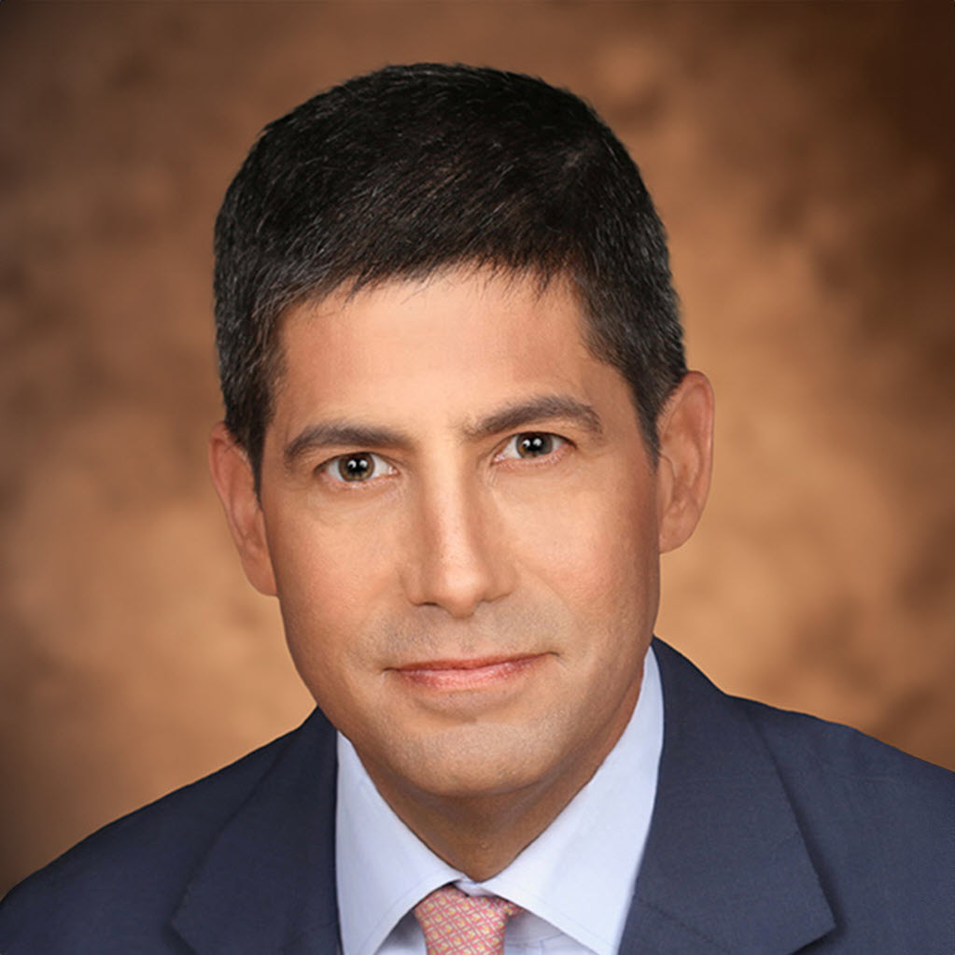
Change in Leadership Likely to Reinvigorate Discussions on Rate Cuts (Eventually)
Fed Governor from 2006 to 2011
Leaned hawkish as governor, voiced opposition to QE2 in aftermath of GFC emergency
Recent Commentary – Fundamental Transformation
1) Deregulation and Productivity Gains Will More-Than Offset Tariff-Related Inflation
“Any inflationary effect of tariff policies will likely be of smaller magnitude than the disinflationary
influence of deregulation and spending cuts”
“AI will be a significant disinflationary force, increasing productivity and bolstering American competitiveness.”
2) “Practical Monetarism” - Shrink the Balance Sheet and Lower Interest Rates
“Money on Wall Street is too easy, and credit on Main Street is too tight. The Fed’s bloated balance sheet, designed to support the biggest firms in a bygone crisis era, can be reduced significantly.”
“Its bloated balance sheet has contributed significantly to inflation. By draining as much as $2.5 trillion in excess reserves, the Fed would mitigate inflation and return its size and scope to pre-pandemic levels”
“That largesse can be redeployed in the form of lower interest rates to support households and small and medium-size businesses.”
3) Reform Regulatory Framework for Banks
“The Fed’s rules and regulations have systematically disadvantaged small and medium-size banks”
“Fed leadership should support rather than undermine the good early work of … [Vice Chair] Bowman”
“In my view, the Basel endgame isn’t America’s endgame. A new, reformed American regulatory regime should make the U.S. the best place for the world’s banks to do business”
4) Less Transparency, Communication, and Forward Guidance
“near-term forecasting is another distracting Fed preoccupation. Economists are not immune to the frailties of human nature. Once policymakers reveal their economic forecast, they can become prisoners of their own words. Fed leaders would be well-served to skip opportunities to share their latest musings.”
“forward-guidance – a tool rolled out to great fanfare in the financial crisis—has little role to play in normal times”
“I do not find the current Fed policy of ‘data dependence’ of much real value. …. Breathlessly awaiting trailing data from stale national accounts - subject to significant, subsequent revision - is evidence of false precision and analytic complacency”

Slide 27
Uncertainty Continues to Cloud Economic and Rate Outlooks
Economic Resilience
Exogenous Shocks Continue to Cloud Outlook
Low-Hiring, Low-Firing Labor Market
Fed – From Navigating Neutral to Watching Energy Shock
Interest Rates – Slight Steepener Expected

Slide 28
Investors Abandon Expectations for Rate Cuts This Year
Fed Funds Futures Contracts
February 27, 2026
1 Hike
June 11, 2026
UNCH
1 Cut
2 Cuts
3 Cuts
Sources: Bloomberg Finance L.P., Stifel

Slide 29
Investors Expect Yields to Remain Largely Rangebound For Remainder of 2026
Treasury Yield Curve and YE26 Forward Curve
Pandemic Peak (10/19/2023)
YE26 Forward Curve (6/11/2026)
Yield Curve (6/11/2026)
2016-2018 Average
Apr. 2020 – Dec. 2020 Average
Sources: Bloomberg Finance L.P., Stifel

Slide 30
Disclaimer
This material is prepared by the Fixed Income Department of Stifel Nicolaus & Co (“Stifel”) and intended for Institutional Use Only and is not intended for use by retail clients. The information contained herein has been prepared solely for informational purposes and is not an offer to buy or sell or a solicitation of an offer to buy or sell any security or instrument or to participate in any trading strategy. Your decision to invest in any security or instrument, liquidate or hold a current position should be made after consultation with legal, tax and accounting professionals in light of your own profile, investment strategy, and risk tolerance.
All materials, including proposed terms and conditions, are indicative and for discussion purposes only. Finalized terms and conditions are subject to further discussion and negotiation and will be evidenced by a formal agreement. Opinions expressed are current as of the date of this publication and are subject to change without notice and may differ from those of the Fixed Income Research Department or other departments that produce similar material. The information contained herein is confidential. By accepting this information, the recipient agrees that it will, and it will cause its directors, partners, officers, employees and representatives to use the information only to evaluate its potential interest in the strategies described herein and for no other purpose and will not divulge any such information to any other party. Any reproduction of this information, in whole or in part, is prohibited. Except in so far as required to do so to comply with applicable law or regulation, express or implied, no warranty whatsoever, including but not limited to, warranties as to quality, accuracy, performance, timeliness, continued availability or completeness of any information contained herein is made. Any historical price(s) or value(s) are also only as of the date indicated.
Stifel does not provide accounting, tax or legal advice; however, you should be aware that any proposed indicative transaction could have accounting, tax, legal or other implications that should be discussed with your advisors and or counsel. The materials should not be relied upon for the maintenance of your books and records or for any tax, accounting, legal or other purposes. In addition, we mutually agree that, subject to applicable law, you may disclose any and all aspects of any potential transaction or structure described herein that are necessary to support any U.S. federal income tax benefits, without Stifel imposing any limitation of any kind.
Stifel shall have no liability, contingent or otherwise, to the user or to third parties, or any responsibility whatsoever, for the correctness, quality, accuracy, timeliness, pricing, reliability, performance or completeness of the data or formulae provided herein or for any other aspect of the performance of this material. In no event will Stifel be liable for any special, indirect, incidental or consequential damages which may be incurred or experienced on account of the user using the data provided herein or this material.
Stifel Nicolaus & Co is a broker-dealer registered with the United States Securities and Exchange Commission and is a member FINRA, NYSE & SIPC. © 2026

