Slide 1

Why Banks Choose Zurich
Proven experience, holistic solutions, and innovative risk management
Stan Bernard Head of Industry Practices, U.S. Middle Market
Trey Martino Head of Financial Institutions and Professional Services, U.S. Middle Market

Slide 2
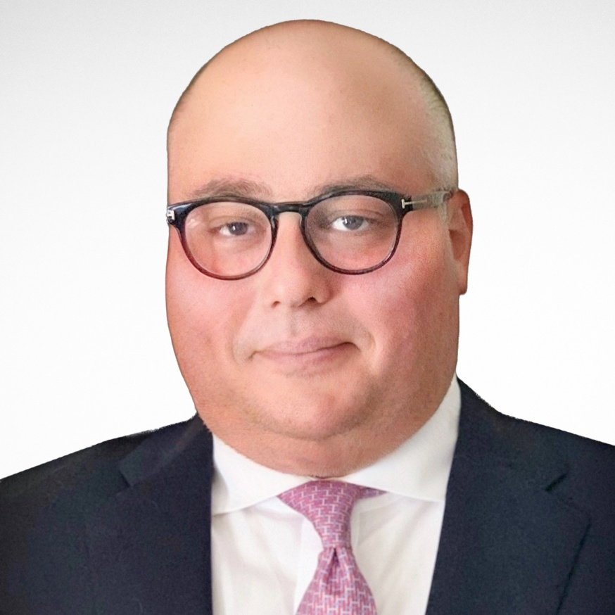
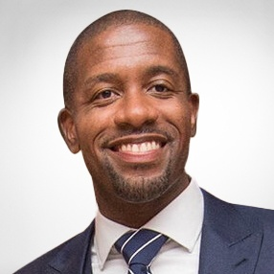
Today’s Presenters
Stan Bernard
Head of Industry Practices U.S. Middle Market
Zurich North America
Trey Martino
Head of Financial Institutions and Professional Services U.S. Middle Market
Zurich North America

Slide 3
Why Zurich
We offer the global strength of a leading insurance provider combined with in-depth knowledge of industries and local markets.
Why?
Breadth of coverage
Deep industry experience
Risk management services
Exceptional claims management
Specialized underwriting
Insurance is underwritten by Zurich American Insurance Company and its underwriting subsidiaries. Insurance product obligations are the sole responsibility of each issuing insurance company. For example, only the assets of Zurich American Insurance Company (and no other assets of the Zurich Insurance Group Ltd) are available to meet its obligations for the performance of its products.. No assurances can be given, and we make no representations, that such information has, or has not, changed since March 31, 2021..
Notes:
Our distinct services:
Breadth of coverages to choose from with a willingness to accept risk through sustainable program structures
Deep industry expertise in mid-sized companies, with over 100 years of experience.
Knowledgeable and specialized underwriting teams with an industry focus
Vast regional footprint staffed with professionals able to provide strategic support
An array of Risk Management services, tools and resources available
Access to a vast global network for Multinational exposures
Specialty products, including Cyber, D&O, E&O, EPLI and more
Exceptional Claims management, with you every step of the way, helping to reduce your claims overall costs

Slide 4




Proven Track Record with Banks
Established Insurance Provider
Over 125 years insuring U.S. Financial Institutions
Delivering insurance solutions to banks longer than any other insurance provider in the U.S.
Member of BancServ’s Endorsed Partner Program¹
Serve more than 95% of Fortune 500 financial companies
Industry Focused Underwriting
Deep institutional knowledge and technical experience
Regionally based Financial Institutions Field Directors
Dedicated and empowered underwriters throughout the U.S.
Over 20 coverage options, tailored to helping Banks safeguard their assets
Claims
24/7 Award-winning, Zurich-owned Customer Care Center²
When utilized, integrated Medical Management program yields a 65% reduction in medical bill costs, on average³
A community-focused, local presence with a vast global footprint covering +200 countries and territories​
Digital tools, integrated medical management and staff legal services available to manage claims​
Risk Engineering
End-to-end risk services, including risk engineering, bringing the best of Zurich to help mitigate risk before, during and after a loss event​
Assigned Risk Engineering Services value add resources:​
Property and Casualty risk assessments
ACURE water damage and prevention program
Office ergonomics
Slip, trip and fall assessments
Fleet program review and telematics
Cyber risk assessment
1. BancServ, Inc. is a wholly owned subsidiary of the Florida Bankers Association: https://www.floridabankers.com/meet-your-endorsed-partners.html
2. Top Mid-size Contact Center as recognized by Contact Center World in 2021
3. Zurich North America Claims Finance 2021
© Zurich

Slide 5



Broad Product Offering for Banks
Property and Casualty
Property
General Liability
Umbrella
Auto
Workers’ Compensation
Multinational
Financial Lines
Management Liability
Professional Liability
Cyber Liability
Specialized P&C coverages
Lender Placed Reporting
Foreclosed Properties
Mortgage Protection Policy
Trust Protector Policy
Repossessed Auto
Contingent Auto Leasing

Slide 6

Bank Association Safety Group Program
All member banks are eligible
Any broker or agent can access for their client
Participants are eligible for dividends (returned premium) across all lines of business for favorable performance of the safety group
Total dividends returned to BancServ¹ Safety Group participants since 2018 is over $3,400,000
1. BancServ, Inc. is a wholly owned subsidiary of the Florida Bankers Association: https://www.floridabankers.com/meet-your-endorsed-partners.html
© Zurich

Slide 7
Questions

Slide 8

Thank you

Slide 9
Disclaimer
The information in this presentation was compiled from sources believed to be reliable for informational purposes only. All sample policies and procedures herein should serve as a guideline, which you can use to create your own policies and procedures. We trust that you will customize these samples to reflect your own operations and believe that these samples may serve as a helpful platform for this endeavor. Any and all information contained herein is not intended to constitute advice (particularly not legal advice). Accordingly, persons requiring advice should consult independent advisors when developing programs and policies. We do not guarantee the accuracy of this information or any results and further assume no liability in connection with this presentation and sample policies and procedures, including any information, methods or safety suggestions contained herein. We undertake no obligation to publicly update or revise any of this information, whether to reflect new information, future developments, events or circumstances or otherwise. Moreover, Zurich reminds you that this cannot be assumed to contain every acceptable safety and compliance procedure or that additional procedures might not be appropriate under the circumstances. The subject matter of this presentation is not tied to any specific insurance product nor will adopting these policies and procedures ensure coverage under any insurance policy. Insurance coverages underwritten by individual member companies of Zurich in North America, including Zurich American Insurance Company. Certain coverages not available in all states. Some coverages may be written on a nonadmitted basis through licensed surplus lines brokers. Risk engineering services are provided by The Zurich Services Corporation.

