Slide 1
Business Update
October 13, 2025
SBA For-Profit 2025 Meeting
Bozeman, MT
In coordination with Synergy by Association
Notes:
#-- DocuMotor-Binding-Variables --#
PresentationDate:<<Field:data.date>>
ID:<<Field:data.customerId>>
CustomerName:<<Field:data.customerName>>
ReviewPeriod:<<Field:data.reviewPeriod>>
#-- DocuMotor-Binding-Variables-End --#

Slide 2



Meet your ODP Business Solutions™ team
Get to know your ODP Business Solutions team — dedicated consultants working behind the scenes with your account manager to provide best-in-class solutions and personalized customer service.
Director
National Healthcare GPO’s & Buying Groups
Mike Mayes
Program Manager
Larry Reinker
Director SMB Acquisition
Talitha Searcy

Slide 3

Agenda
Atlas Acquisition
Updates
Appendix- service offerings

Slide 4
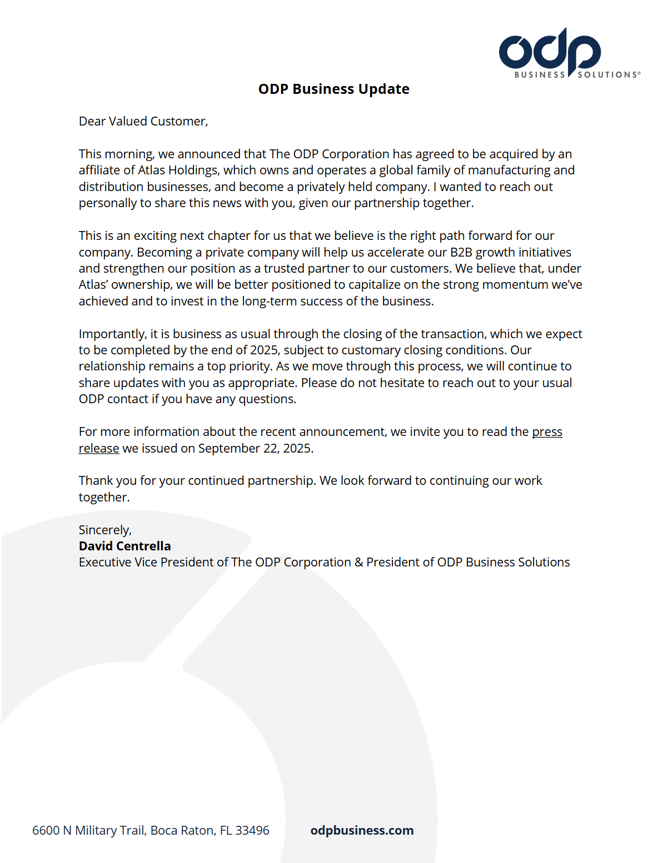
New for year end 2025
ODP agrees to acquisition
By private Equity firm Atlas holdings
Customers were notified directly.
Transaction should close
Prior to end of year 2025

Slide 5
New for year end 2025
New Senior Management in Austin at Inside Sales
Focus on new account acquisition
Talitha recently promoted to Director of Acquisition
Continuing transition to vertical specialization
SBA representatives will have more broad industry knowledge
New programs to increase associate retention
And more coming in 2026…

Slide 6
The ODP story, simplified
Office Depot has spent 37 years assisting business leaders to run the working world.
Now, we’re doing it as ODP Business Solutions.
Why is our business evolving? Well, why is any business evolving?
To answer shifting marketplace demands.
To stay competitive against an expanding set of challengers.
To take advantage of technological innovation.
To enable more efficient ways of working.
To make business more inclusive and sustainable.
To better support and empower our employees.
To continue to serve our customers to the very highest standard.
To enrich and elevate local communities.
To make sure business works for people, and not just the other way around.
Sound familiar?
Our business is evolving because your business is evolving.

Slide 7

ODP Business Solutions SBA Highlights
Partner with over 40 bankers associations across the United States
Program is built for banks
2600+ commonly ordered items, including bank-specific items, deeply discounted
Free, next-day delivery on orders over $50
Expense reductions tools to manage account spend
Customizable program to meet member needs
Not just paper and toner…
Cleaning and Breakroom-coffee, soda, paper towels, etc.
Copy and Print-forms from front-line to HR forms, printed on demand
Managed Print Services-copier and printer fleet management
Workspace Interiors and Furniture-from design to implementation
Promotional Products-logo-wear, bank branded items

Slide 8
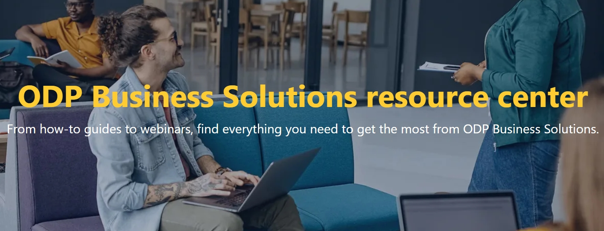
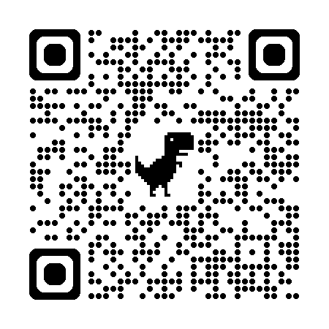
ODP Business Solutions Resource Center
Our online Resource Center has articles, case studies, videos, blogs and more to keep our customers informed & inspired.

Slide 9
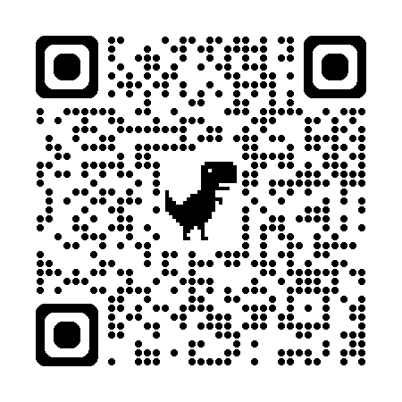


ODP Business Solutions Community Involvement
As a founding partner of ELEVATE TOGETHER®, ODP Business Solutions actively partners with this initiative designed to aid business growth and profitability in Black and Hispanic communities.
Learn more about our partnership with Elevate Together®.

Slide 10

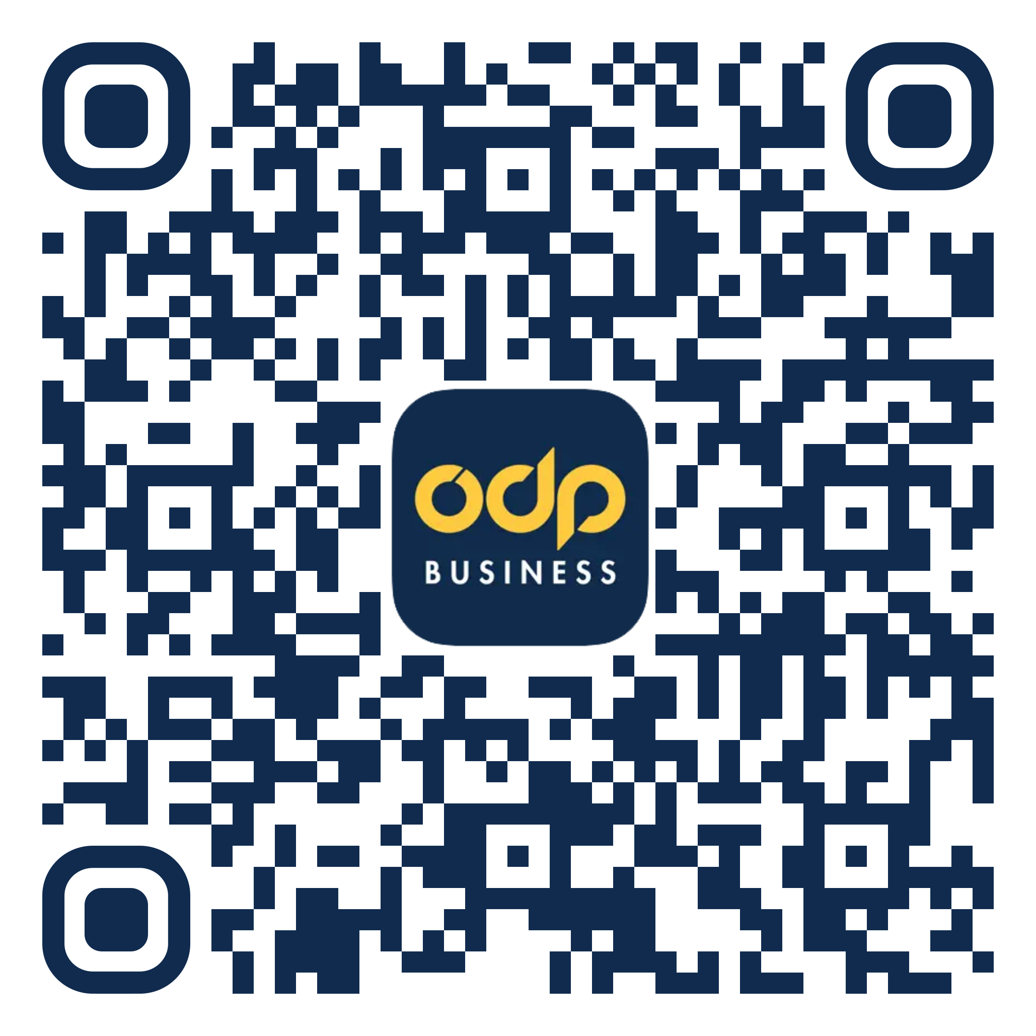
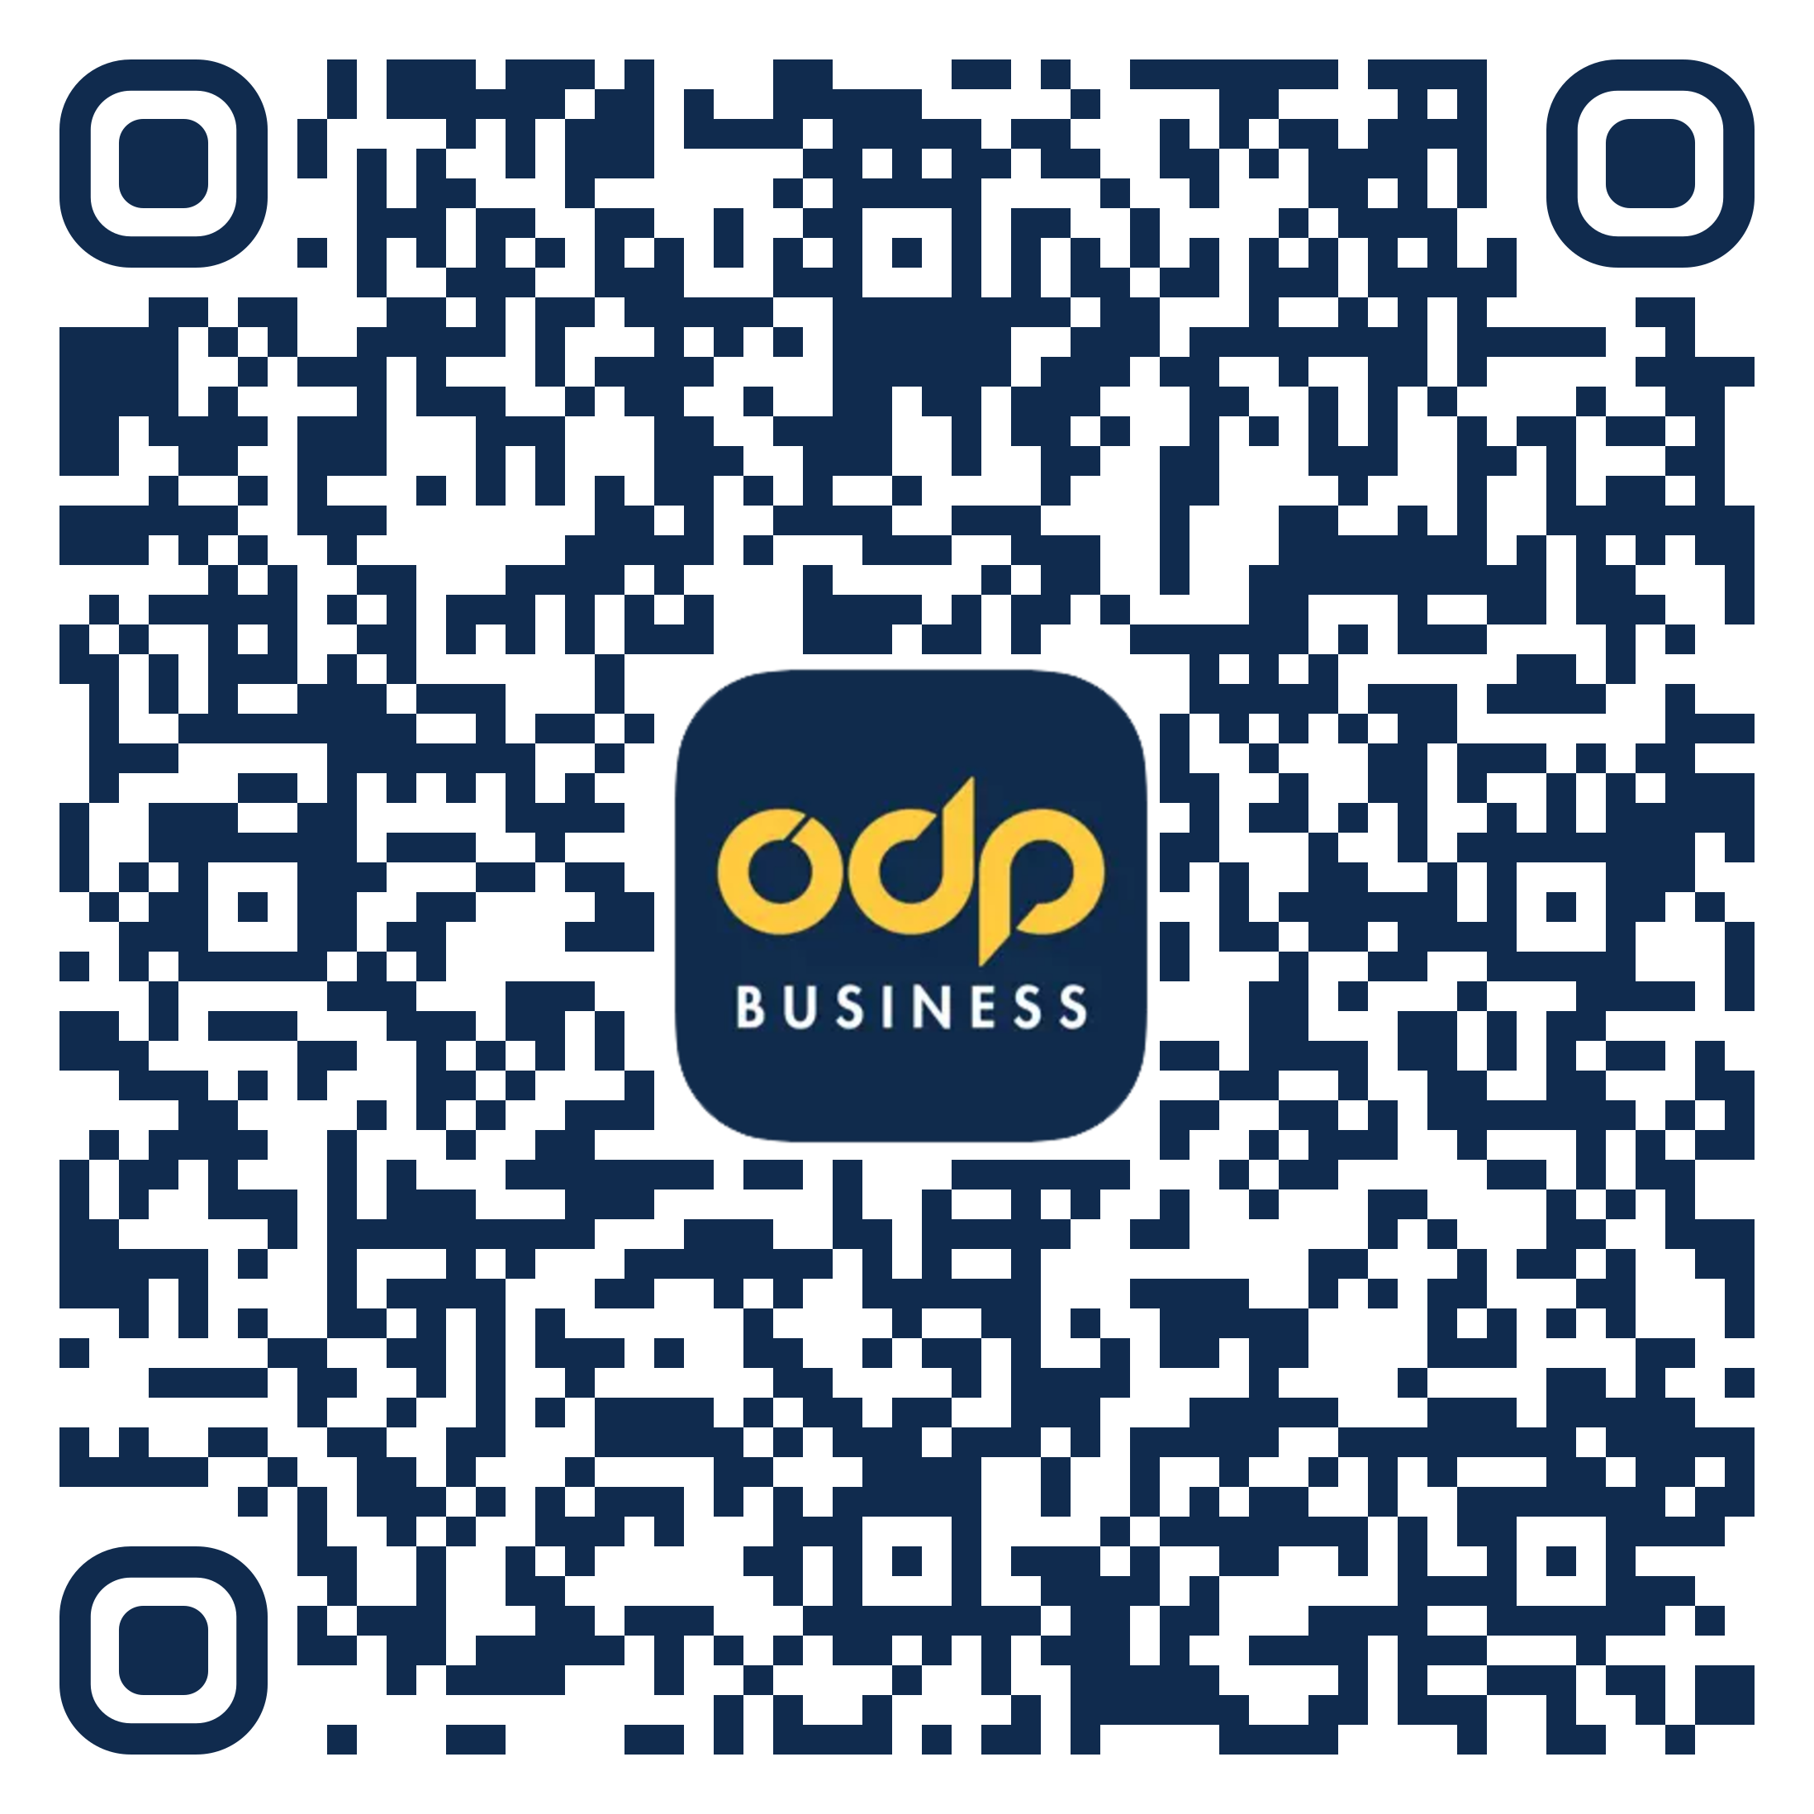
ODP Business Solutions Mobile App
You can now order the products and supplies you need for your business using the ODP Business Solutions Mobile app, available in the Apple Store & on Google Play
ODP Business Solutions App
Apple Store
ODP Business Solutions App
Google Play
Notes:
Use the ODP Business Solutions Mobile app to quickly, easily and conveniently order the products and supplies you need for your business.

Slide 11
Appendix

Slide 12
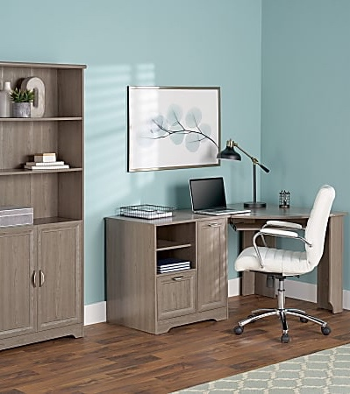





ODP Business Solutions™ collection of brands
Well designed. Well made. Well priced.
TUL®
WorkPro®
Realspace®
Highmark®
Ativa®
High-quality school supplies
See Jane Work® exclusive brand partner
Executive Suite®
Ativa, Executive Suite, and Realspace are trademarks of The Office Club, Inc. TUL is a trademark of OMX, Inc. Highmark and WorkPro are trademarks of Veyer, LLC.
Notes:
Discover our collection of brands that strive to offer high quality at an exceptional value:
TUL®: High performance writing instruments and custom note-taking system
WorkPro®: Multi-use commercial-grade furniture and seating
Realspace®: Affordable, versatile furniture and accessories for stylish workspaces
Highmark®: Quality, value-packed cleaning and breakroom supplies
Ativa®: Reliable shredders and intuitive tech accessories
High-Quality School Supplies: Trusted, high-quality school supplies, instruction books and more
See Jane Work® Exclusive Brand Partner: Stylish desk sets, furniture and accessories for your organized workspace
Executive Suite®: Fresh, delicious coffees that rival national brands for taste and quality

Slide 13

Subscription services
Tired of worrying about running out of the supplies you use most?
ODP Business Solutions™ Subscription Services are an easy way to help you manage your inventory on supplies you use frequently. Simple to set up with no fees or commitments, our subscription services can help you stay focused on what matters most: your business.
Valid credit card or account billing required. Recurring payments based upon your selected subscription frequency (weekly, monthly, quarterly, etc.) will be automatically billed to your method of payment until you cancel the subscription.
Notes:
Convenience you can count on
Schedule and control automatic deliveries
Simple to set up
No commitments
Change or cancel at any time
Zero fees
Choose quantity and frequency of deliveries
Weekly, quarterly and everything in between
The products you want, when you want them
Breakroom supplies
Coffee, water, snacks and more
Cleaning supplies
Paper towels, trash bags, cleaners and more
Office supplies
Paper, pens, binders, ink and toner and more

Slide 14






Our solutions
OFFICE SUPPLIES
FURNITURE
TECHNOLOGY
CLEANING AND BREAKROOM
MAILING AND SHIPPING
INK AND TONER
BACK TO APPENDIX
BACK TO SOLUTIONS
Notes:
Office supplies
ODP Business Solutions can help customize and curate the right mix of supplies to help boost productivity whether employees are in the office or working remotely. We offer next business day delivery that’s within budget, supplied sustainably, and from a diverse range of suppliers — plus our collection of brands and 100% guarantee.
Furniture
Is your workplace furnished for productivity? From ergonomic seating and sit/stand desks to shelving and storage to accessories like mobile partitions, lighting and décor, ODP Business Solutions can help you furnish your space in comfort and style — with commercial-grade quality you can count on.
Technology
We are in a hybrid world now, and ODP Business Solutions is uniquely positioned as an experienced partner and problem solver that can provide you with tech products and services that support your changing workplace and team.
Cleaning and breakroom
As one of North America’s largest distributors of cleaning and breakroom supplies, ODP Business Solutions has the resources and network you can rely on to provide consistency and timely delivery of cleaning and breakroom supplies. Start with a free site assessment that allows us to be there in-person to discuss your challenges, objectives, and develop a plan that works for your business.
Mailing and shipping
Not everything can be sent via email. Whether you’re looking for padded envelopes, industrial-strength tape, asset tags or corrugated boxes, ODP Business Solutions can help you stay well stocked, so you can pack and ship quickly and conveniently.
Ink and toner
Make a lasting impression with quality ink and toner that can help your printed materials shine. Looking for a greener way to print? ODP Business Solutions offers remanufactured ink and toner, as well as our ink and toner recycling program to help you address your sustainability objectives.

Slide 15


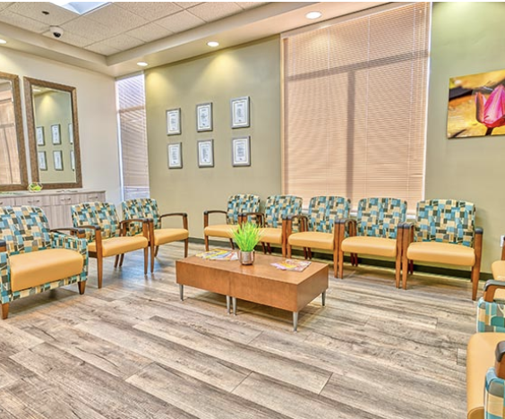
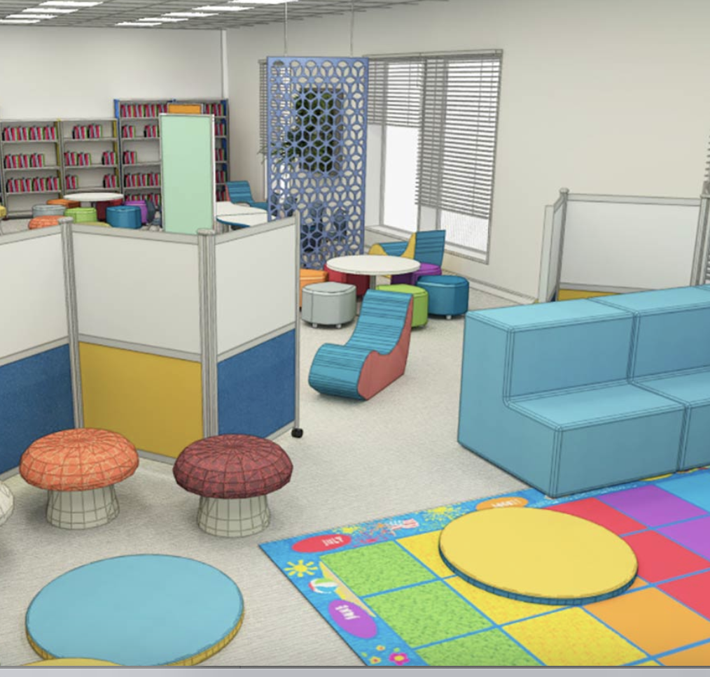
Furniture and space planning
Want to help furnish every corner of your organization for success?
ODP Business Solutions™ Workspace Interiors offers space planning and design services, certified installation, repair, and restoration — plus easy online ordering for select in-stock furniture items.
Notes:
ODP Business Solutions Workspace Interiors is dedicated to providing your business with complete furniture solutions to help keep your employees comfortable and productive.
With Workspace Interiors, you have options. Whether your business goal is small and simple or larger and more complex, our comprehensive program offers you the right solution to fit your objectives. We contract with top furniture manufacturers to offer one of the best selections in the industry, and we specialize in providing customized solutions to fit your unique style and space.
With over 38 locations throughout the nation and more than 175 local service representatives, we are ready to help turn your vision into reality. Providing you consistent service nationwide and collaborating with you to gain efficiency, cost savings and control into your overall spend. Our experienced Workspace Interiors team can manage every aspect of your next project — right down to the last detail. Providing the individual attention your business deserves.
15

Slide 16

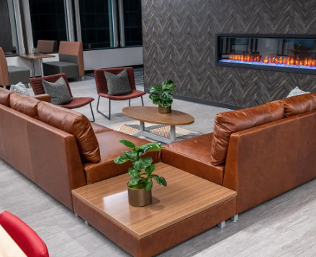
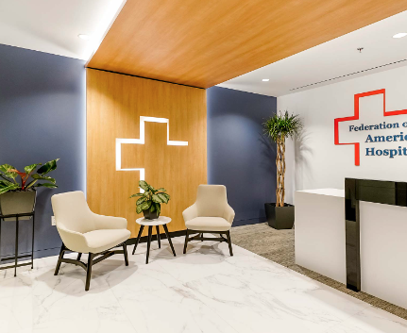
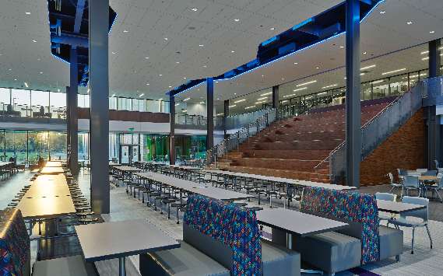
Comprehensive products and network
Looking for a nationwide network that provides access to top brands?
Our complete furniture solutions include offerings from names such as Hon, Kimball International, and Safco, and our unified network provides strategic advantages across every phase of your project.
Notes:
Furniture offerings
We proudly offer one of the most extensive selections in the industry for every functional area of your space in a variety of styles – from traditional to transitional to contemporary. With Workspace Interiors, you will find a comprehensive selection of quality furniture from top names such as HON, Kimball International Brands, Safco, Global, Trendway, Allermuir, and offerings from more than 200 manufacturers.
This wide breadth of options allows us to address any budget with both commercial grade and contractor grade furniture offerings
200+ custom niche manufacturers
5,000+ in-stock commercial-grade catalog items
Our own collection of brands — (WorkPro® and Realspace®) rounds out our complete furniture solution by providing outstanding value, fast delivery and great quality.
Additional services and offerings
With so many manufacturers and such a large assortment, you might want some assistance finding that perfect furniture solution for your business. Our furniture team is experienced in our product assortment and can help you find exactly what you’re looking for.
Space planning – Not sure if it will fit? Let us create a design for your space and help you visualize your new, productive workspace.
Product recommendations – Good, better, best comparisons
Standard programs – Eliminate rogue spending and establish standards that represent your brand.
Ergonomic solutions
Order placement and management
Installation and delivery arrangements
Our network
A full-service, four-wall solution provider nationwide
Diverse network of employees ranging from designers to experienced sales representatives to project managers
Coast-to-coast distribution, installation network and enhanced delivery program can help your organization receive consistent service anywhere in the country
Offers a consistent and scalable service model
Focused on delivering a seamless customer experience
Industries we serve
Enterprise and large business
Medium and small business
Education
State, local, and federal government
Healthcare
16
Change image to an education photo (perhaps Baldwin image?)

Slide 17

Print, promo, and apparel
Looking for a way to showcase your brand?
ODP Business Solutions and the ODP360 technology platform can custom-create your company store for all your branded promotional products and branded apparel for use in:
• Gifting programs
• Sales incentives
• Client gifting
• Event giveaways
Let us handle the sourcing and distribution, and you enjoy the ease of a seamless company store for all your branded products.
Notes:
17

Slide 18

Print, promo, and apparel, continued
Apparel
Industries served
Healthcare, retail, hospitality, manufacturing, financial, professional, and technology
Program control
Program aggregation and cost management
End-to-end online tools
Defined user groups
National reach
Multiple points-of-presence
Just-in-time and timed delivery
Flexibility
Third-party manufacturing partners
Scaled high-volume distribution
Highest quality apparel, promo, and print solutions
Signs and graphics
Promotional products
eCommerce Platform
Commercial printing, brand identity, direct mail, and labels
Digital document services

Slide 19
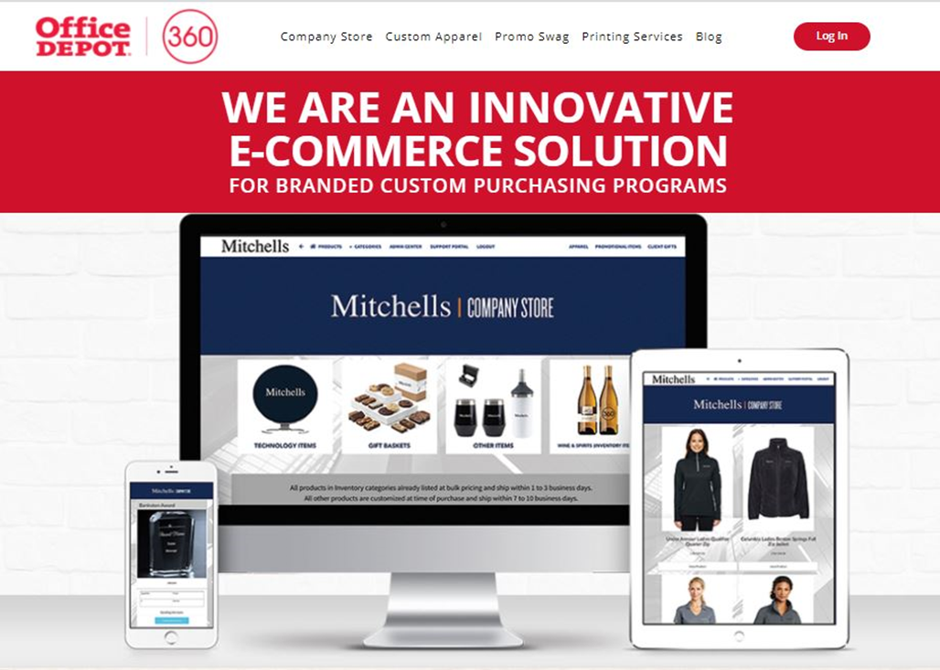
Brand management eCommerce platform
Print, promo, and
apparel, continued
Access to inventory and on-demand printed products
Third-party vendor integration (3PV)
Brand identity products
Signage
Apparel products
Promotional products
WE ARE AN INNOVATIVE E-COMMERCE SOLUTION
Notes:
Brand identity products Business cards, name badges and holders
Signage Point of purchase, permanent and window
Apparel products Uniform and logo wear — order quantity as low as 1
Promotional products Employee rewards, new hire kits and events

Slide 20

Technology solutions
Looking for more tech value and selection for your business?
Look to ODP Business Solutions to help you plan, acquire, deploy, and fund technology across every area of your business. We’ll help you keep employees connected while leveraging virtual technologies to generate more ideas and promote innovation.
Notes:
TECHNOLOGY SOLUTIONS
Most major computer and networking companies, including HP, Lenovo and Apple
Virus removal and security software
Software optimization on new and existing devices
Installations, moves or on-site support
Performance protection plans and warranties
Software licenses and imaging
Cloud storage
Asset life cycle services
Managed Wi-Fi and hosted VoIP
Hosted digital signage
Data center assessments and services
TECHNOLOGY SERVICES
Multidevice management
Procurement, configuration, deployment, support and disposal
Self-help options
Workplace support services
Cloud services, backup, collaboration and data recovery
New technology rollouts and migration
Analytics and insights
Automation

Slide 21
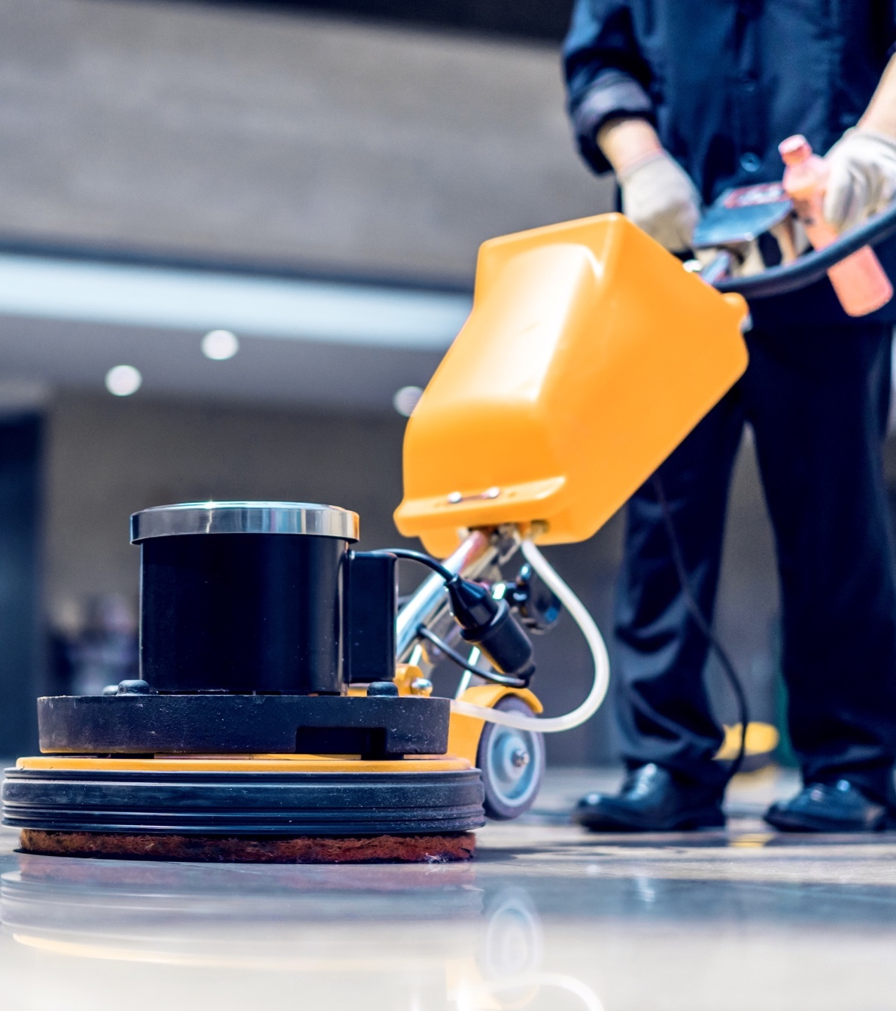
Workspace Facilities — cleaning
Want to help maintain a cleaner environment while reducing labor costs and the use of harsh chemicals?
From greener cleaning supplies to data reporting to our Ready to Ship program, ODP Business Solutions can help your facility shine. We even offer free site assessments, so we can help tailor our solutions to your organization.
Notes:
• Leverage our world-class supply chain capabilities
• Count on our high service levels and fill rates
• Stay on top of — and consolidate — your facility spending
• Discover additional cost savings throughout your supply chain
A centralized solution for cleaning supplies
Soaps and sanitizers
Smart dosing and dilution control
Tissues, towels and paper goods plus dispenser installation services
Cleaners and chemicals
Heavy-duty cleaning equipment and accessories
Trash bags and receptacles
First-aid kits and medical and safety items
Matting and floor care equipment
Totes and handcarts
Premier selection of greener alternatives
READY TO SHIP PROGRAM
We stock thousands of cleaning and breakroom products. More than 1,500 essential items that facilities use the most are stocked and Ready to Ship in our local distribution centers throughout the nation.
These products typically get shipped out the same day — Monday through Friday — for delivery the next business day (if ordered by 3:00 p.m. local time)

Slide 22

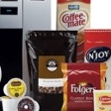
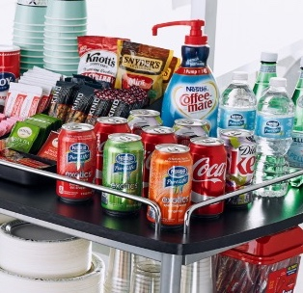

Workspace Facilities — breakroom
Are you perking up productivity while providing some comforts of home?
Help boost your energy and morale with our wide range of breakroom supplies. From coffee and water services to customized shopping lists to individually wrapped items, we can help you keep your breakroom as refreshed as your workforce.
Notes:
Are you perking up productivity while providing some comforts of home?
Help boost your energy and morale with our wide range of breakroom supplies. From coffee and water services to customized shopping lists to individually wrapped items, we can help you keep your breakroom as refreshed as your workforce.

Slide 23

Evolution of business
Does your workforce stay productive beyond the walls of your office?
Whether your staff is remote, hybrid, or back in the office, ODP Business Solutions can help staff members maintain productivity from any location. Count on us to provide solutions that can help your employees stay more connected and collaborative — wherever business gets done.
Notes:
Laptops and technology
Cybersecurity software
Videoconferencing and headsets
Printers, toner and paper
Ergonomic furniture
Files and organizers
Calendars and planners
Writing and supplies

Slide 24
Q&A

Slide 25
Thank you
ODP and ODP Business Solutions are trademarks of ODP Business Solutions, LLC. Office Depot is a trademark of The Office Club, Inc. © 2022 ODP Business Solutions, LLC. All rights reserved.

