Slide 1
SBA For Profit
Notes:
[Speaker notes]
Welcome the client. Introduce yourself and your role. Mention that this session is tailored for their organization and today’s goal is to explore how Integris can support their IT strategy. Acknowledge their presence and thank them for their time.

Slide 2






What we’ll cover today
What we learned about [Company Name]
Why Integris
Recommended Services
What to Expect
Our Coverage and additional services
Next steps

Slide 3
About Integris
Notes:
[Speaker notes]
Reinforce how recommendations align with the client’s needs and goals.

Slide 4
Currently serving more than 1,800 clients in over a dozen states
Offering best-in-class services like dedicated vCIOs, specialized security and compliance advisory services, a 24/7 help desk, and more
Expertise across multiple industries:
Financial Institutions
Law firms
Manufacturing
Healthcare
Non-profits
“Integris,” stands for integrity. And it’s something we aim to deliver, every day.
Notes:
[Speaker notes]
Summarize the client’s pain points. Show that you’ve listened and understand their challenges. This builds credibility and sets the stage for how Integris can address these issues.

Slide 5
Our Financial Institution Division is over 175 employees strong that work exclusively with community banks
Currently serving more than 120 banks coast to coast
IT Solutions for Financial Institutions
Managed IT Support
Cybersecurity
Hosting
IT Operations Assessment
vCISO
“Integris,” stands for integrity. And it’s something we aim to deliver, every day.
Notes:
[Speaker notes]
Summarize the client’s pain points. Show that you’ve listened and understand their challenges. This builds credibility and sets the stage for how Integris can address these issues.

Slide 6





Driven by our values
People first
Do the right thing
Get it done right
Own it
Build for better
Integris is powered by people, so it’s important we don’t get wrapped up in the wires. Our people always come first.
Every team member owns their part. We take responsibility for our clients and hold each other accountable.
Our name is rooted in integrity. It’s the heart of how we run the business and guides everything we do.
A single checkbox can make or break our business. No detail is too small. We want to make it right.
We don’t just build for today—we build for what’s next. Decisions are rooted in purpose, with an eye on long-term impact.
Notes:
[Speaker notes]
Share our core values. Emphasize our people-first culture, integrity, accountability, and long-term thinking. This builds emotional connection and trust.

Slide 7
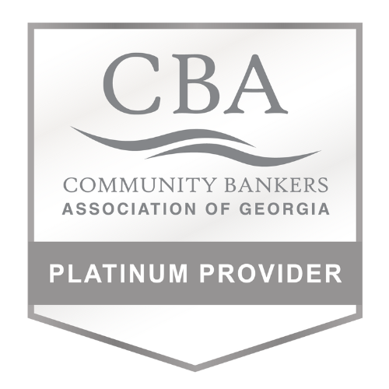




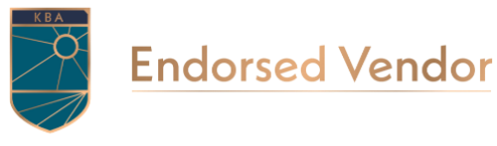
Endorsements

Slide 8
















Associate Members

Slide 9




Why our clients trust us
This partnership has been built on clear communication and strategic alignment with a company that truly has the best interest of community banking at heart.
Their [Integris] team consistently delivers exceptional support and education to community bankers. We are proud to recommend Integris, confident that the banks we refer will receive outstanding service and trusted guidance.
For us, when choosing a preferred cybersecurity provider, Integris was the clear choice. Their dedication to understanding the unique needs and challenges of community banks makes them the perfect partner.
Brenda Unruh
EVP – Director of Education & Conferences, Strategic Partnerships
Kansas Bankers Association
Julie Courtney
President, IBAT Services
IBAT
John McNair
CEO
CBA of Georgia
Notes:
[Speaker notes]
Share real quotes from clients. Highlight specific outcomes and talk about how we serve clients across multiple industries, including highly-regulated industries.

Slide 10
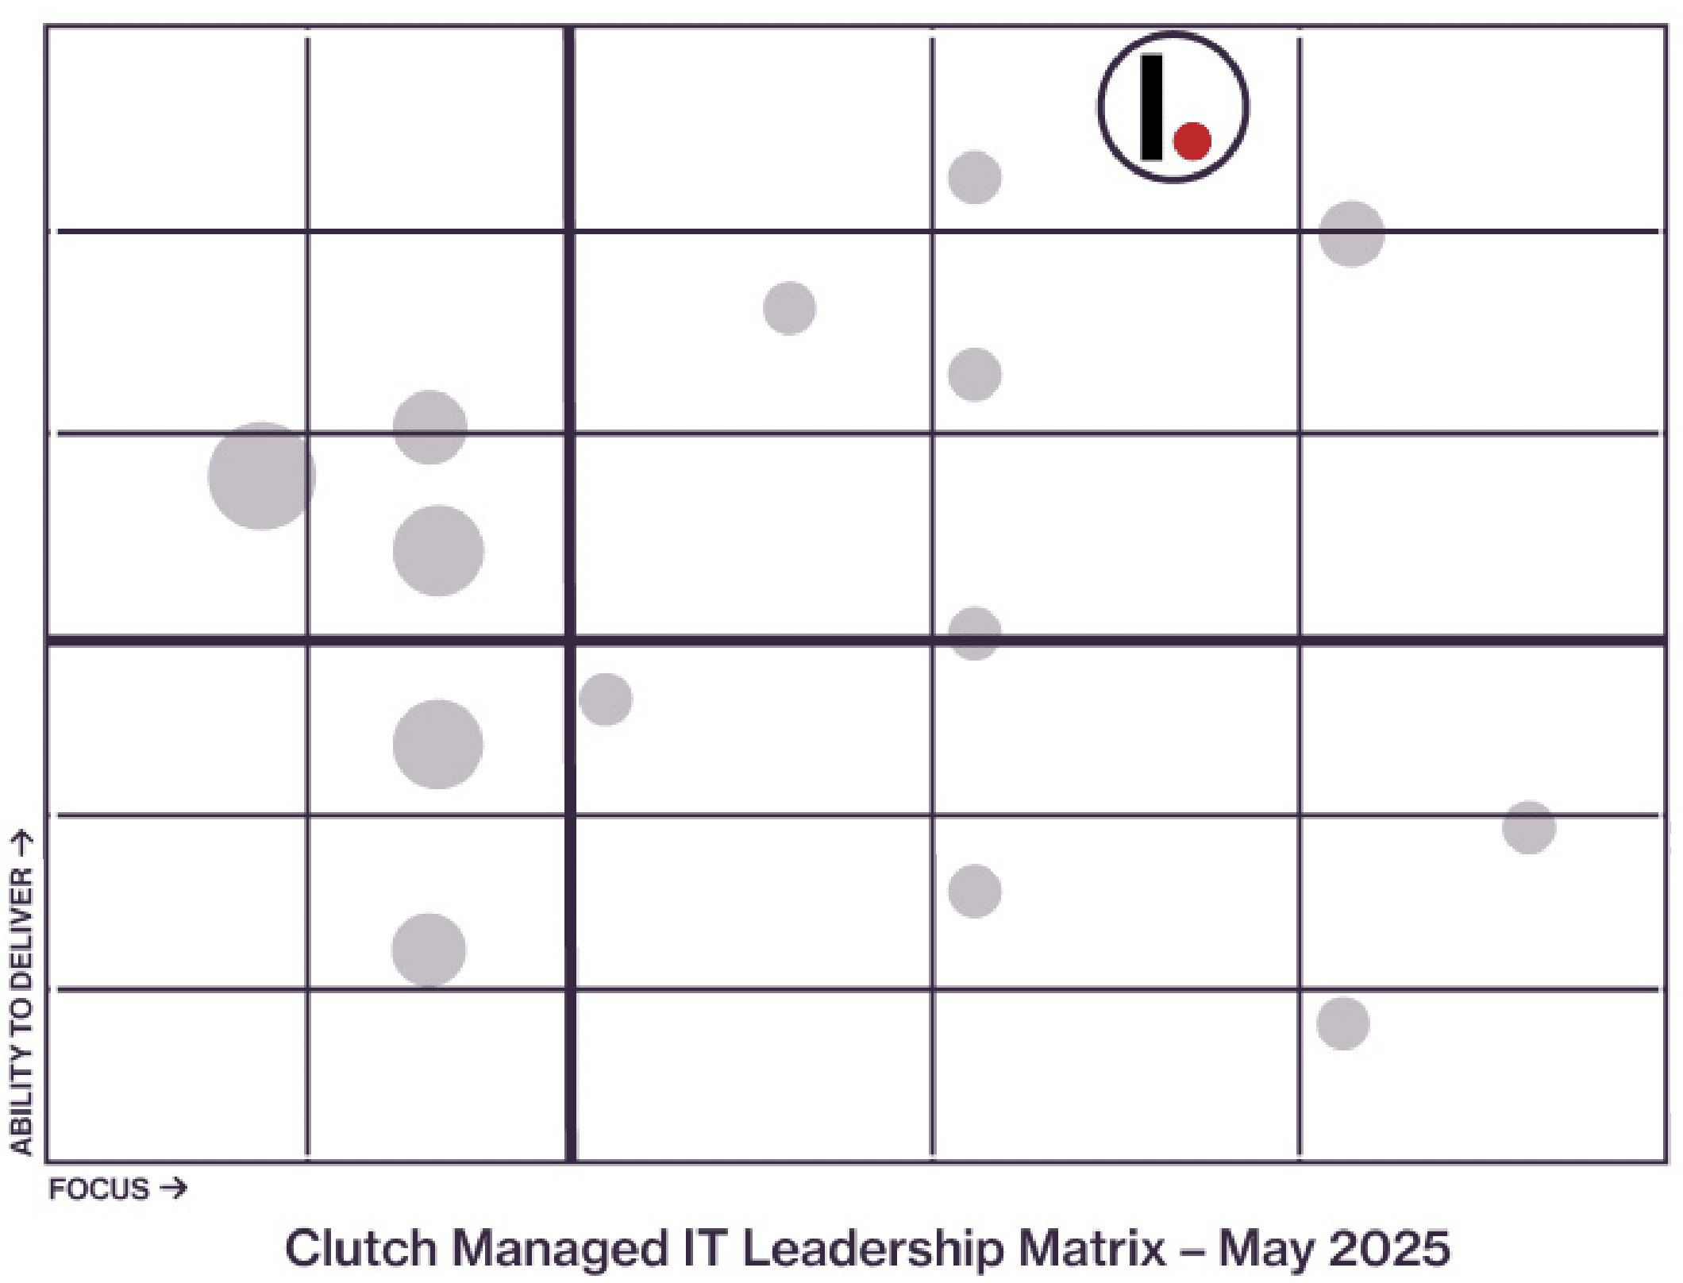










1997-2020
Clients rate Integris the #1 managed service provider
Our reviews on Clutch speak for themselves—we’ve been ranked the #1 managed IT service provider based on our ability to deliver services and our focus in the managed IT space.
Notes:
Clutch is a valuable resource for buyers of B2B services, such as marketing and IT, because it provides verified, in-depth information that builds trust and helps buyers find the right partner
.Buyers can cut through marketing hype by consulting a transparent third-party platform that is committed to filtering out fake reviews.
Reasons Clutch is a valuable resource for buyers
Authenticity and trustworthiness. Clutch's rigorous verification process involves interviewing clients directly to confirm the legitimacy of reviews. This gives buyers confidence that the feedback is from real customers, which is a top priority for B2B purchasing decisions.
Access to reliable information. Buyers can find detailed, first-hand accounts of a company's performance, including feedback on project quality, timeliness, and customer service. This provides a more reliable picture of a potential partnership than a company's own website testimonials.
In-depth case studies. In addition to reviews, Clutch provides comprehensive case studies on service providers. These offer deeper insights into a company's capabilities and past successes, which helps inform purchasing decisions.
Data for evaluating providers. Clutch collects information on quantitative factors like a provider's client list, industry recognition, and market presence, allowing buyers to compare multiple companies objectively.
Identification of top performers. The platform maps service providers in "Leaders Matrices" based on their area of focus and ability to deliver. This enables buyers to quickly identify top-performing companies that meet their specific needs, whether for a one-off project or a long-term relationship.
Targeted search and matchmaking. Through search tools like SmartMatch and Clutch AI, buyers can narrow down providers based on specific criteria, such as location, budget, and industry expertise. The platform can even create a shortlist of qualified providers tailored to a buyer's business.
Transparency and cost data. Some reviews provide objective data, such as the general cost and scope of a project, which helps buyers budget and plan more effectively. This transparency is a key factor for many B2B purchasers.

Slide 11

1997-2020
Notes:
Clutch is a valuable resource for buyers of B2B services, such as marketing and IT, because it provides verified, in-depth information that builds trust and helps buyers find the right partner
.Buyers can cut through marketing hype by consulting a transparent third-party platform that is committed to filtering out fake reviews.
Reasons Clutch is a valuable resource for buyers
Authenticity and trustworthiness. Clutch's rigorous verification process involves interviewing clients directly to confirm the legitimacy of reviews. This gives buyers confidence that the feedback is from real customers, which is a top priority for B2B purchasing decisions.
Access to reliable information. Buyers can find detailed, first-hand accounts of a company's performance, including feedback on project quality, timeliness, and customer service. This provides a more reliable picture of a potential partnership than a company's own website testimonials.
In-depth case studies. In addition to reviews, Clutch provides comprehensive case studies on service providers. These offer deeper insights into a company's capabilities and past successes, which helps inform purchasing decisions.
Data for evaluating providers. Clutch collects information on quantitative factors like a provider's client list, industry recognition, and market presence, allowing buyers to compare multiple companies objectively.
Identification of top performers. The platform maps service providers in "Leaders Matrices" based on their area of focus and ability to deliver. This enables buyers to quickly identify top-performing companies that meet their specific needs, whether for a one-off project or a long-term relationship.
Targeted search and matchmaking. Through search tools like SmartMatch and Clutch AI, buyers can narrow down providers based on specific criteria, such as location, budget, and industry expertise. The platform can even create a shortlist of qualified providers tailored to a buyer's business.
Transparency and cost data. Some reviews provide objective data, such as the general cost and scope of a project, which helps buyers budget and plan more effectively. This transparency is a key factor for many B2B purchasers.

Slide 12
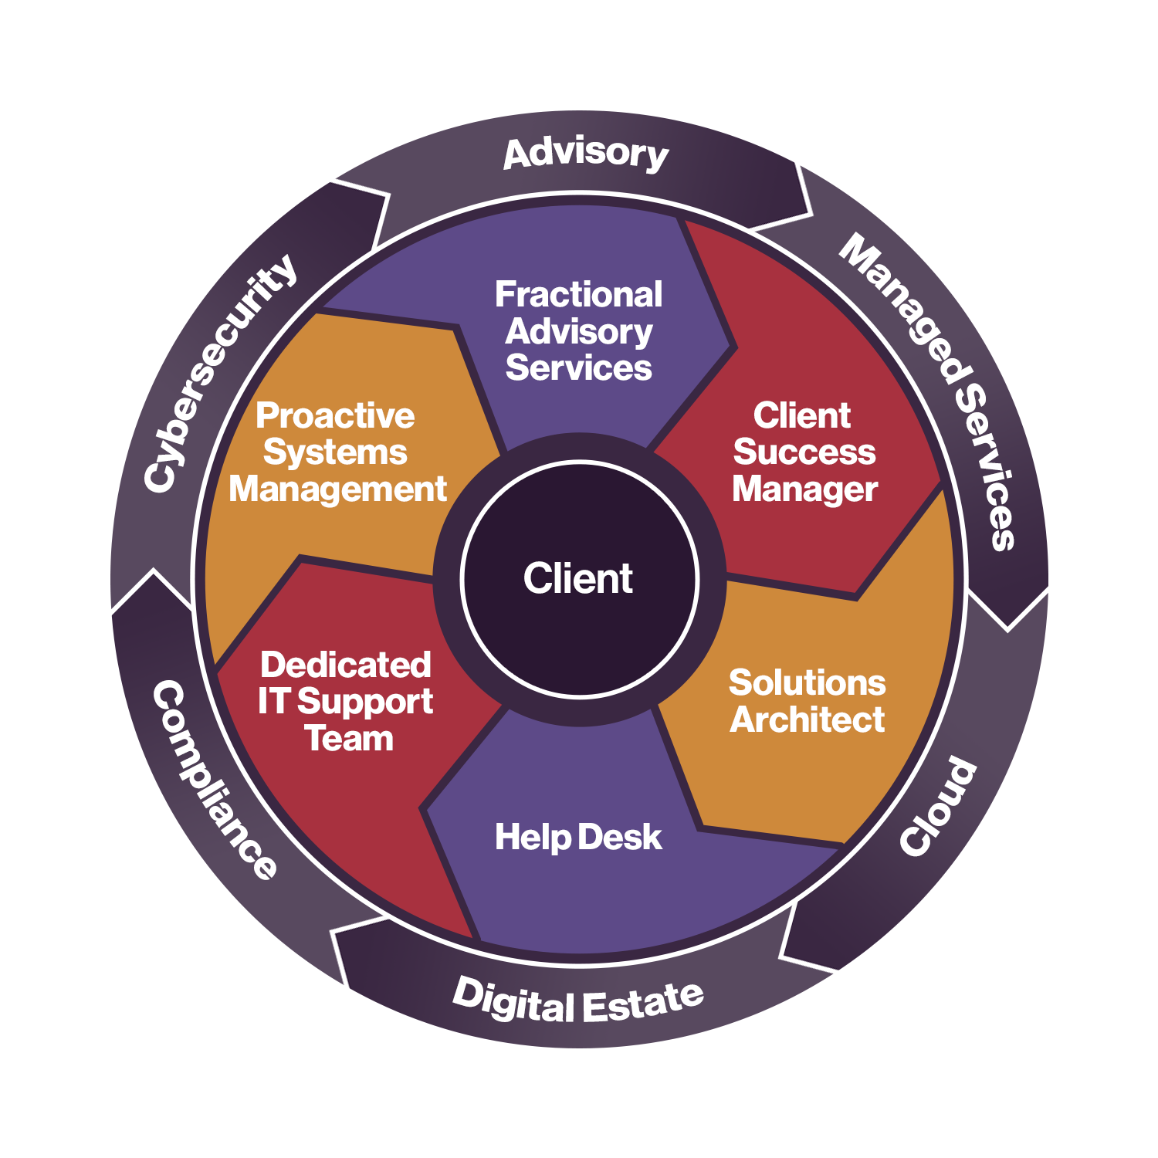
About our banks
120
Banks Integris Currently Supports
175
Employees in Integris FID
15-250
Our ‘Sweet Spot’ for potential clients
Notes:
[Talking points]
We take a client-centric approach. Our fully managed services are centered around you, which is what the flywheel indicates.
With our clients in the middle, we surround them with a dedicated team of experts, robust resources, and unwavering support to ensure your success.
All teams work together (inner wheel) providing premium technology solutions (represented in the outer rim).

Slide 13





Our core solutions
Managed services
Cybersecurity
Cloud services
Build a strong, future-focused technology architecture. Our managed services extend far beyond the “break/fix” models offered by traditional MSPs.
Defense-in-depth approach to cybersecurity that combines strategic planning with comprehensive implementation and monitoring.
Expertise to architect a secure, compliant, high-performing IT environment.
Governance, risk and compliance
Advisory
Rapid monitoring with gold-standard compliance consulting from CISSP-certified security experts.
We assess your environment, identify gaps, and deliver a roadmap to drive growth, resilience, and long-term maturity.
Notes:
[Speaker notes]
Summarize our service pillars—Managed Services, Cybersecurity, Cloud, GRC, and Advisory.
Position Integris as a comprehensive, premier IT partner.

Slide 14
Marketing
Notes:
[Speaker notes]
Reinforce how recommendations align with the client’s needs and goals.

Slide 15

integrisit.com/resources
Notes:
[Speaker notes]
Reinforce how recommendations align with the client’s needs and goals.

Slide 16
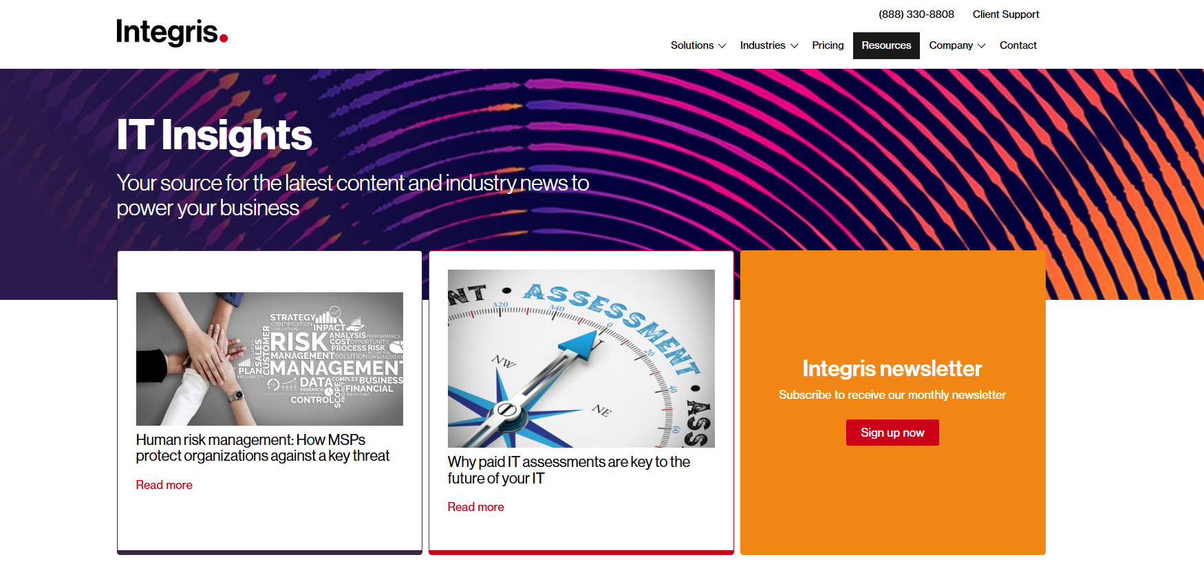
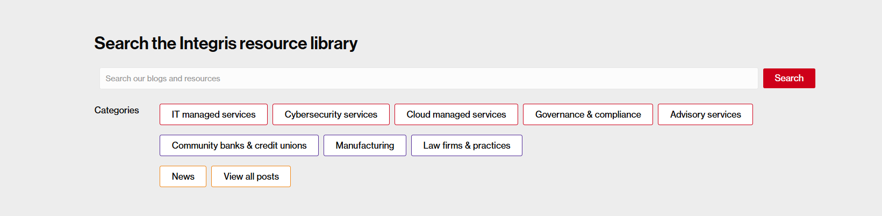
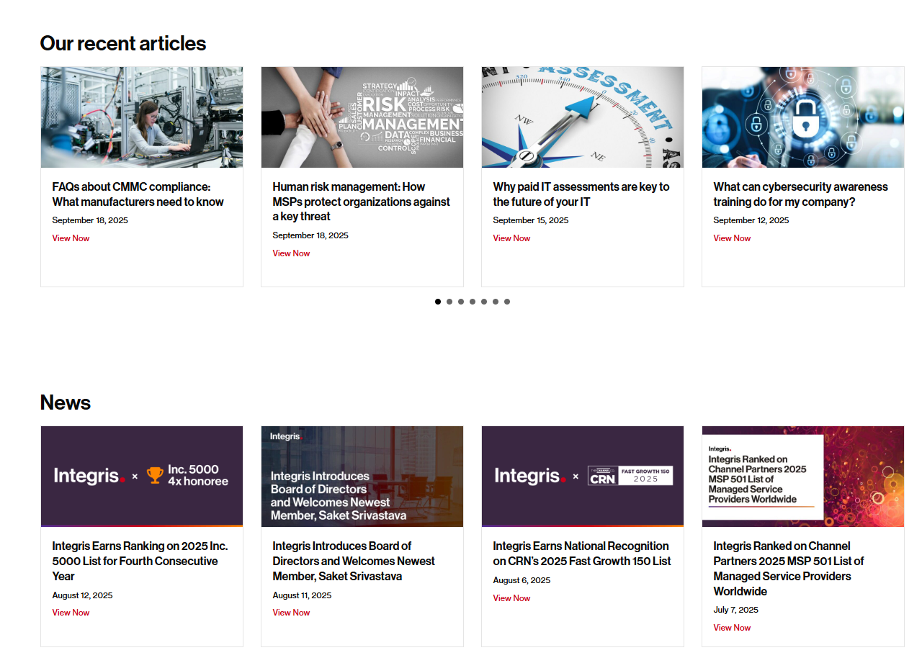
Notes:
[Talking points]
Our first step is an assessment, to determine if you have all the tools necessary to secure your systems. We assess your system against our Responsible IT Architecture framework, which we’ve developed to help us determine where gaps are, or might be.
Some of these things might be to ensure that you: Meet all your regulatory burdens; Qualify for cyber risk insurance; Have proper authentications and access protocols; Secure all your endpoints; Install tools that filter and quarantine content; Calibrate your backups to match your usage and data needs; Create a network of defense that catches hacks outside and inside your systems.

Slide 17
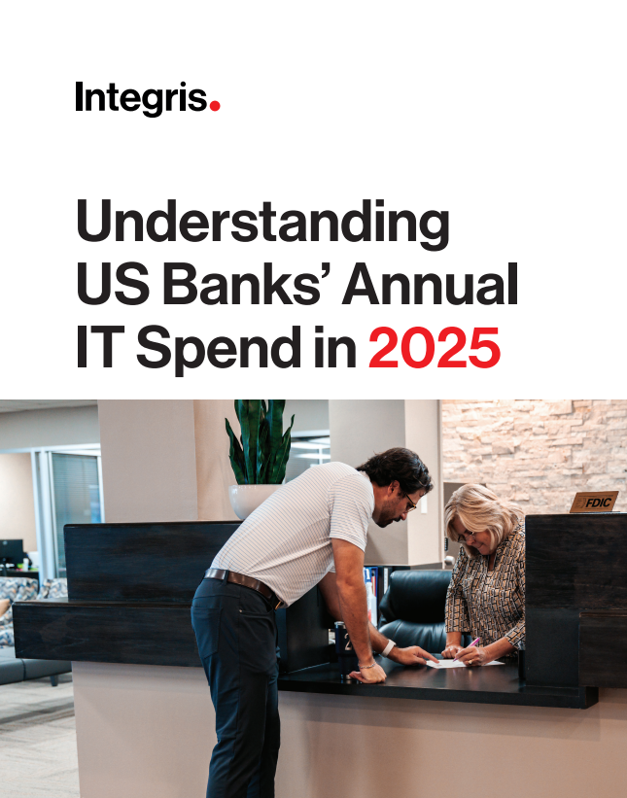
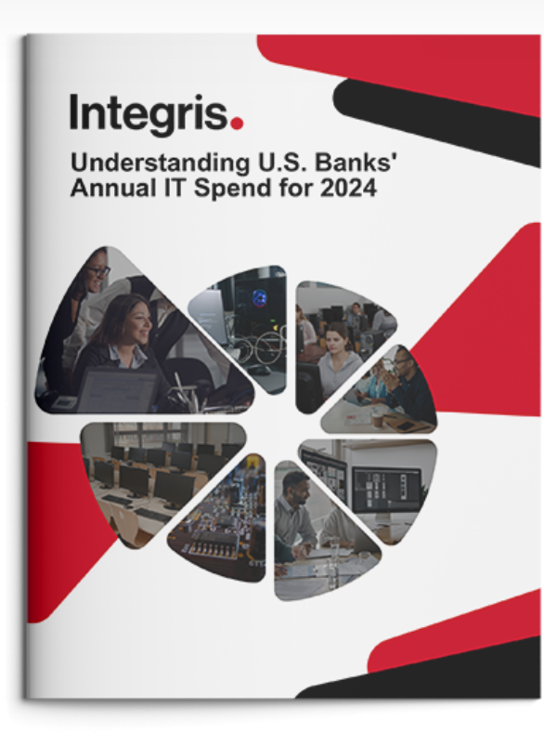
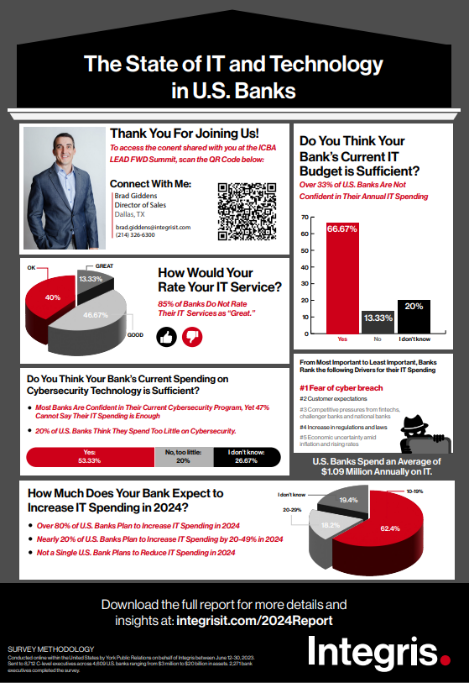
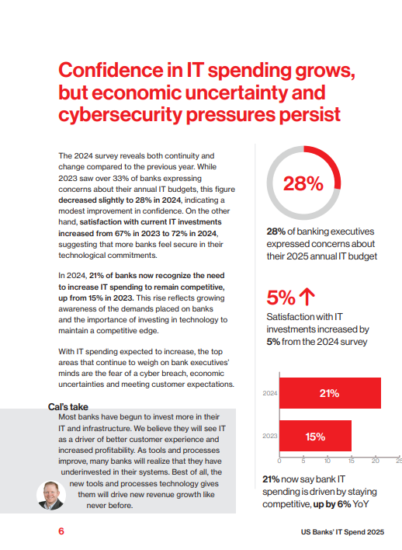
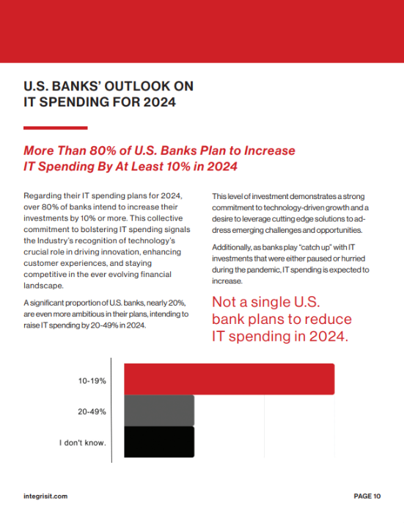
Thought Leadership – Reports / eBooks
Notes:
[Talking points]
These are the key elements in our Responsible IT Architecture framework that we assess.
[Speaker notes]
Network Firewall
Filter out emerging threats and handle all the traffic your systems can expect now, and in the future.
Backup Strategy
Meet your recovery time and point objectives (RTO/RPO), so your business never misses a beat during an outage or breach.
Internet Security & Content Filtering
Sophisticated enough to prevent your employees from navigating to suspicious websites or clicking on dangerous links.
Endpoint Protection
Using AI to learn each employee’s usage patterns, and flag anything that looks like a hack or takeover.
Security Awareness Training
Continuous end-user education and testing prepares your team to identify and respond to suspicious activity.
Least Privilege Access
Create layers of permissions, so only a strategic few get access to your most sensitive data.
Email Security
Monitor messages 24/7, so your organization is protected from phishing, malware, spam and more—before employees have the chance to click.
Multifactor Authentication
Employ a zero-trust architecture to continuously scan for imposters on your systems and ensure your employees/web users have secure access to your network, wherever they are.
Effective Patching
Ensure your system gets patched quickly, 24/7, so no vulnerabilities have time to turn into threats.
Updated Hardware & Software
So you’re never running tools or hardware that’s not under warranty and backed up by its manufacturers.

Slide 18
Event Involvement
90
25
Events attended in 2025. Including in-person events, socials, board meetings, tech committees, etc.
Speaking engagements in 2025. Webinars, in-person, with partners, etc.
Notes:
[Talking points]
These are the key elements in our Responsible IT Architecture framework that we assess.
[Speaker notes]
Network Firewall
Filter out emerging threats and handle all the traffic your systems can expect now, and in the future.
Backup Strategy
Meet your recovery time and point objectives (RTO/RPO), so your business never misses a beat during an outage or breach.
Internet Security & Content Filtering
Sophisticated enough to prevent your employees from navigating to suspicious websites or clicking on dangerous links.
Endpoint Protection
Using AI to learn each employee’s usage patterns, and flag anything that looks like a hack or takeover.
Security Awareness Training
Continuous end-user education and testing prepares your team to identify and respond to suspicious activity.
Least Privilege Access
Create layers of permissions, so only a strategic few get access to your most sensitive data.
Email Security
Monitor messages 24/7, so your organization is protected from phishing, malware, spam and more—before employees have the chance to click.
Multifactor Authentication
Employ a zero-trust architecture to continuously scan for imposters on your systems and ensure your employees/web users have secure access to your network, wherever they are.
Effective Patching
Ensure your system gets patched quickly, 24/7, so no vulnerabilities have time to turn into threats.
Updated Hardware & Software
So you’re never running tools or hardware that’s not under warranty and backed up by its manufacturers.

Slide 19

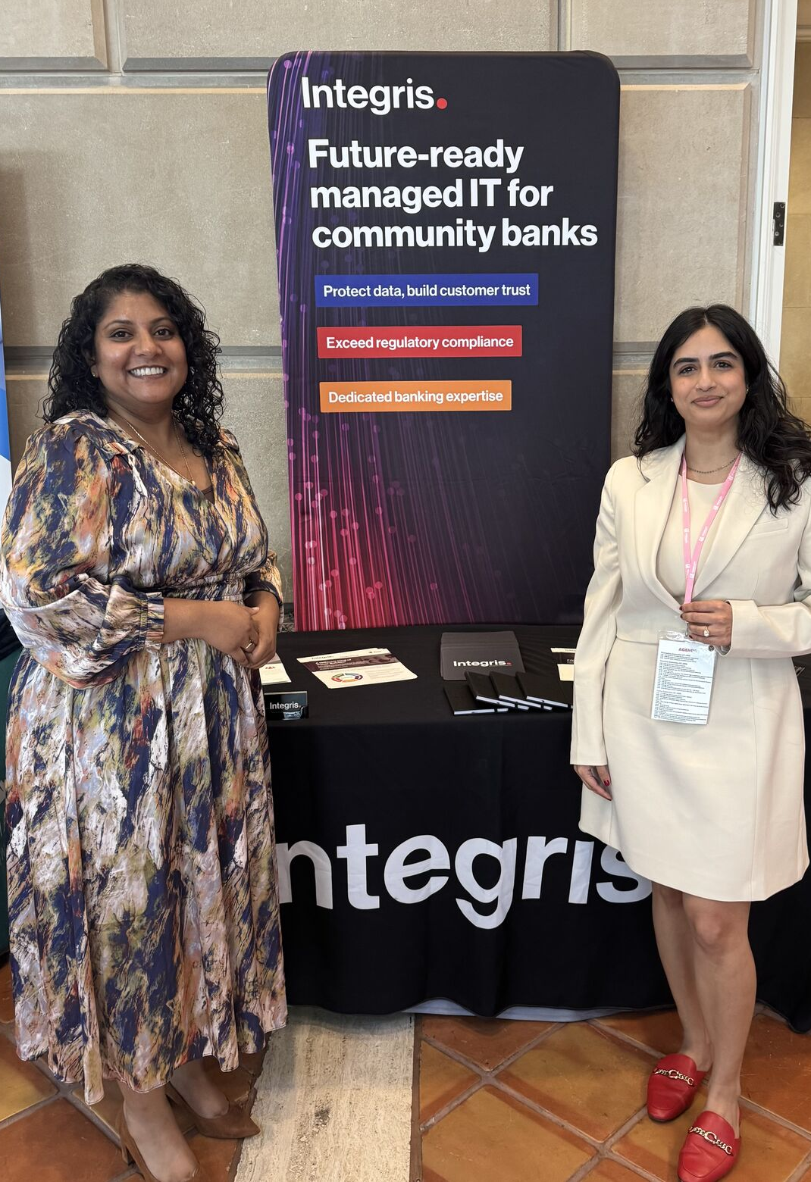
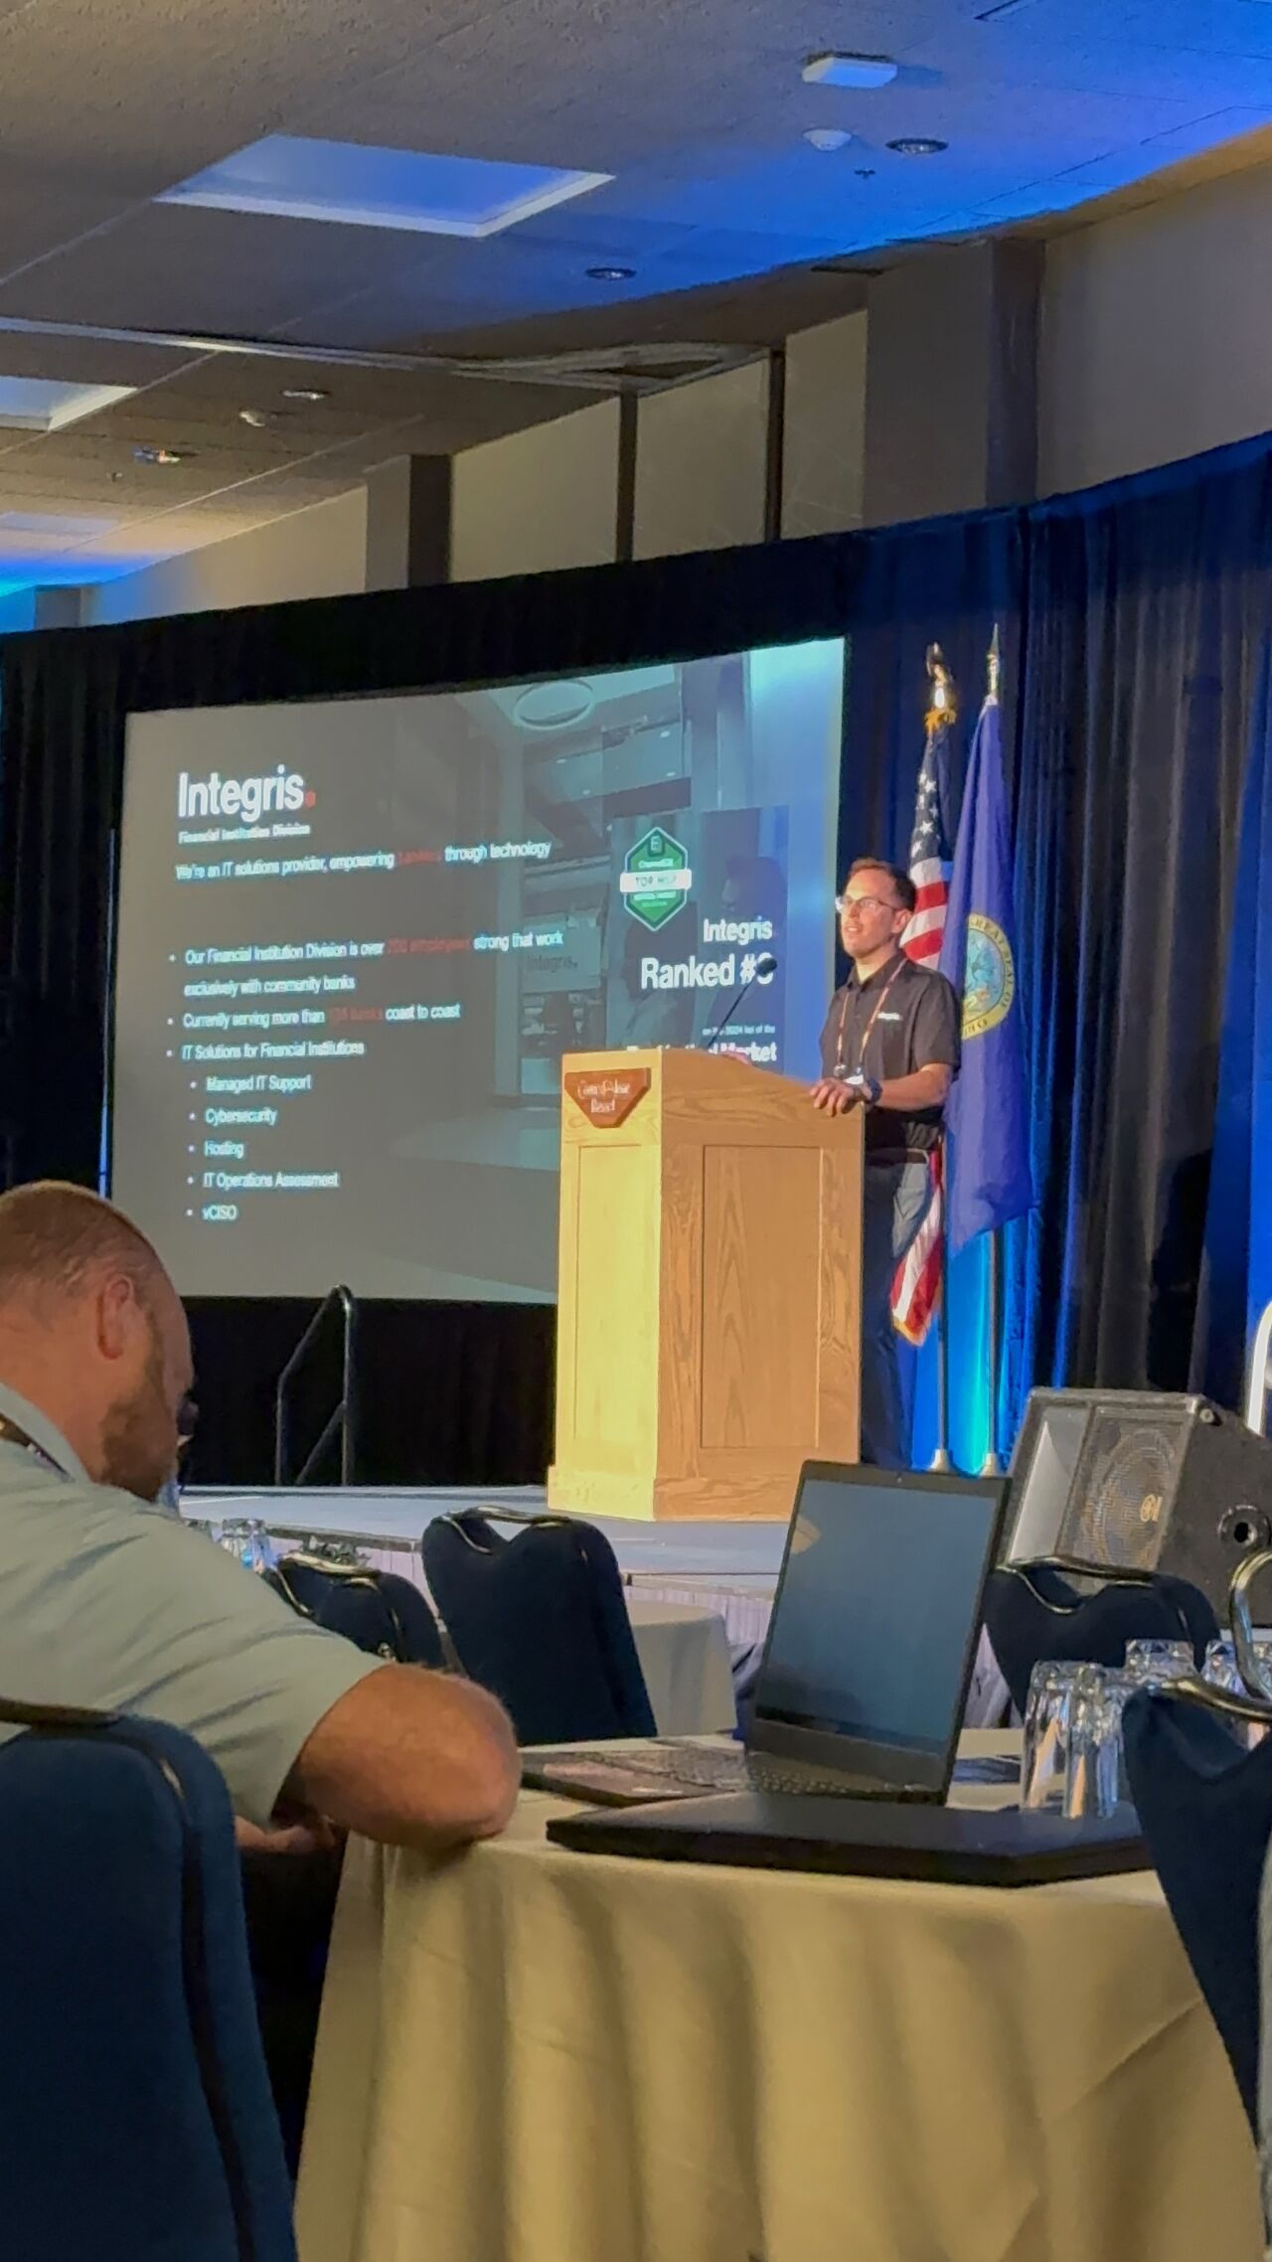
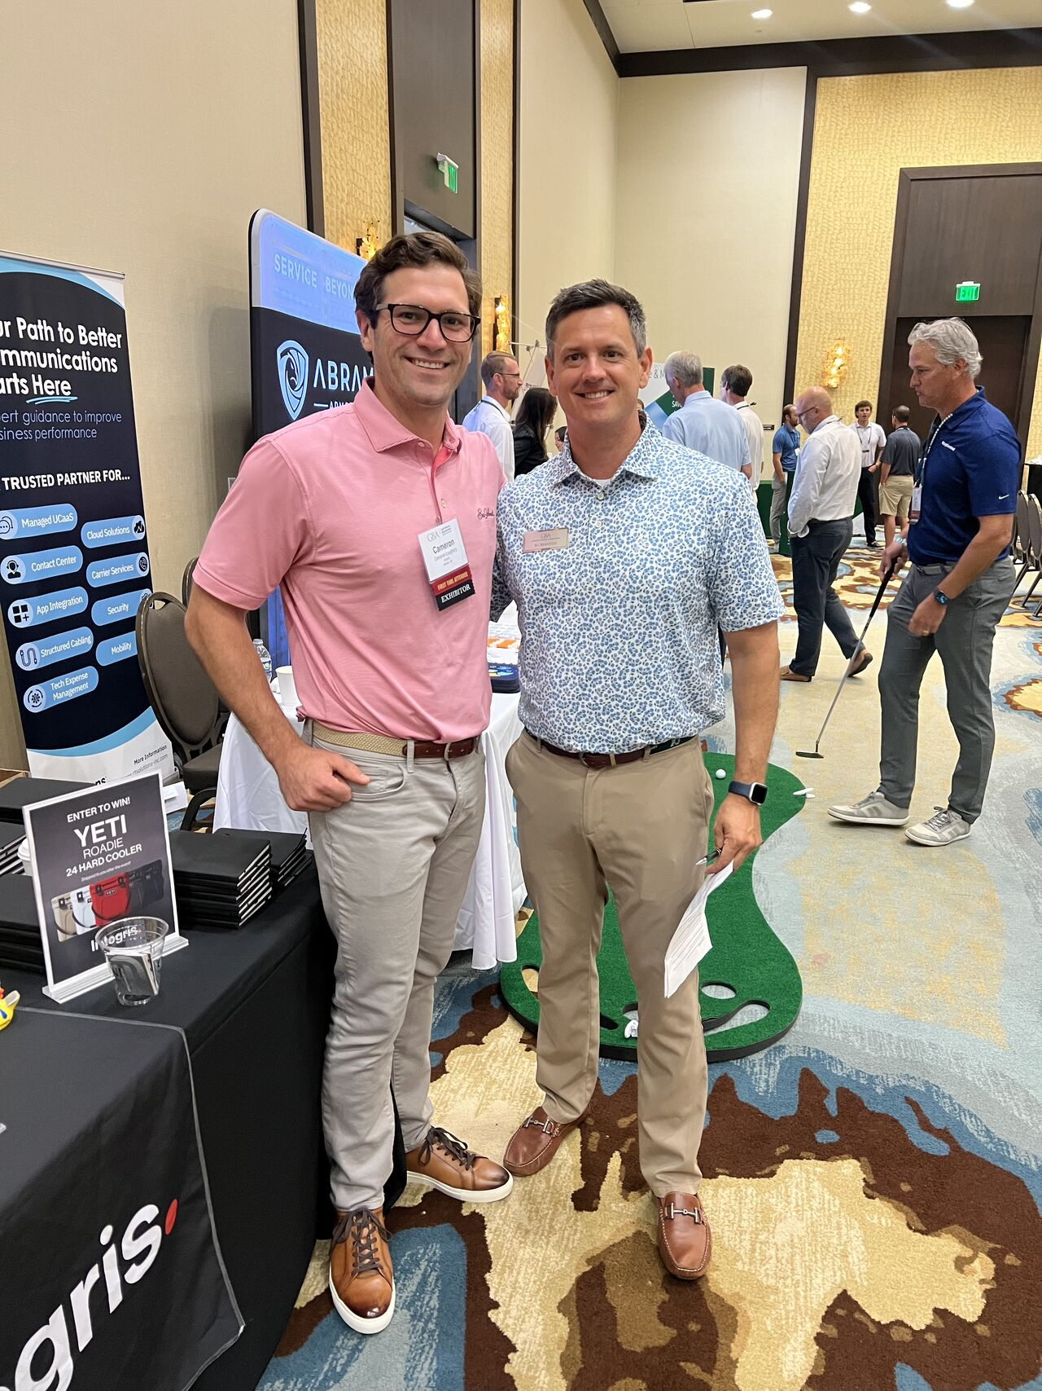
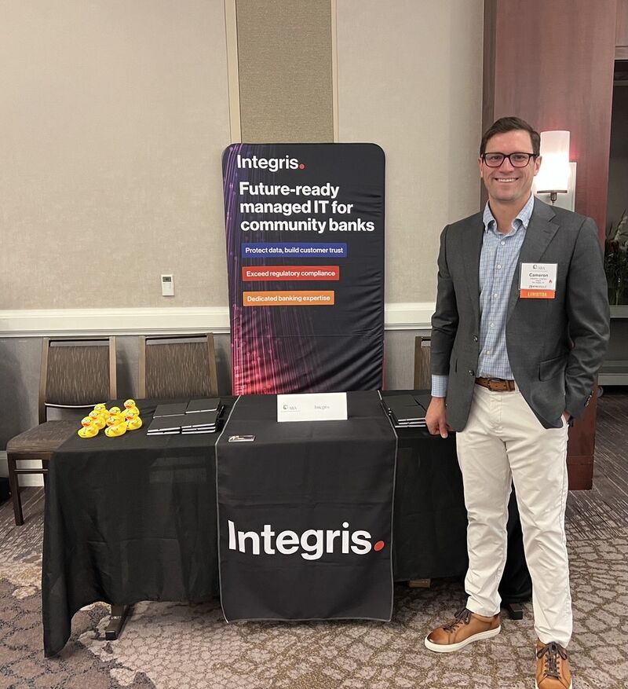
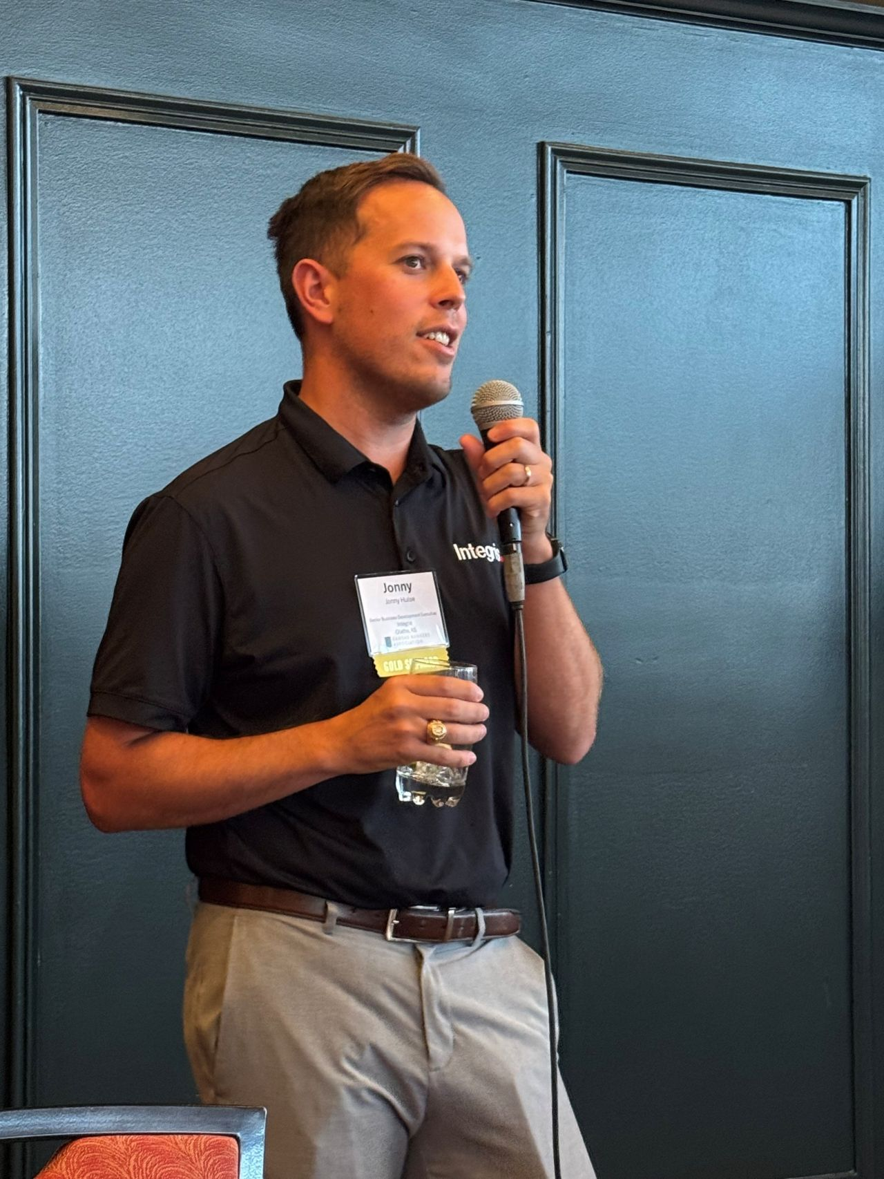
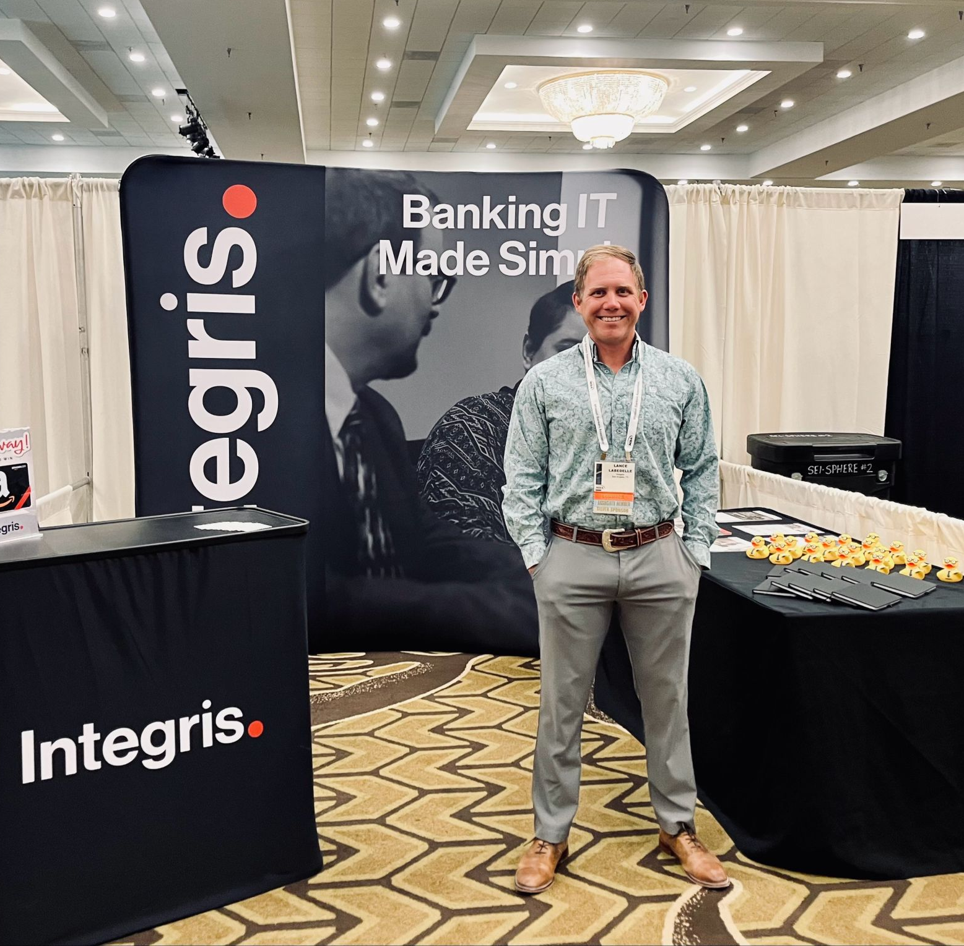
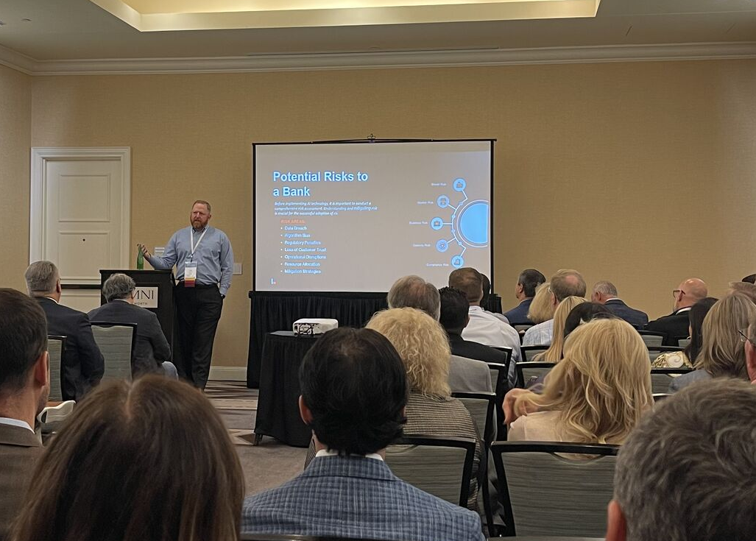
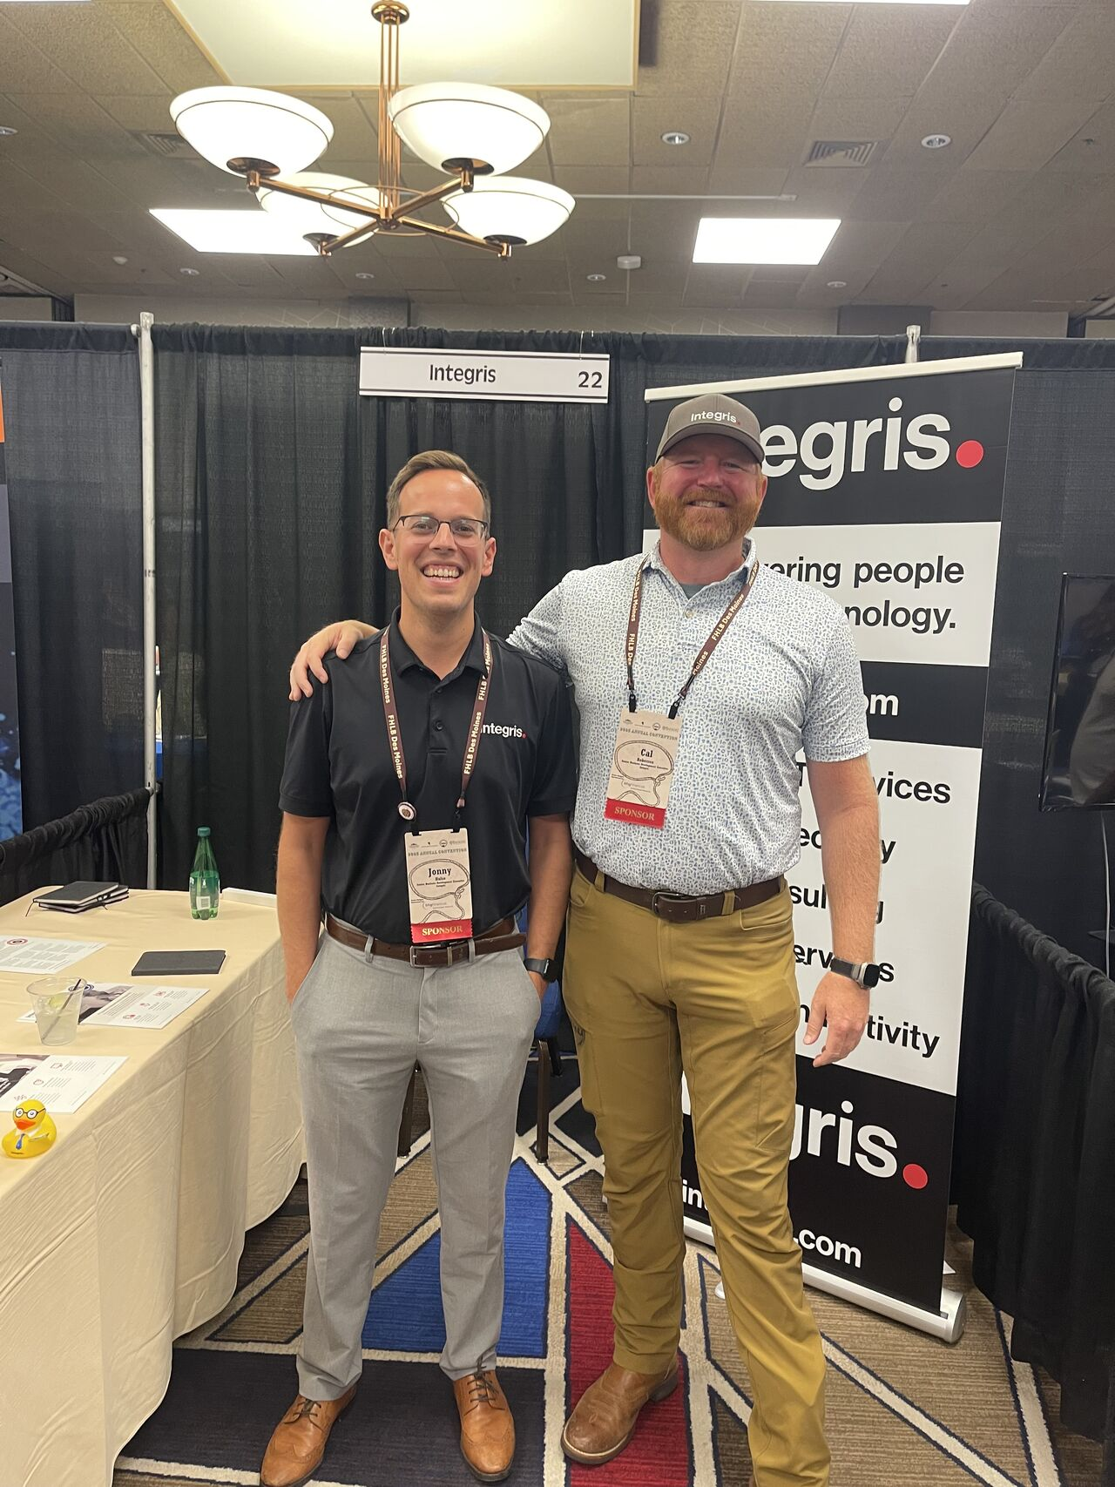
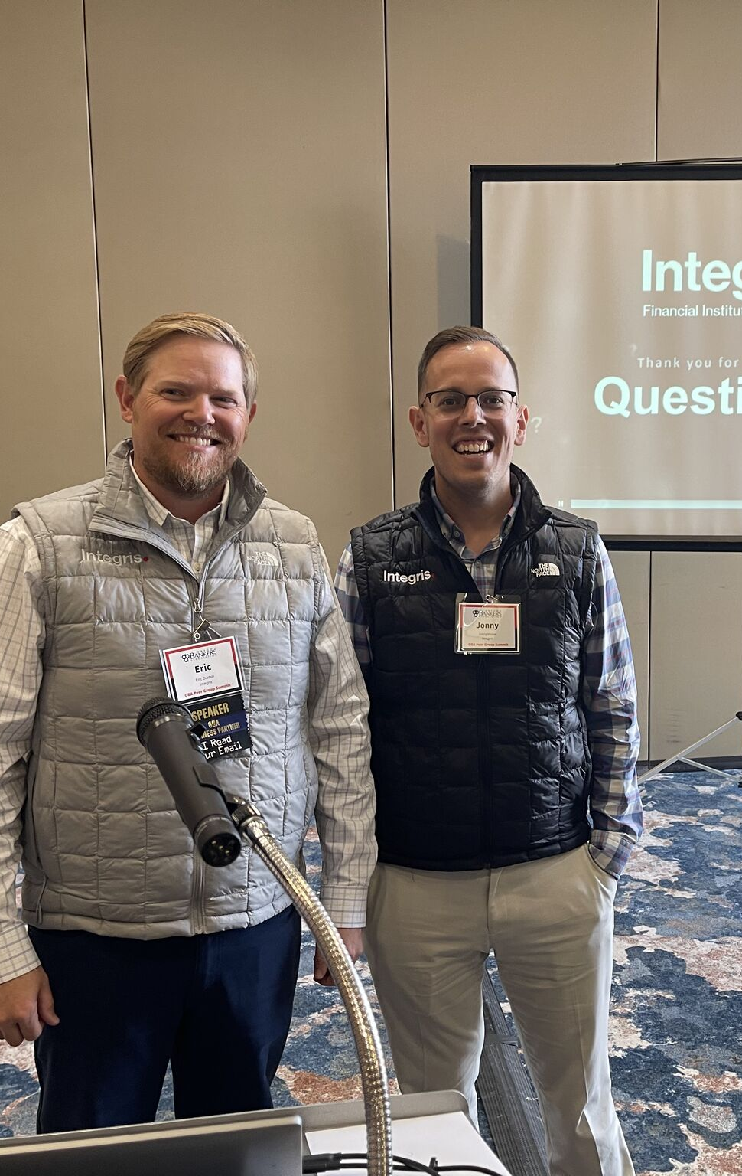
Thank You!
Notes:
[Talking points]
These are the key elements in our Responsible IT Architecture framework that we assess.
[Speaker notes]
Network Firewall
Filter out emerging threats and handle all the traffic your systems can expect now, and in the future.
Backup Strategy
Meet your recovery time and point objectives (RTO/RPO), so your business never misses a beat during an outage or breach.
Internet Security & Content Filtering
Sophisticated enough to prevent your employees from navigating to suspicious websites or clicking on dangerous links.
Endpoint Protection
Using AI to learn each employee’s usage patterns, and flag anything that looks like a hack or takeover.
Security Awareness Training
Continuous end-user education and testing prepares your team to identify and respond to suspicious activity.
Least Privilege Access
Create layers of permissions, so only a strategic few get access to your most sensitive data.
Email Security
Monitor messages 24/7, so your organization is protected from phishing, malware, spam and more—before employees have the chance to click.
Multifactor Authentication
Employ a zero-trust architecture to continuously scan for imposters on your systems and ensure your employees/web users have secure access to your network, wherever they are.
Effective Patching
Ensure your system gets patched quickly, 24/7, so no vulnerabilities have time to turn into threats.
Updated Hardware & Software
So you’re never running tools or hardware that’s not under warranty and backed up by its manufacturers.

