Slide 1
SBA Forum- Empyrean Solutions
Jillian Daniels- Sales Executive
Notes:
Hi Everyone, Thank you for allowing us the time to speak about who Empyrean is and how we can benefit partnering with you and your State Banking Association

Slide 2


Introductions
I lead our event coordination efforts at Empyrean, supporting the sales and marketing team with conferences, sponsorships and other related events.
I am a part of the Community Bank Sales team where I’m dedicated to serving banks and credit unions with assets up to $1 billion. Prior to Empyrean Solutions, I worked for a competitor but started my career in public accounting.
Jillian Daniels
Andrea Chilczuk
Sales Executive,
Community Banking Market
Event Coordinator
Notes:
For a quick introduction..
My name Jill Daniels and I am a sales executive here at Empyrean. I have been with the company for 2 years and prior to Empyrean I was with a competitor but started my career in public accounting. At Empyrean I focus on institutions under a billion in assets, we also have teams covering the $1-4 space and $4 and up.
With me, i have Andrea Chilczuk, she leads our event planning and coordination efforts. She is the one that facilitates all the details and coordination of each event working with many of SBA’s currently on sponsorship and other related event items.

Slide 3


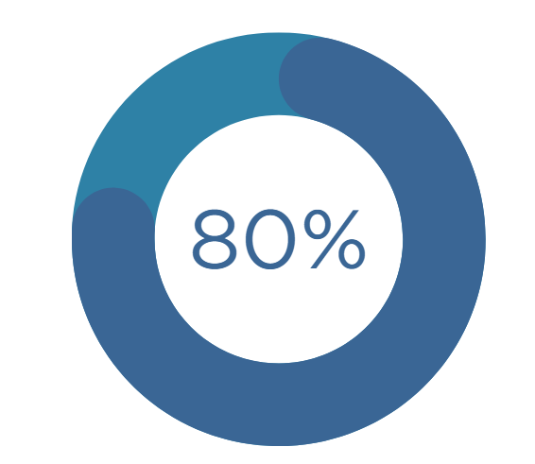


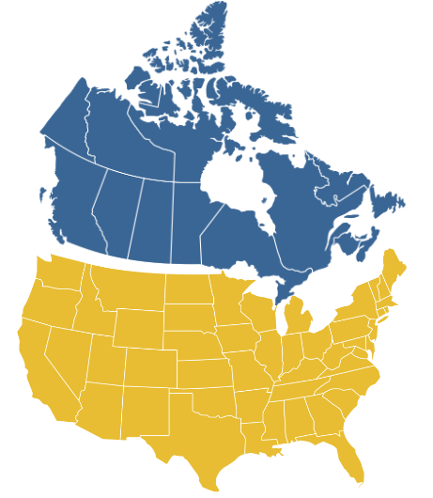

320+
Empyrean Clients
2008
Founded
150+ EMPLOYEES
150+
banks & credit unions chose Empyrean in 2023 & 2024
staff dedicated to product development, implementation & support
Market Leader in Financial Risk & Performance Management Solutions for the
Banking Industry
100% dedicated to risk & performance management for financial institutions
800+
financial institutions leverage the Empyrean ALM Model
52
150+
Performance Management customers since release in 2022/2023
states & provinces throughout USA and Canada
Notes:
Im going to keep this high level when it comes to our products, but I first wanted to cover who Empyrean is.
Although some of you may not have heard of Empyrean, we’ve actually been around since 2008. We first cut our teeth in the industry with our Asset Liability Management solution which was servicing larger banks. From there through acquisition and building upon our solution suite we have grown to over 150 employees and 320 clients.
Out of that 150 employees, we are proud that 80% of our team is focused on development, implementation, and ongoing support—and none of that is outsourced. This gives us full control over the quality of our solutions and the overall client experience.
We’re also unique in that 320 clients, 100% of them are dedicated to the financial services industry AND focused solely on financial risk and performance management. We feel that focusing on this niche allows us to deliver best-in-class tools for banks and credit unions.
In addition to our software clients, youll see the 800+ institutions leverage the Empyrean model, we work directly with firms such as Raymond James, FHN Baker Group, they leverage the Empyrean model to deliver Outsource ALM to their clients.

Slide 4

WHO WE SERVE
Empyrean equips finance leaders with modern, powerful tools for their Budgeting, ALM and Profitability needs. Whether it is the CFO, Controller, VP of Finance, Accountant etc, our tools will allow them to analyze and plan with their data in an efficient way, providing them more time to make strategic decisions.
Notes:
In the slide before I said we focus on banks and credit unions, however within each organization we are focused on the office of the CFO
Empyrean equips finance teams with modern, powerful tools for their Budgeting, ALM and Profitability needs. Whether it is the CFO, Controller, VP of Finance, Accountant etc, our tools will allow them to analyze and plan with their data in an efficient way, providing them more time to make strategic decisions.

Slide 5










EMPYREAN RISK & PERFORMANCE SOLUTIONS
FINANCIAL RISK MANAGEMENT
- Asset Liability Management
- Liquidity Stress Testing
- Capital Management & Stress Testing
- Expected Credit Loss (ECL)
- Funds Transfer Pricing (FTP)
FINANCIAL
RISK MANAGEMENT
FINANCIAL PERFORMANCE MANAGEMENT
- Budgeting & Planning
- Profitability Measurement & Analysis
- Funds Transfer Pricing (FTP)
Shared Data,
Assumptions,
Engines & Results
FINANCIAL ANALYTICS & REPORTING
FINANCIAL ANALYTICS & REPORTING
FINANCIAL
PERFORMANCE
MANAGEMENT
Portfolio Analytics (Deposits)
Portfolio Analytics (Loans)*
CECL*
BI Analytics (persona-based)*
* In Development
Notes:
Now for how we serve them; I mentioned financial performance and risk management solutions, which you may be questioning what that means, so I wanted to give a visual of our solution suite.
Our Financial Risk Management is the top which encompasses our Asset Liability Management Solution- banks need a model for regulatory purposes but also to manage interest rate risk. Which is what the ALM engine does. Within this solution, you can add on other modules.
Our Financial Performance Management solutions include our Budgeting & Planning and Profitability Solutions. Budgeting im sure is a more familiar word than Asset Liability Management, but again banks use our budgeting tools to plan their annual budget and reforecast or report against it. For Profitability our solution can drill downt o see how profitable a client, product or branch can be.
All of our solutions come with a financial analytics and reporting tool embedded into the software where we have over 100 standard reports or the option to build their own.
I have it broken out, but a advantage to empyrean is al of these solutions sit upon a single “datamart” we refer to as dataverse allowing for an easier user experience and a lot of time saved by only needing to upload data to one place and being used in multiple ways and even share assumptions and results between the solutions.
Lastly- due to our employee concentration being in development and support, we have a few more solutions currently in production we have heard from our clients as being a need.

Slide 6
COMPETITIVE ADVANTAGE
Focused investment – This is our niche. While core providers spread investment across multiple business units, Empyrean is laser-focused on financial risk and performance management solutions.
Integrated ALM & Budgeting (including outsourced) – Very few vendors integrate ALM and budgeting, and we’re the only one offering true integration with outsourced ALM—ideal for smaller institutions without the resources to run ALM in-house.
Purpose-Built for Banks & Credit Unions – Unlike generic platforms, our software is designed specifically for financial institutions, aligning with their structures, processes, and regulatory needs.
Proven Excel & Legacy Replacement – We most often displace outdated legacy systems or spreadsheets, providing a modern, cloud-based solution that delivers accuracy, efficiency, and scalability.
Notes:
That is as far as im going to go on our products, Next, I’m going to share what makes us unique in this market….
1. Focused Investment This is our niche, so we’re not trying to be everything to everyone. I can speak to this from my previous employer where development dollars were spread across a lot of different lines of business, health care, higher end , financial insitutins, while here, every dollar we spend goes into making these solutions better for our clients.
2. True ALM & Budgeting Integration We’re one of a few vendors offering integrated ALM and budgeting but we’re the only one that integrates budgeting with our outsourced ALM offering. That’s a game-changer for institutions that want to leverage the benefits of the integration but aren’t able to take on the heavy lift of running their own model. Given I work with smaller institutions this allows them to make more strategic decisions rather than just checking the box for regulators.
3. Purpose-Built for Financial Institutions Unlike generic platforms that try to serve every industry, our platform was built specifically for banks and credit unions from day one by people that worked in the insdustry. It’s designed to align with the unique structures, processes, and regulatory requirements of financial institutions.
4. A go-to for replacing Excel and legacy software: but the cool thing is that our solutions are also built to scale with our clients…so if they grow or their needs change over time, they’re not going to outgrow us and need to move to another vendor. So, our solutions are designed to be easy to use for the smaller institutions but can also address the more complex needs of larger institutions. That’s why we have clients under $100M to over $200B all leveraging the same platform.

Slide 7










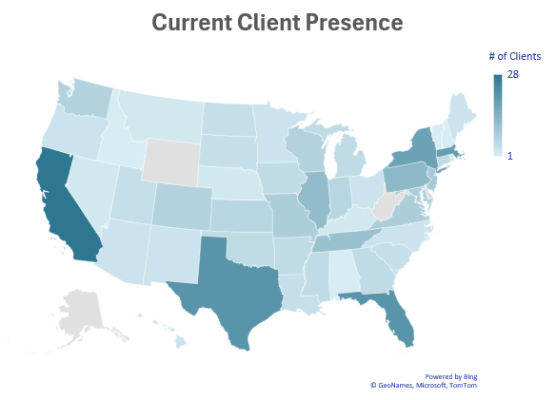
CURRENT SBA PARTNERHIPS
Notes:
On the left you will see the state banking associations that we are currently partenered with. I included ICBA as I know they do a lot with state banking associations
But on the right I wanted to show a heat map of where our clients are all located to uncover some potential states where we are present but not apart of the SBA yet

Slide 8
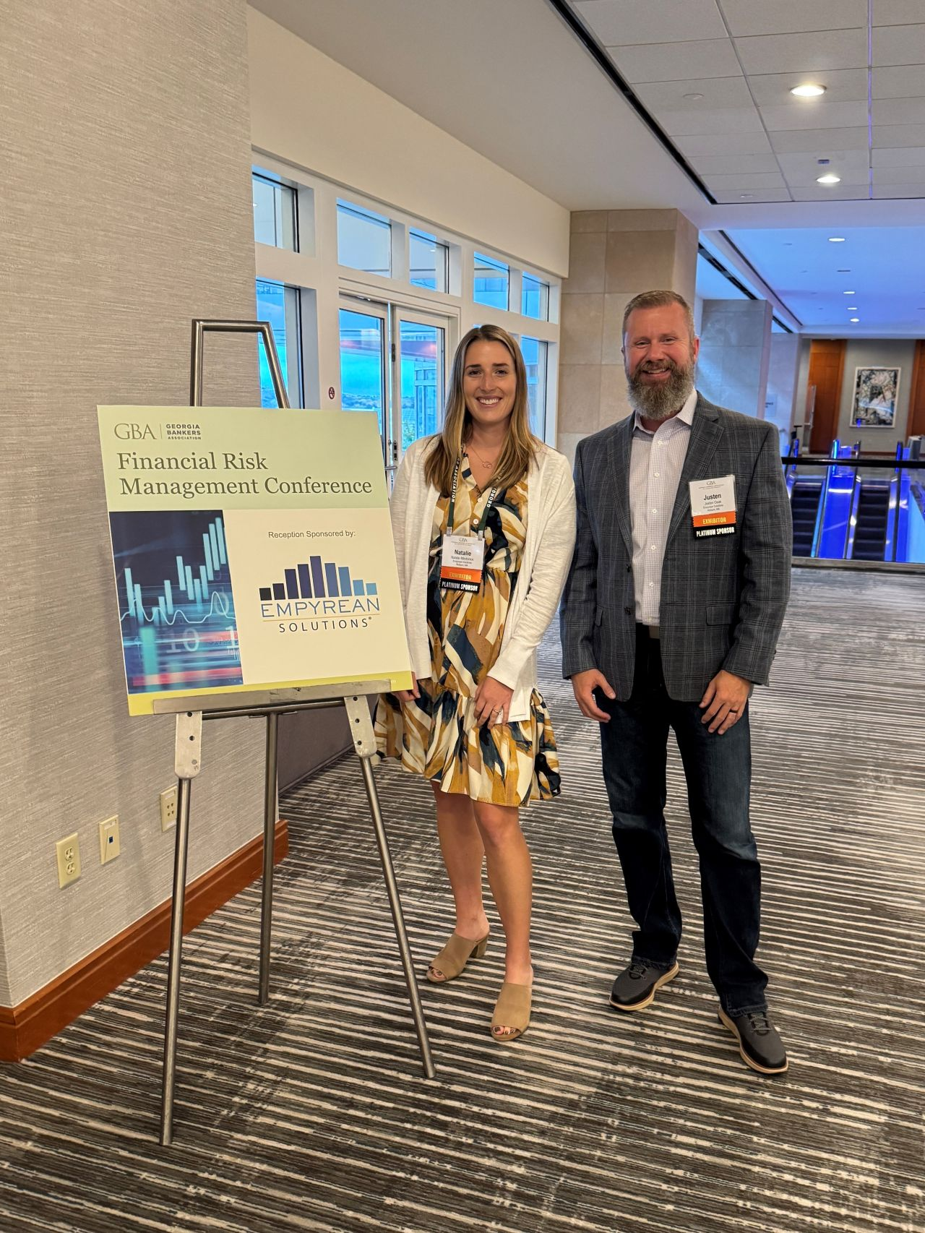
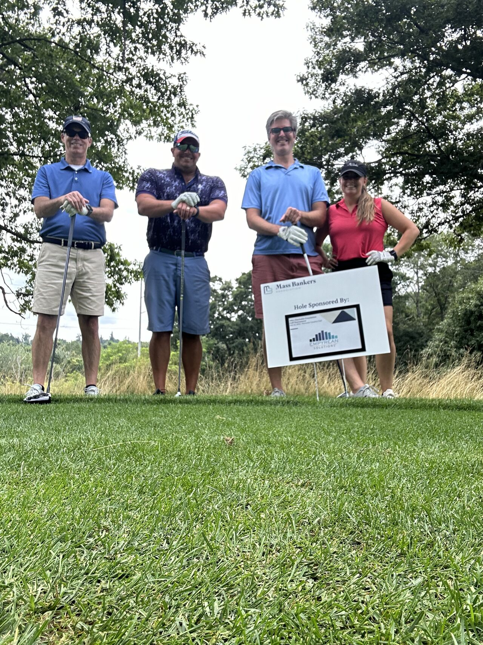

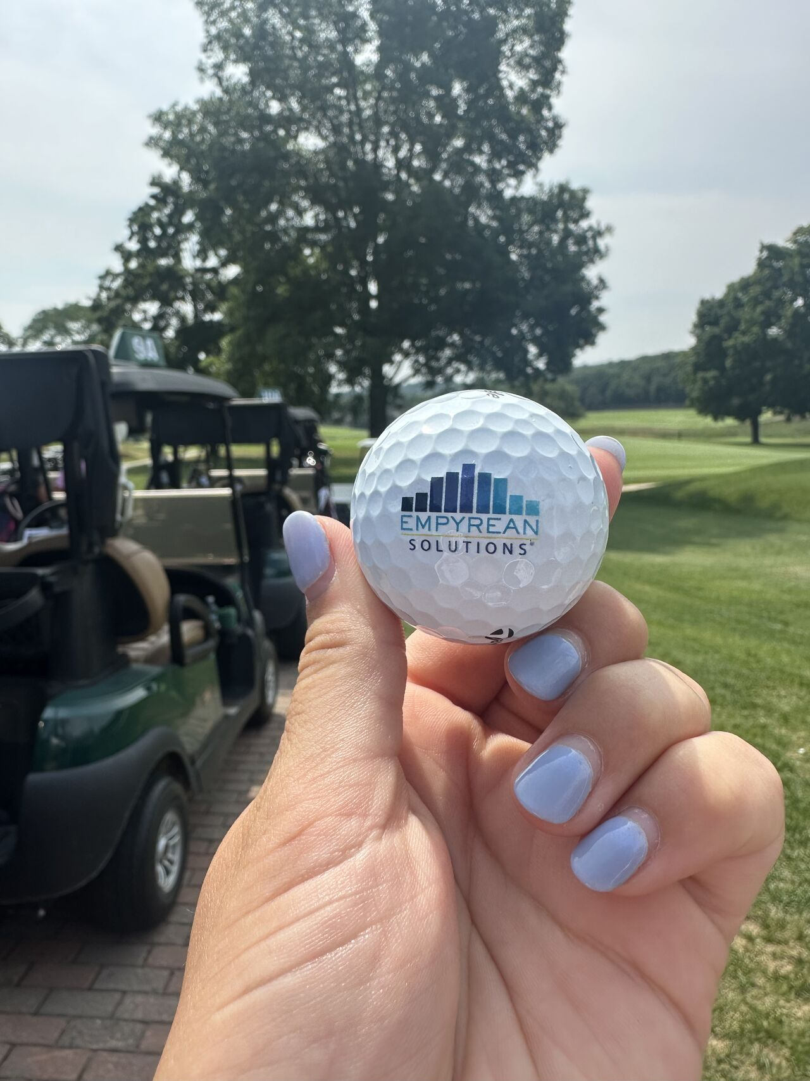
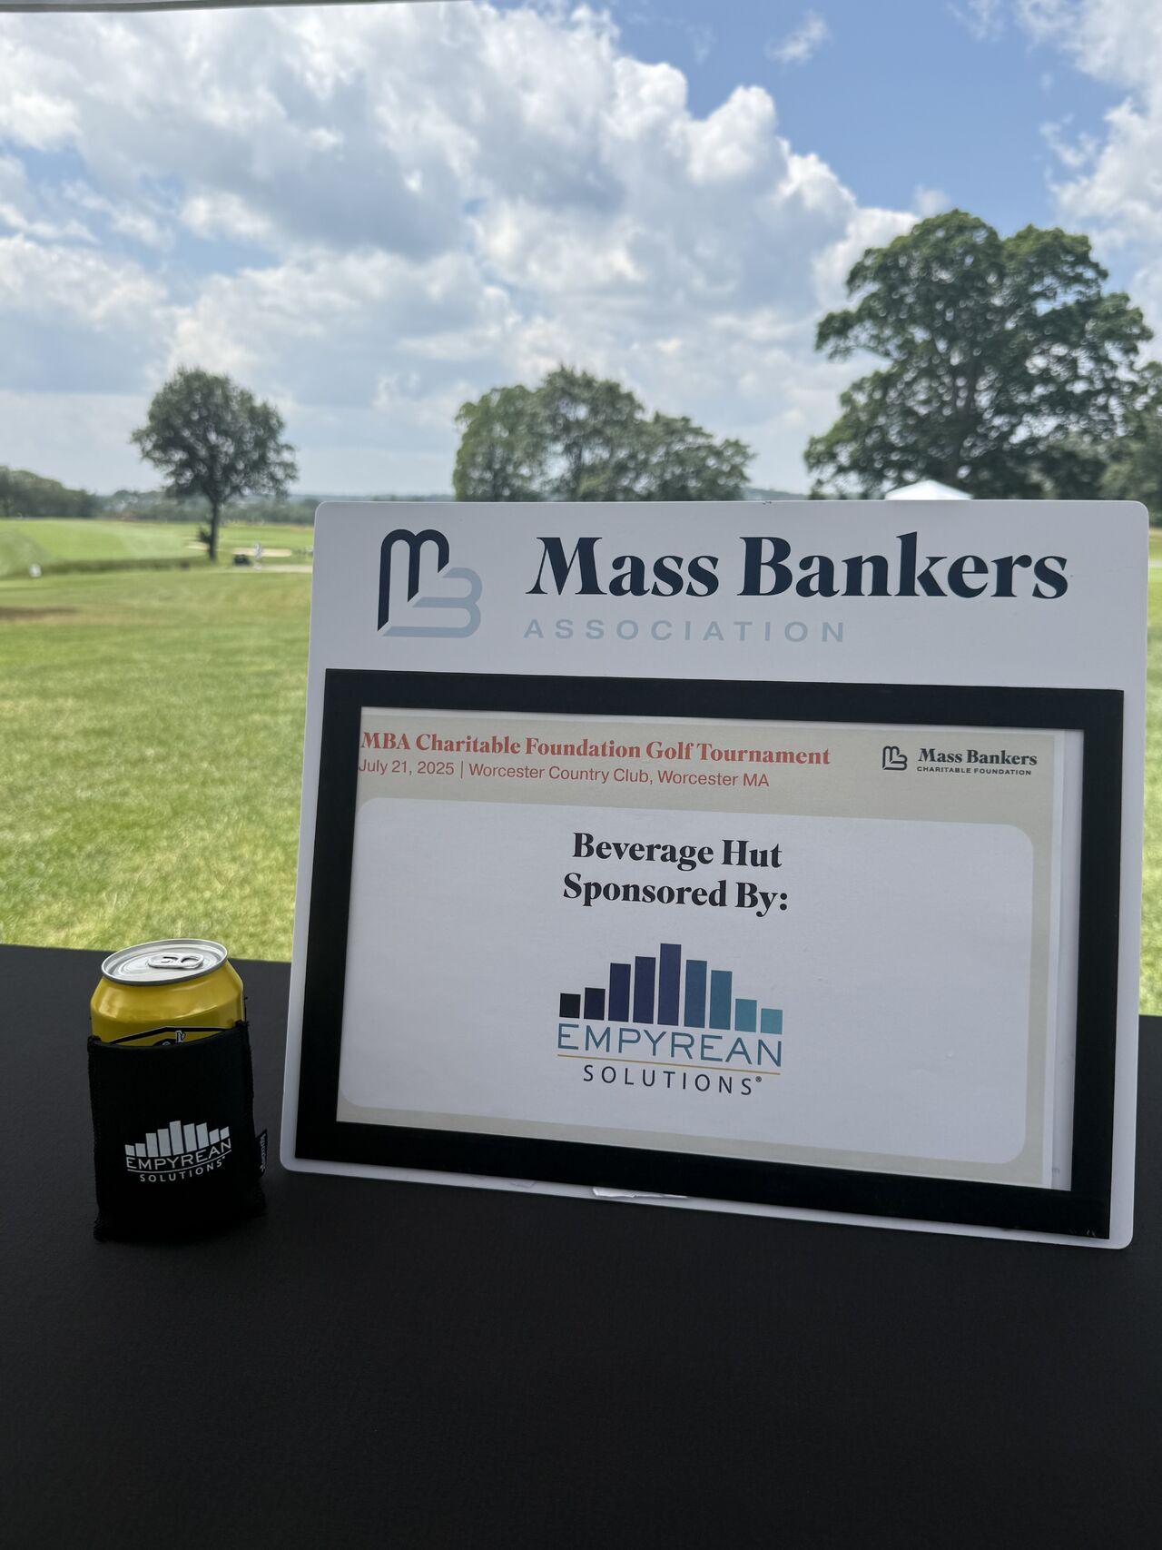
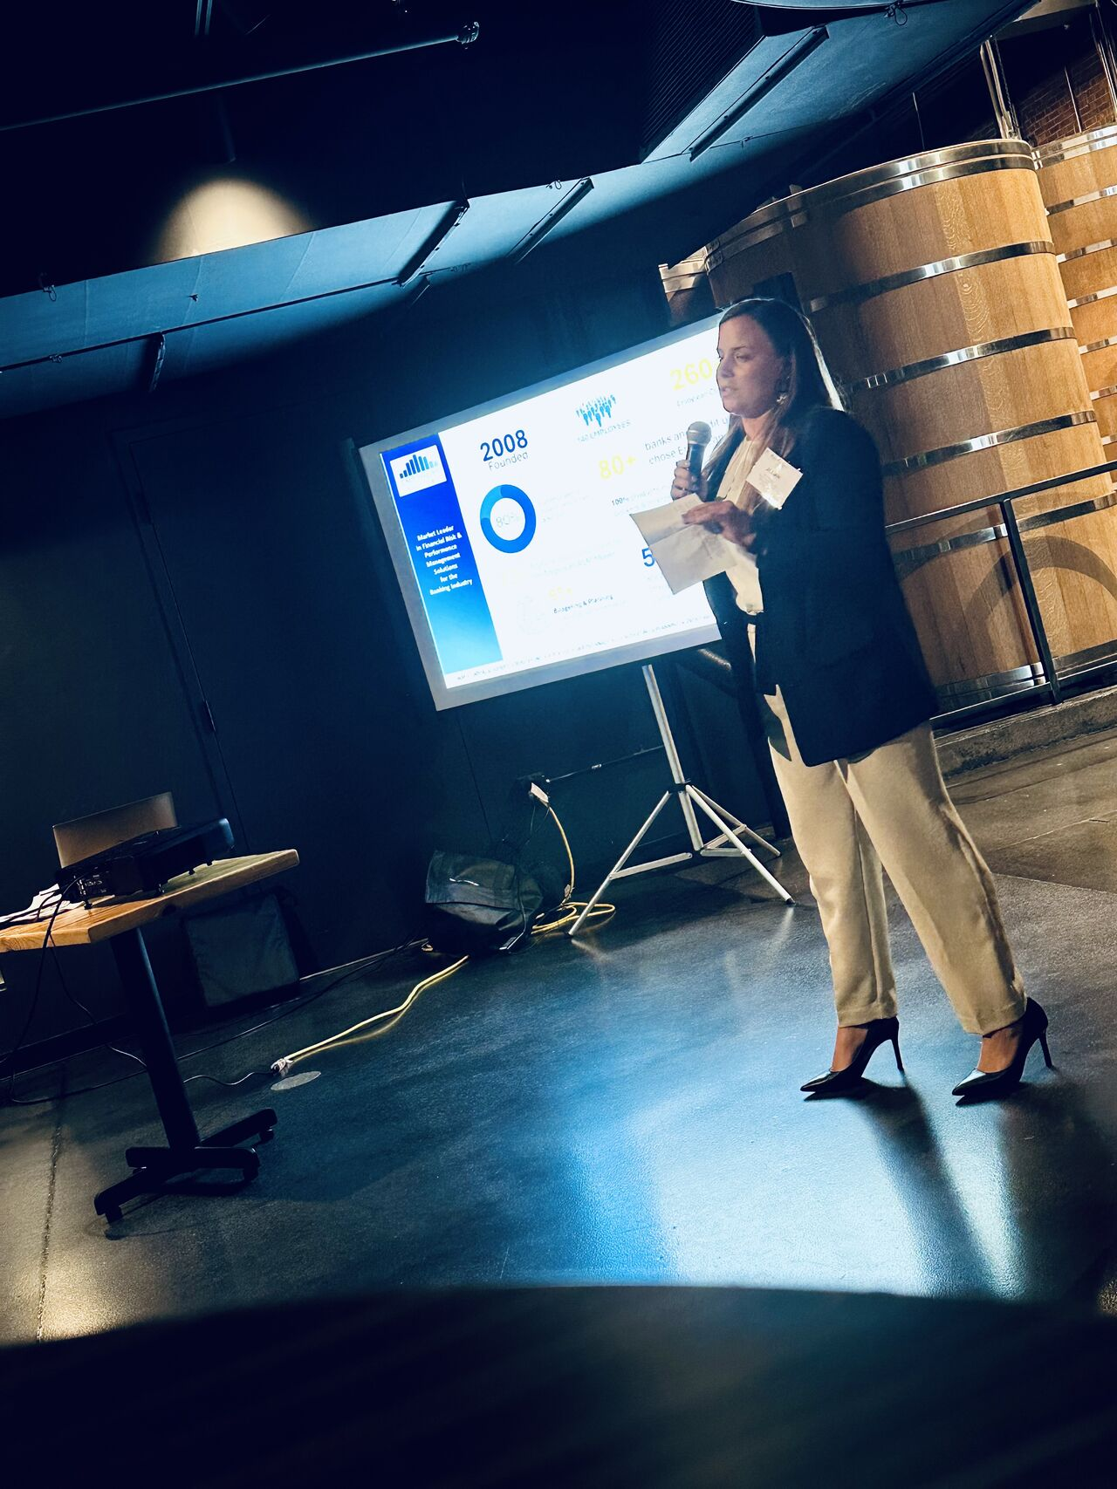
SUCCESS WITH SBA’S
Sponsorships- Across all partnerships; we have sponsored conferences, golf tournaments, pickleball tournaments, and various other outings etc.
Speaking Engagements- Across all partnerships; we have hosted multiple webinars along side an SBA and had various talking tracks at conferences or outings
Thought Leadership- Some SBA’s send out quarterly or monthly newsletters, Empyrean has been able to have a spot on these providing thought leadership articles
Notes:
This is to show our success with our current SBA partners, but also to talk how can we help eachother.
At Empyrean, we love to be involved. Whether is be conferences, golf tournaments, pickleball tournaments, you name it we want to be there.
I am going to pick on Mass Bankers a little because I am heavily involved with them. They do a great job of partnering with us to help us reach banks and getting our name out there. Within the last 2 years
-We have had a spot on their newsletter that they send out
-They promoted an article we had released focusing on one of our products
-Was a sponsored at both of their Annual Conferences -Sponsored their golf tournaments
-They have a separate group for their emerging leaders which i find helpful being a young professional and have done a speaking engagement there
-We are currently working to get on their webinar cadences.
That’s just mass bankers- you will also see in the pictures the team at other SBA events.
This is all to say; we want a true partnership with more State Banking Associations. We want to be apart of more than just the annual conference and grow the relationship with you all!

Slide 9
THANK YOU!
Notes:
Again I want to say thank you for giving us this time! Id love to learn more about the associations here and how get more involved so please connect with me after if you think it may be a good fit!

