Slide 1

2025 SBA for Profit Meeting Sponsor Presentation
Sandy Schartman, CEO and Co-Founder
Jim Schartman, President and Co-Founder
Greg Baitt, Executive Vice President and COO

Slide 2
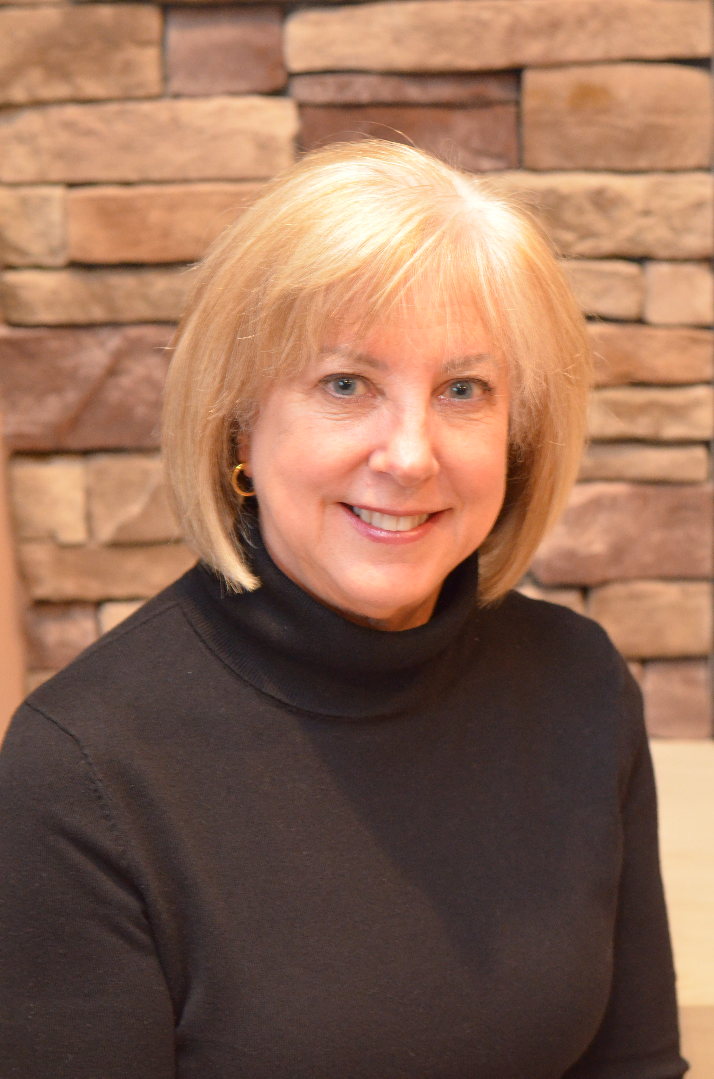
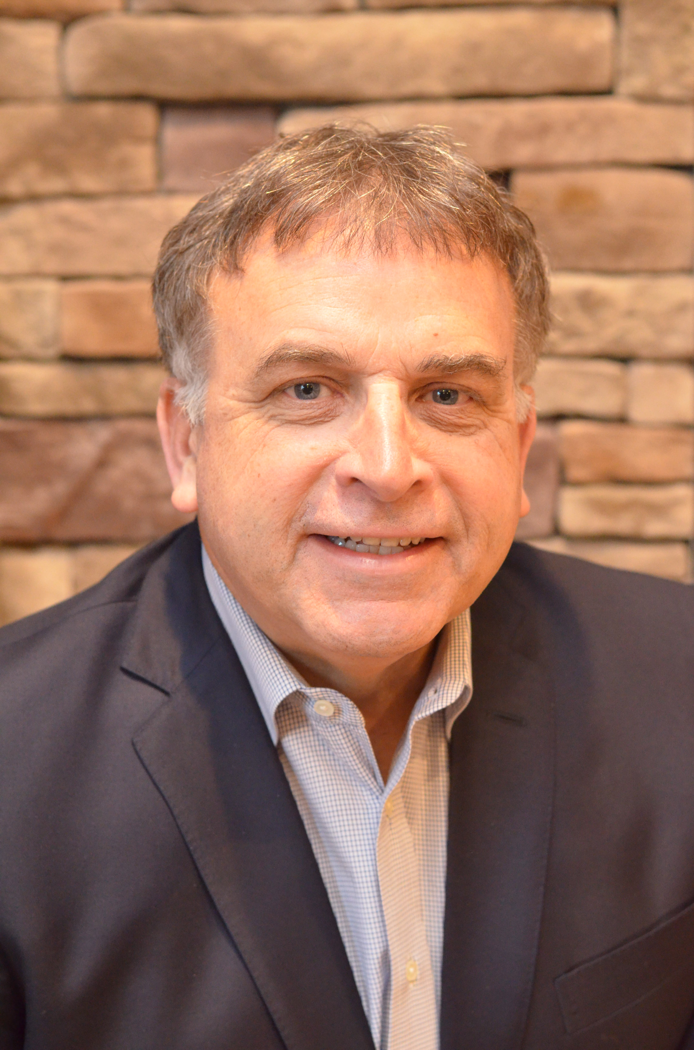
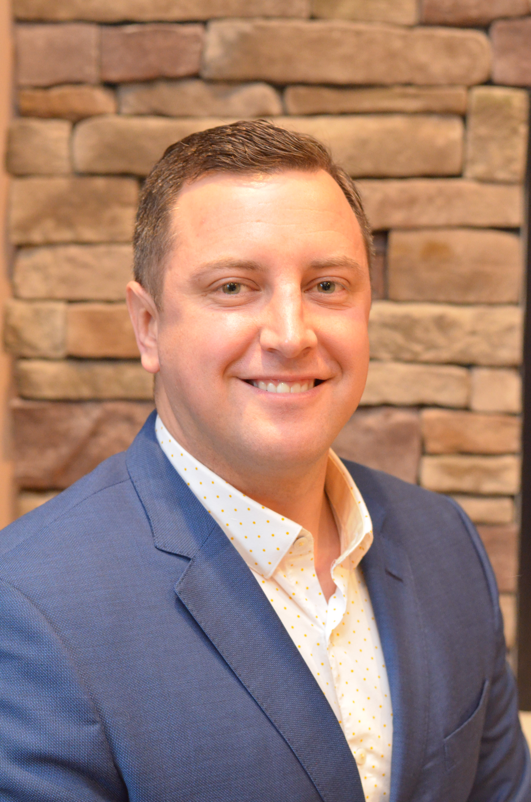
Our Guiding Principles
Always provide an outstanding client experience
Deliver a much larger financial benefit than our clients would typically expect
Treat all parties in a respectful and professional manner and build win-win outcomes
Save our clients time by completing all related work
Always protect our client’s positive vendor relationship
Sandy Schartman
CEO & Co-Founder
216.396.1742
Sandy.Schartman@checkprintingconsulting.org
Jim Schartman
President & Co-Founder
216.970.0105
Jim.Schartman@checkprintingconsulting.org
Greg Baitt
Executive Vice President & COO
216.396.0225
Greg.Baitt@checkprintingconsulting.org

Slide 3
How we help a bank?
We greatly reduce costs/increase income for the bank’s check printing program. About 95% of our clients choose to remain with their current vendor.
No work, no changes, no risk – we do all the work, our clients don’t have to make any changes, and if we don’t save them money, we don’t get paid.
Typical profit increases/savings are tied to the bank’s checking accounts:
Bank with 35,000 accounts - Five year total savings $500,000 or more
Bank with 70,000 accounts - Five year total savings $1,000,000 or more
Bank with 140,000 accounts - Five year total savings $2,000,000 or more

Slide 4
Product/Service Details
We can help any bank that has at least 12,000 checking accounts.
NO out of pocket cost to our clients. Average savings that we negotiate is over 40%.
The key in check printing is what the vendors do NOT tell you about and leave OUT of their contracts.
Our consulting fee is a percentage of negotiated savings. We never invoice a client until the bank receives a cash payment from the check vendor that exceeds our fee.
We maintain excellent relationships with the executives at both major check vendors, Deluxe and Vericast/Harland Clarke. We build win-win check programs and contracts.
About 95% of our clients choose to stay with their current vendor. They enjoy tremendous profit increases with no other changes. Many clients double or triple their check program fee income without raising fees.

Slide 5

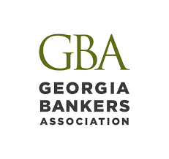
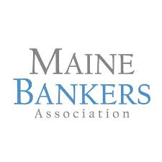
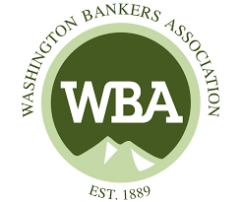
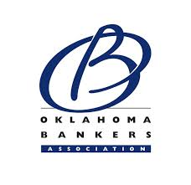
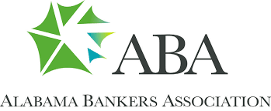


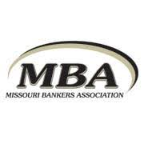
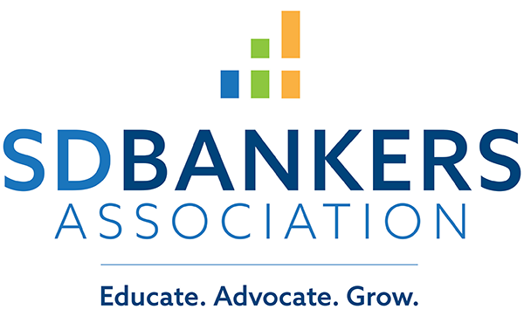



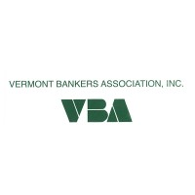
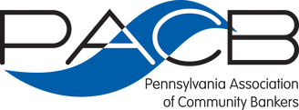
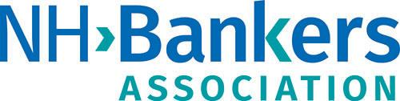
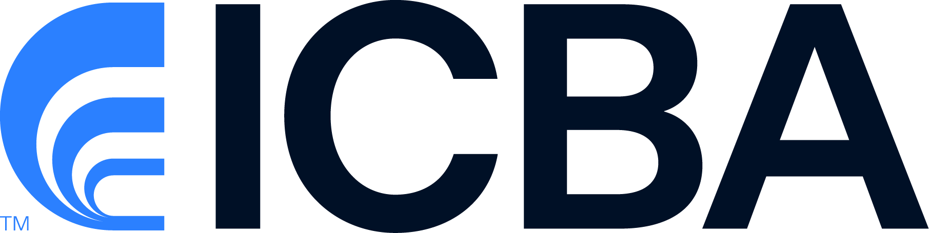
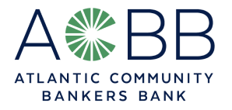
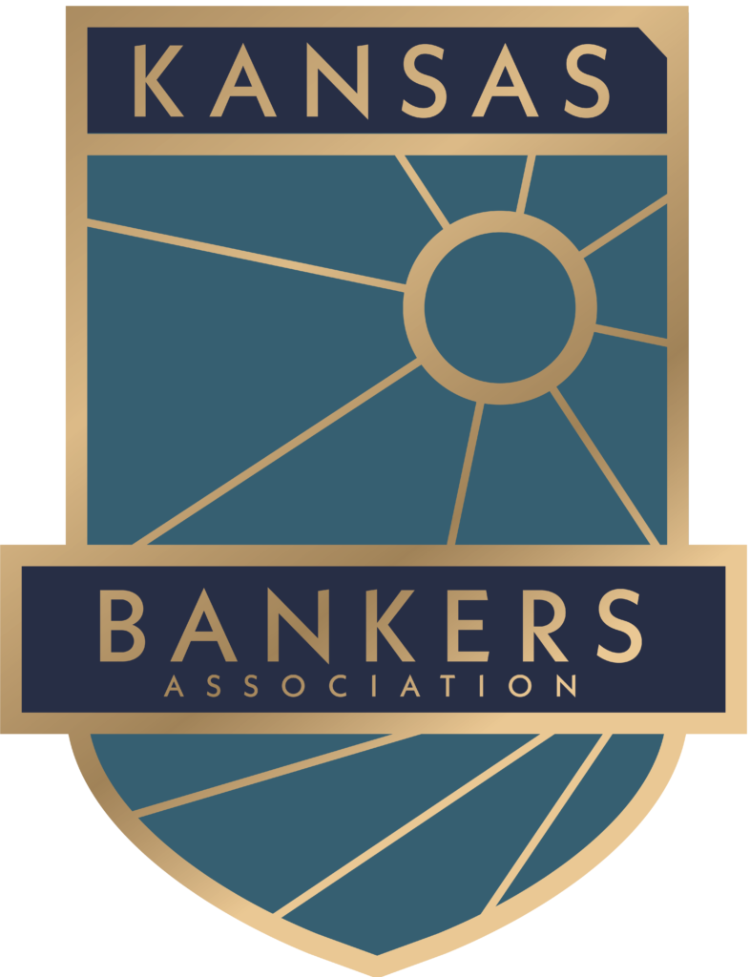
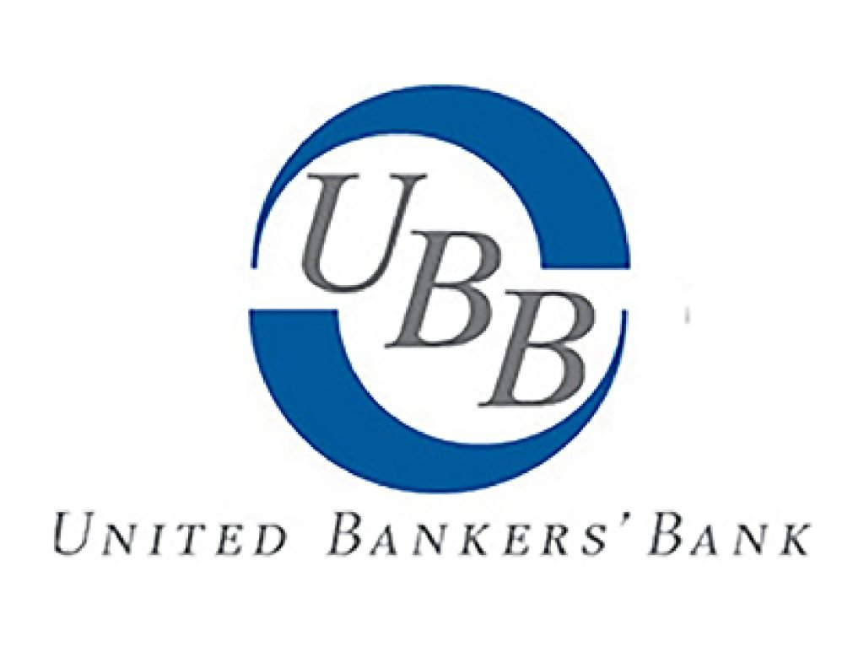



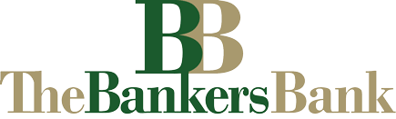
Endorsed by:
What you don’t know… will hurt you and your bottom line!

Slide 6
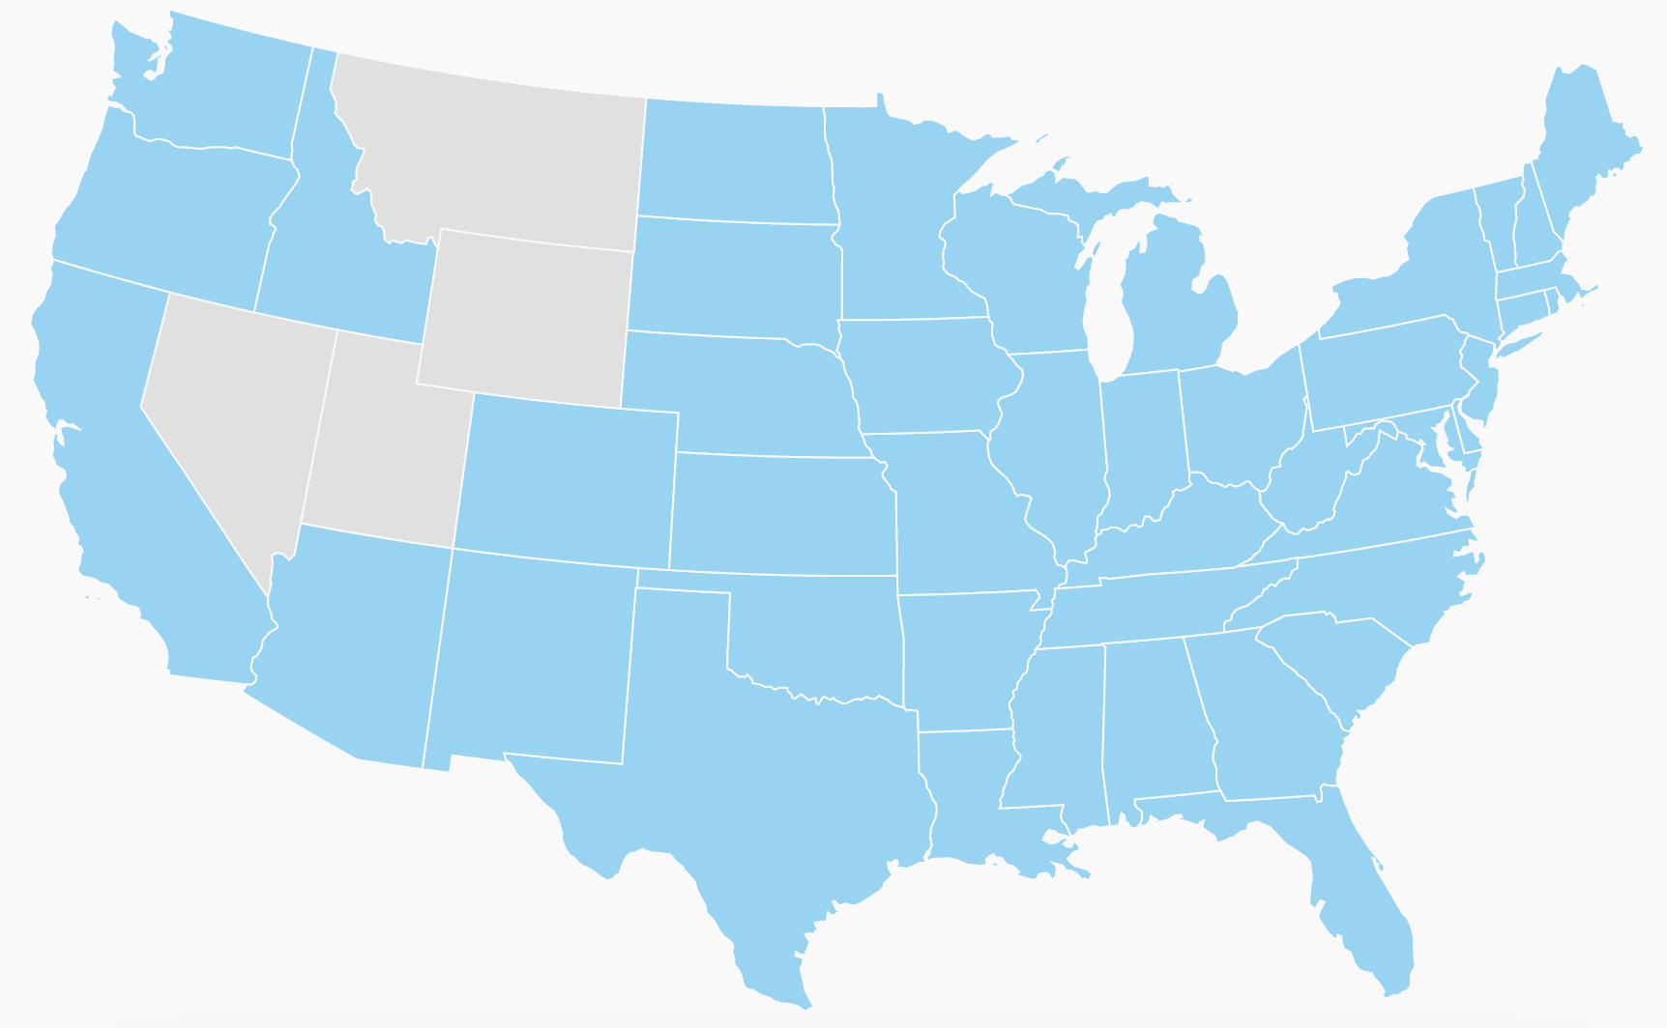
Completed Projects
Started our consulting firm in early 2015 - have completed contract negotiations for more than 350 institutions:
45+ of the largest 150 institutions nationwide
90+ of the largest 300 institutions nationwide
140+ of the largest 500 institutions nationwide

Slide 7
Case Study – Mississippi Bankers Association
Started our partnership in late 2019
17 member banks have hired our firm – 2 of these used us before 2019
2 banks are above $10 billion in assets
3 banks are between $5 billion to $10 billion
8 banks are between $1 billion to $5 billion
4 remaining banks are from $400 million to $850 million
Combined results – net five year total projected savings
More than $14,000,000 vendor savings negotiated
Average savings negotiated has been over 40%
15 of 17 clients were with either Deluxe or Vericast and stayed with their current vendor with no changes. 2 clients were with Main Street and chose to make a change.

Slide 8
What if you already endorse a check printer?
If your preferred check vendor is providing your member banks competitive pricing, how can we pose any threat to the vendor? Respectfully, if the vendor isn’t providing your member banks good pricing, shouldn’t they be?
The savings that we provide our clients is enormous. Therefore, we earn a large consulting fee and would share 20% of our fee with your SBA.
Landscape has changed in last 10-15 years. Endorsing the check vendor was a good idea. However, this may no longer be the case.
With many association endorsements the bank has to switch providers or implement a new service/vendor
With our service, the bank does NOT have to switch providers or start anything new

Slide 9
Typical Example – Client and Vendor Impact
Bank has 25,000 checking accounts. Many banks this size might make an annual net profit on their check program of $20,000.
Check vendor has annual revenue of $200,000 with a profit margin of 75%. Five year revenue is $1,000,000 and their actual cost is only $250,000.
We ask the vendor to accept a profit margin of 50%. Their revenue becomes $500,000 and their cost remains $250,000.
While we provide industry knowledge, vendor leverage and do 98% of the work, our typical fee is only 20-25% of negotiated savings. Other similar consultants charge up to 33%.
Gross five year savings for the bank is $500,000. Our consulting fee is $125,000 and the net bank savings is $375,000, or $75,000 per year.
Bank’s annual net profit increases nearly five-fold, from $20,000 to $95,000 with NO changes in vendor, customer prices, etc.

Slide 10
Questions and Answers – Open Discussion
Contact Information
Jim Schartman, President & Co-Founder
Email - Jim.Schartman@checkprintingconsulting.org
Cell – 216.970.0105
Greg Baitt, Executive Vice President & COO
Email – Greg.Baitt@checkprintingconsulting.org
Cell – 216-396-0225

