Slide 1
Abrigo AI
Trust, Speed, Expertise

Slide 2



Meet the Abrigo Association Team
Persis Tuttle
Marketing, Events, Association Manager
Joseph Heiman
Sales and Referrals
Lauren Phelps
Marketing, Events and Thought Leadership
Notes:
2400 customers
Award winning client services

Slide 3






Helping Communities Win
by Championing FIs
Financial Institution Focused
Customer Centric
COMMUNITIES
Innovative
US BANKS

Slide 4
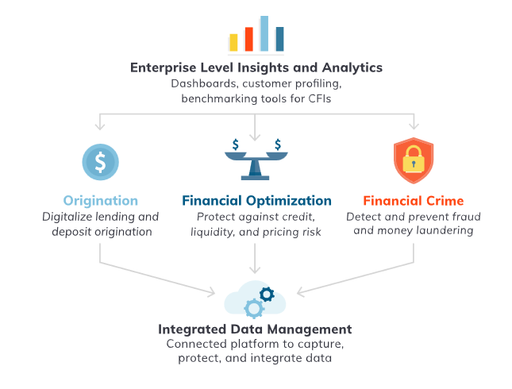

Slide 5






Drive Growth, Manage Risk with Abrigo
Drive Growth
Manage Risk
Lending and Credit Solutions
Risk and Compliance Solutions
Commercial Lending
Consumer Lending
Small Business Lending
Ag Lending
Construction Lending
Account Opening
Credit Risk
Leasing Origination
AML/CFT
Fraud
Watchlist Scanning
CECL & Investment Accounting
ALM
Stress Testing
Pricing & Profitability
Loan Review
Data Analytics & Insights Business Process Automation API Ecosystem Machine Learning/AI
Notes:
2400 customers
Award winning client services

Slide 6



Abrigo AI Capabilities
Abrigo AI
Trust, Speed, Expertise
Boost efficiency across your institution with explainable AI
Predictive AI
Generative AI
Intelligent Automation
Scores
Abrigo Small Business Lending
SMB Business Risk Score
SMB Cash Flow Score
Abrigo Fraud Detection
Transaction Analysis Score
AskAbrigo
Assistants
Abrigo Loan Review Assistant
Abrigo AML Assistant
Abrigo Lending Assistant
Embedded Functionality
Abrigo Allowance
Allowance Narrative Generator
Automation
Abrigo Small Business Lending
Credit Decisioning Automation
Abrigo Fraud Detection
Fraud Decisioning Automation
abrigo AI

Slide 7
AskAbrigo

Slide 8
Challenge – Accessing Institutional Knowledge
Teams waste time hunting down answers. With turnover on the rise and internal expertise spread thin, institutional knowledge is harder to access than ever.
Critical knowledge is buried in manuals, PDFs, policy documents and more
New hires struggle to ramp up without easy access to internal guidance
Time spent asking coworkers or waiting on answers slows productivity

Slide 9
Ask Abrigo Demo

Slide 10
Abrigo AML Assistant

Slide 11
Challenge – Inefficient AML/CFT Operations
Compliance teams are under increasing pressure due to manage rising alert volumes, constrained resources, and high expectations from regulators
Need for increased focus on high risk
alerts and cases
High rate of false positives drains team resources
Lack of consistency with alert narratives

Slide 12
AML Assistant Demo

Slide 13
Abrigo Loan Review Assistant

Slide 14
Loan review teams are facing a talent shortage, as from 2023 to 2024 there were double-digit drops in the years of experience across all levels of loan review teams
Threatens loan review process effectiveness
Expands need for job support
Increases risk to institution
*Abrigo 2024 Loan Review Benchmark Survey

Slide 15
Abrigo Loan Review Assistant Demo

Slide 16
Thank you!

